Slide 1
RNA
Translation

Slide 2
Terms
Codon: a series of 3 bases in DNA or mRNA that code for a single amino acid
Anticodon: a series of 3 bases in tRNA that is complementary to the codon

Slide 3
Translation
Process by which the “language” of nucleic acids (bases) is changed into the “language” of proteins (amino acids)
Occurs in the cytoplasm
Divided into 3 parts:
Initiation
Elongation
Termination

Slide 4
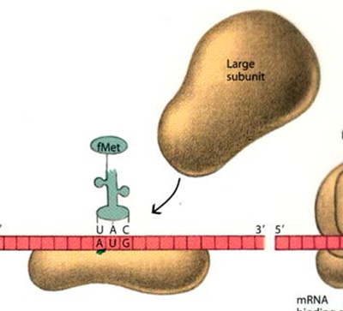
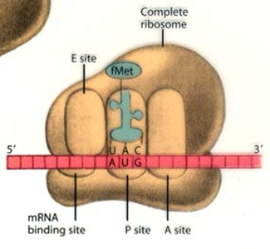
Initiation
and
of a
The
ribosome attach to a strand of mRNA
The first codon in a mRNA strand is AUG; this is known as the start codon
small
large subunits

Slide 5
Initiation (cont.)
The first tRNA with the anticodon matching the AUG start codon (UAC)
brings in the first amino acid--methionine

Slide 6
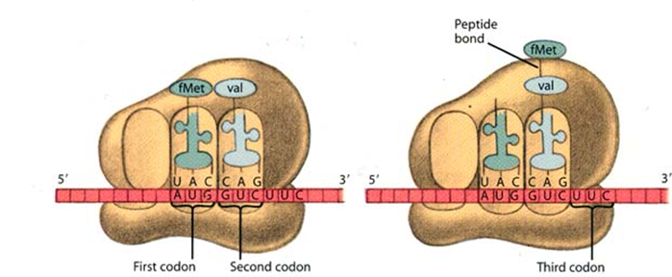
Elongation
Another tRNA with a matching anticodon brings in another amino acid
A peptide bond is formed between the two amino acids

Slide 7
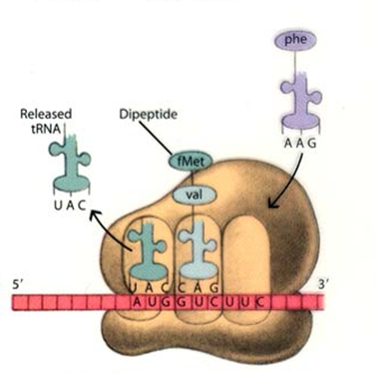
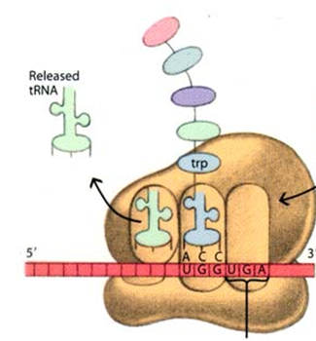
Elongation (cont.)
The ribosome moves down the mRNA
tRNA can now bring in the next amino acid
The ribosome will continue to move down one codon at a time to add more amino acids
chain one codon (3 bases)
and a new
and extend the protein chain

Slide 8
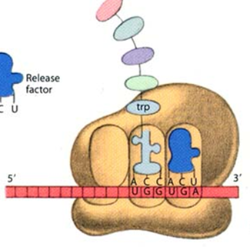
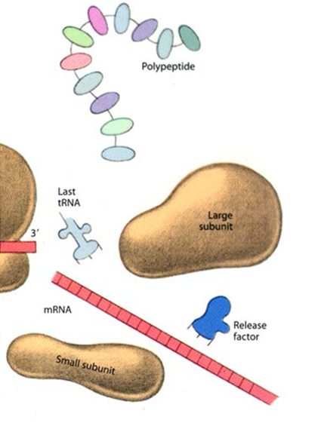
Termination
When the ribosome encounters a stop codon,
and binds
subunits to release the mRNA strand
a release factor is brought in
causing the large and small

Slide 9
Termination (cont.)
The newly formed amino acid chain or protein is released into the cytoplasm
There are 3 different stop codons:
UAA
UAG
UGA

Slide 10
Genetic Code
The genetic code is universal, meaning that it is the same for all organisms
For example, UGU will always code for the amino acid cysteine
GUC will always code for valine

Slide 11
Redundancy
There are 64 possible codons, yet there are only 20 amino acids
This means that the genetic code is redundant, or that some amino acids have more than one codon that code for it
EX: CUU, CUC, CUA, and CUG all code for the amino acid leucine

