Slide 1
RNA
Compared to DNA and Types

Slide 2
DNA vs. RNA
 | DNA | RNA
Type of Sugar
Number of Strands
Bases
Deoxyribose
Ribose
Double Stranded
Single
Stranded
A C G
Thymine (T)
A C G
Uracil (U)

Slide 3
Types of RNA
There are 3 types of RNA:
Transfer RNA (tRNA)
Ribosomal RNA (rRNA)
Messenger RNA (mRNA)

Slide 4
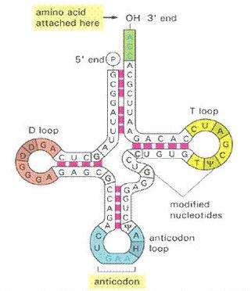
Transfer RNA (tRNA)
Makes up 15% of the total RNA in the cell
Has two active sites: one for the attachment of an amino acid and the anticodon loop, which recognizes mRNA codons
Although there are only 20 amino acids, there are at least 56 different types of RNA, each recognizing different anticodon triplets
Made in the nucleus

Slide 5
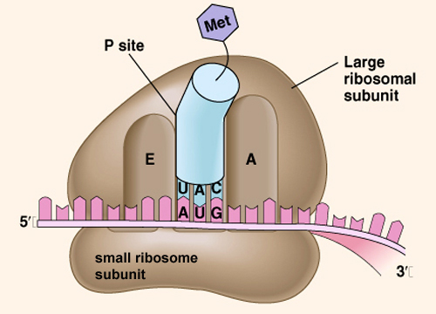
Ribosomal RNA (rRNA)
Makes up 80% of the total RNA in the cell
Along with proteins, rRNA makes up the ribosomes
Made in the nucleolus

Slide 6
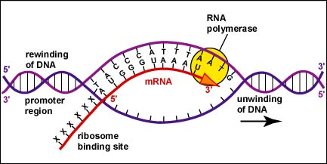
Messenger RNA
Direct carrier of the genetic information in DNA
It is complementary to a DNA strand
In eukaryotes, it is made up of introns (non-coding regions) and exons (coding regions)
Made in the nucleus

