Slide 1
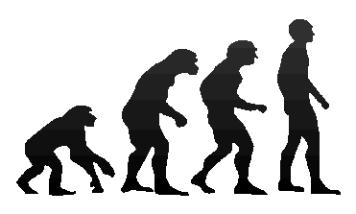
Darwin’s Theory of
Evolution

Slide 2
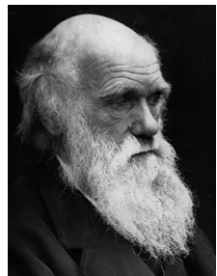
Darwin’s Theory of Evolution
Evolution, or change over time, is the process by which modern organisms have descended from ancient organisms
A scientific theory is a well-supported testable explanation of phenomena that have occurred in the natural world
Charles Darwin

Slide 3
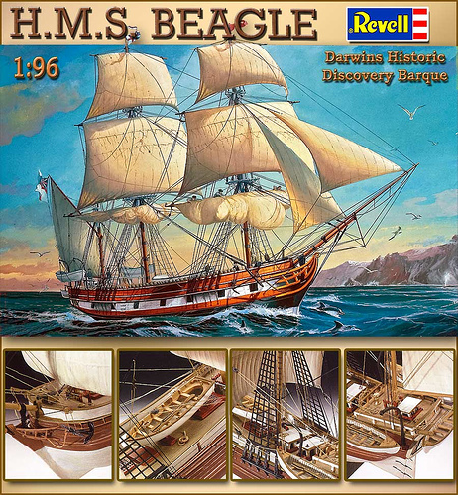
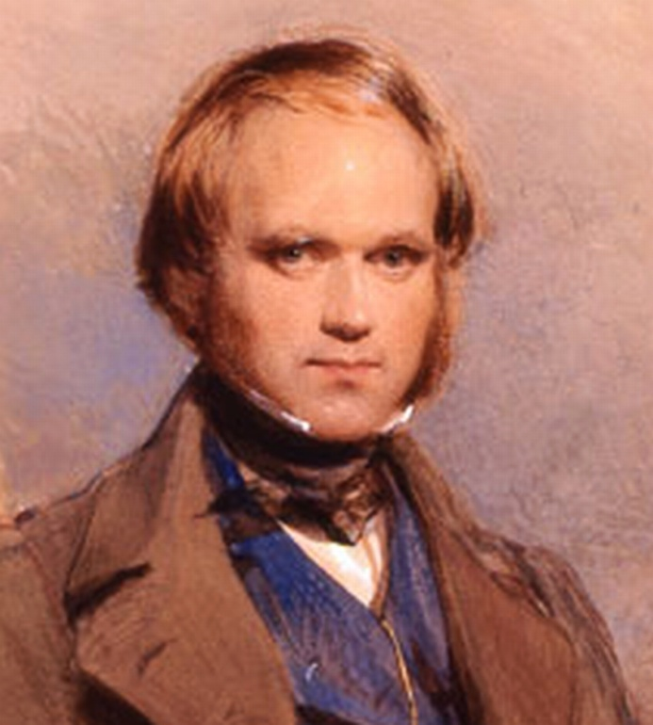
Voyage of the Beagle
Dates: February 12th, 1831
Naturalist: Charles Darwin
Ship: H.M.S Beagle
Destination: Voyage around the world
Findings: Evidence to propose a revolutionary hypothesis about how life changes over time

Slide 4
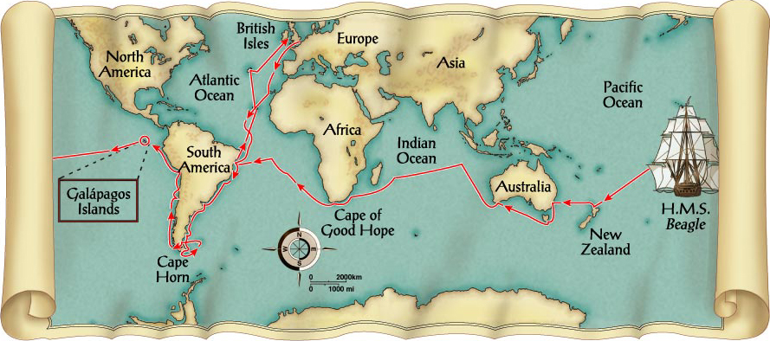

Slide 5
Patterns of Diversity
Darwin visited Argentina and Australia which had similar grassland ecosystems.
  those grasslands were inhabited by very different animals.
  neither Argentina nor Australia was home to the sorts of animals that lived in European grasslands.

Slide 6
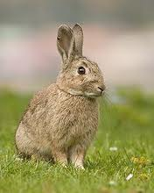
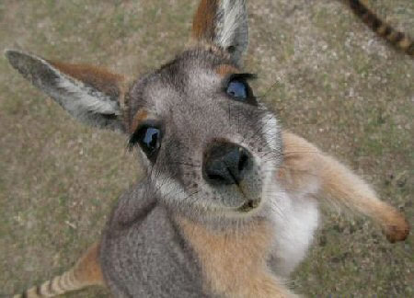
Patterns of Diversity
Darwin posed challenging questions.
  Why were there no rabbits in Australia, despite the presence of habitats that seemed perfect for them?
  Why were there no kangaroos in England?

Slide 7
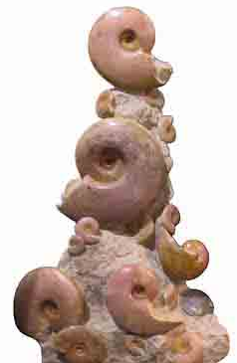
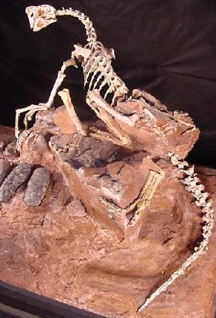
Living Organisms and Fossils
Darwin collected the preserved remains of ancient organisms, called fossils.
Some of those fossils resembled organisms that were still alive today.

Slide 8
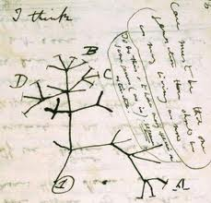
Living Organisms and Fossils
As Darwin studied fossils, new questions arose
  Why had so many of these species disappeared?
  How were they related to living species?

Slide 9
The Galapagos Island
The smallest, lowest islands were hot, dry, and nearly barren-Hood Island-sparse vegetation
The higher islands had greater rainfall and a different assortment of plants and animals-Isabela- Island had rich vegetation.

Slide 10
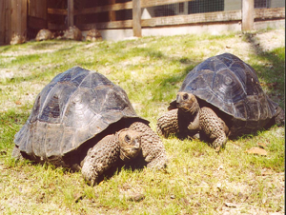
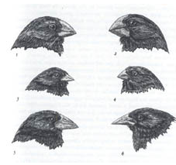
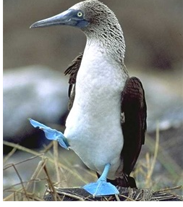
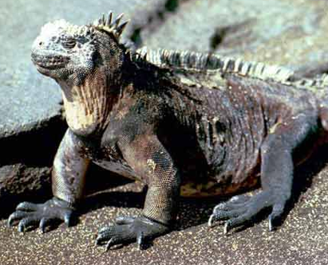
The Galapagos Island
Land Tortoises
Darwin Finches
Blue-Footed Booby
Marine Iguanas

Slide 11
The Galapagos Island
Darwin was fascinated in particular by the land tortoises and marine iguanas in the Galápagos.
Giant tortoises varied in predictable ways from one island to another.
The shape of a tortoise's shell could be used to identify which island a particular tortoise inhabited.

Slide 12
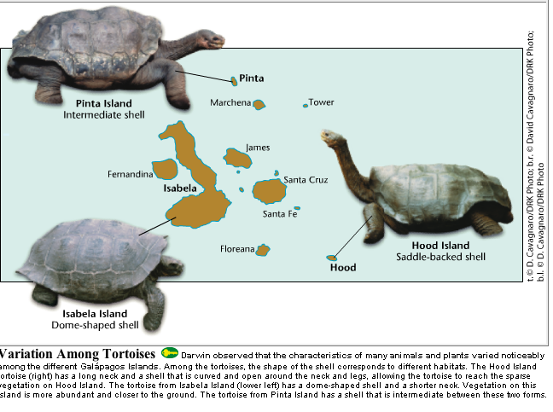

Slide 13
The Journey Home
Darwin Observed that characteristics of many plants and animals vary greatly among the islands
Hypothesis: Separate species may have arose from an original ancestor

Slide 14
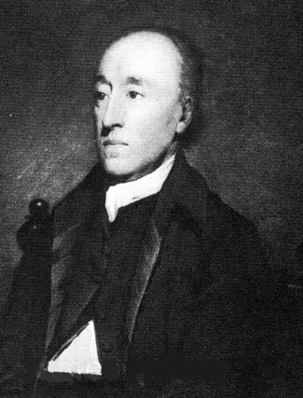
Ideas that shaped Darwin’s Thinking
James Hutton:
1795 Theory of Geological change
  Forces change earth’s surface shape
  Changes are slow
  Earth much older than thousands of years

Slide 15
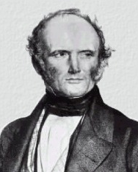
Ideas that Shaped Darwin’s Thinking
Charles Lyell
Book: Principles of Geography
Geographical features can be built up or torn down
Darwin thought if earth changed over time, what about life?

Slide 16
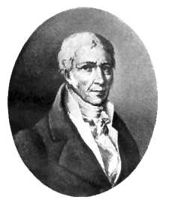
Lamarck

Slide 17
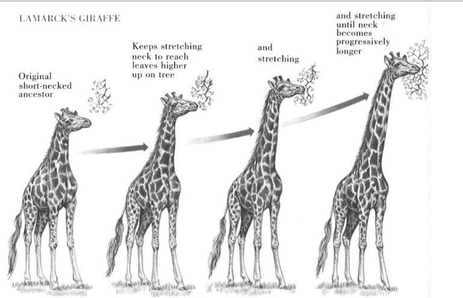
Lamarck’s Theory of Evolution
Tendency toward Perfection
  Innate tendency toward complexity and perfection

Slide 18
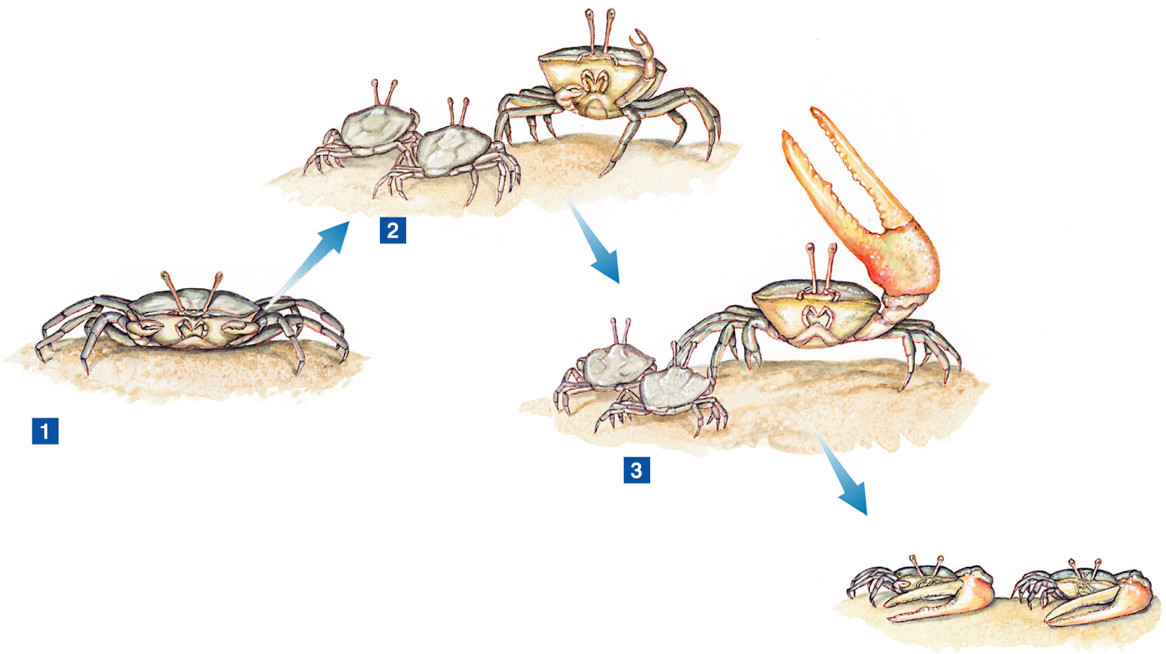
Lamarck’s Theory of Evolution
Use and Disuse
  Alteration of size or shape of particular organ by using the body in a new way

Slide 19
Lamarck’s Theory of Evolution
Inheritance of Acquired Traits
  Acquired characteristics could be inherited

Slide 20
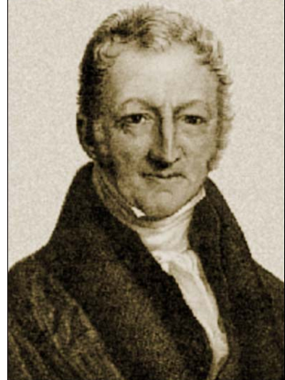
Population Growth
Thomas Malthus-19th century English economist
If population grew (more Babies born than die)
  Insufficient living space
  Food runs out
  Darwin applied this theory to animals

Slide 21

Publication of Origin of Species
Russel Wallace wrote an essay summarizing evolutionary change from his field work in Malaysia
Gave Darwin the drive to publish his findings

Slide 22
Artificial & Natural Selection
Natural variation--differences among individuals of a species
Artificial selection- nature provides the variation among different organisms, and humans select those variations they find useful.

Slide 23
Evolution by Natural Selection
The Struggle for Existence-members of each species have to compete for food, shelter, other life necessities
Survival of the Fittest-Some individuals better suited for the environment

Slide 24
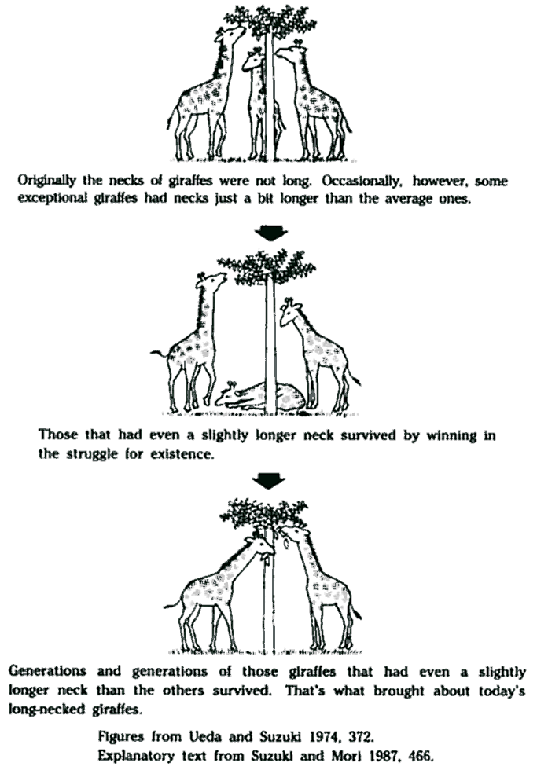
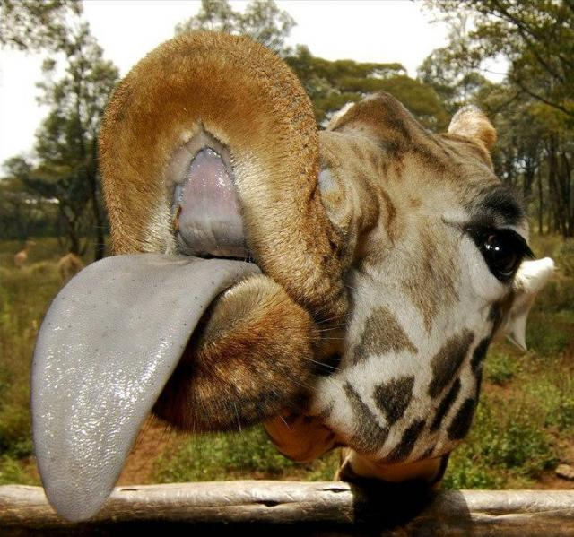

Slide 25
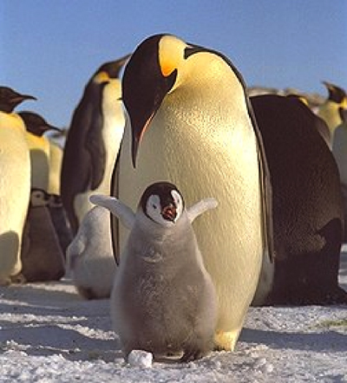
Natural Selection
Over time, natural selection results in changes in inherited characteristics of a population. These changes increase a species fitness in its environment

Slide 26
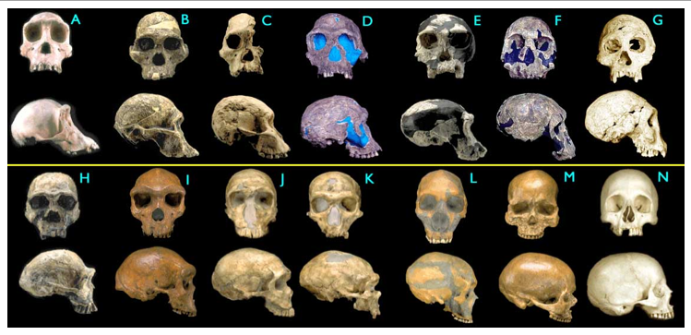
Descent
Descent with Modification-Each living organism has descended, with changes from other species over time
Common Descent- were derived from common ancestors

Slide 27
Evidence of Evolution
The Fossil Record
Geographic Distribution of Living Things
Homologous Body Structures
Similarities in Early Development

Slide 28
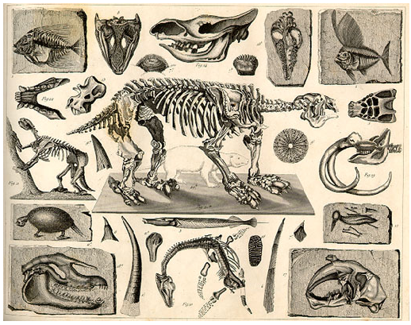
Evidence for Evolution
The Fossil Record
  Each layer of rock shows various changes in organisms over time

Slide 29
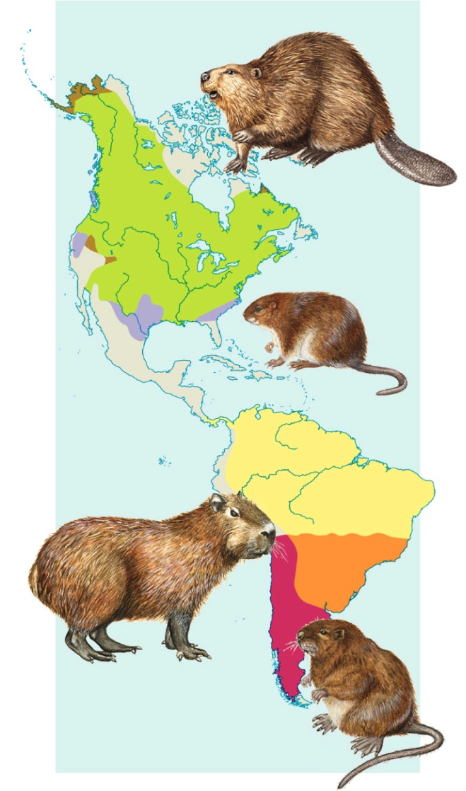
Evidence of Evolution
Geographic Distribution of Living Things
  Similar environments have similar types of organisms

Slide 30
Evidence of Evolution
Homologous Structures
  structures that have different mature forms in different organisms, but develop from the same embryonic tissue

Slide 31
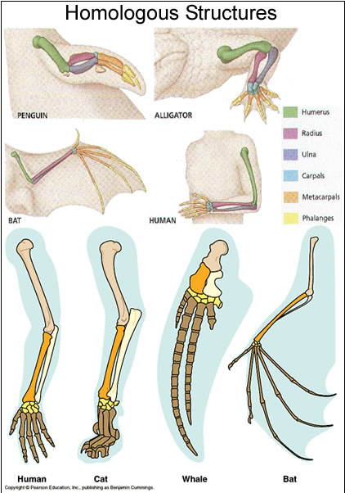
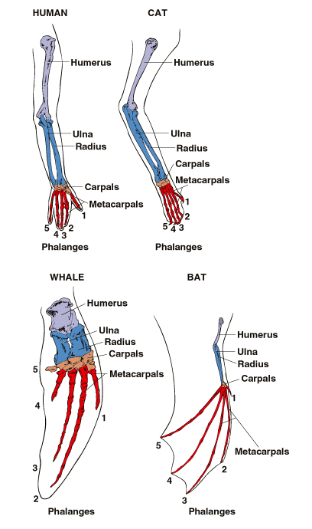

Slide 32
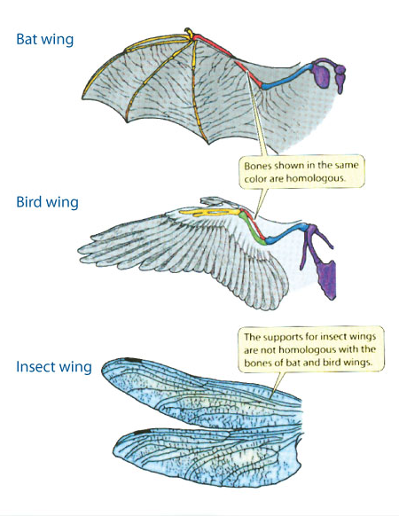
Analogous Structure
Evolved from different embryologic tissue
Looks the same
Similar in function

Slide 33
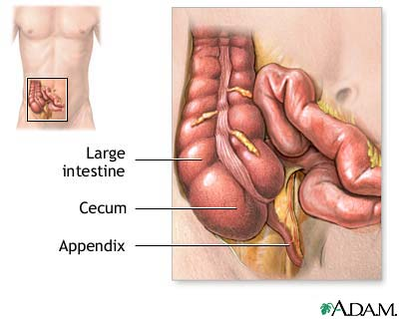
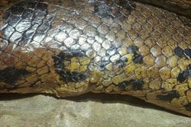
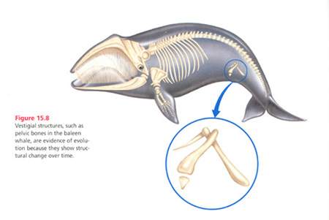
Evidence for Evolution
Vestigial organs
  organs that serve no useful function in an organism

Slide 34
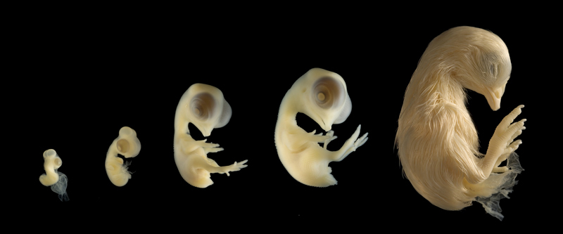
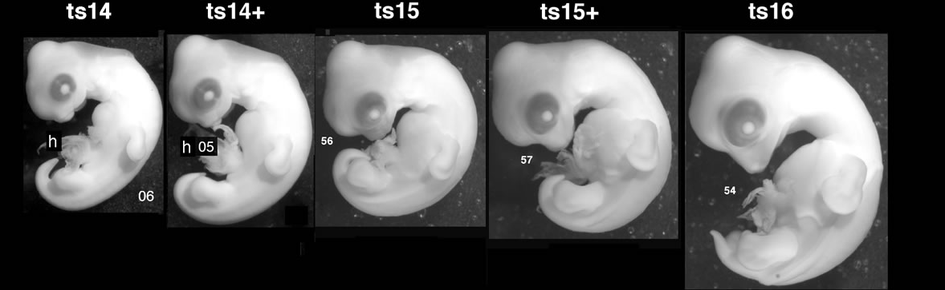
Similarities in Early Development

Slide 35
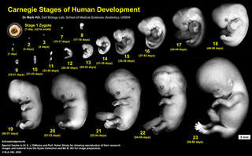

Slide 36
Summary of Darwin’s Theory
Individuals in nature differ from one another
Organisms in nature produce more offspring than can survive, and many of those who do not survive do not reproduce.

Slide 37
Summary of Darwin’s Theory
Because more organisms are produced than can survive, each species must struggle for resources
Each organism is unique, each has advantages and disadvantages in the struggle for existence

Slide 38
Summary of Darwin’s Theory
Individuals best suited for the environment survive and reproduce most successful
Species change over time

Slide 39
Summary of Darwin’s Theory
Species alive today descended with modification from species that lived in the past
All organisms on earth are united into a single family tree of life by common descent

Slide 40
Strengths and Weaknesses of Evolutionary Theory
Scientific advances
  Geology and physics
  Confirmed and expanded
Change is continuous
  How species arise?
  Why species become extinct?
  How did life begin?

Slide 41
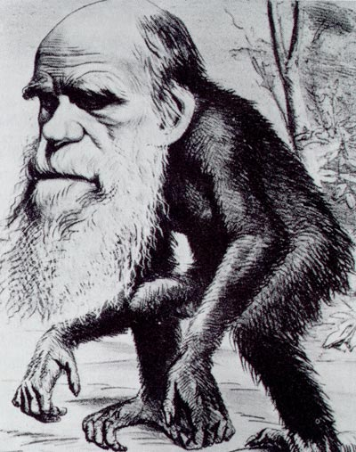
The Journey Continues…

