Slide 1
Weather Maps
Isotherms and Isobars

Slide 2
Iso-Lines
Similar to contour lines on geologic maps; “iso” lines connect points of equal temperatures or equal pressures on weather maps

Slide 3
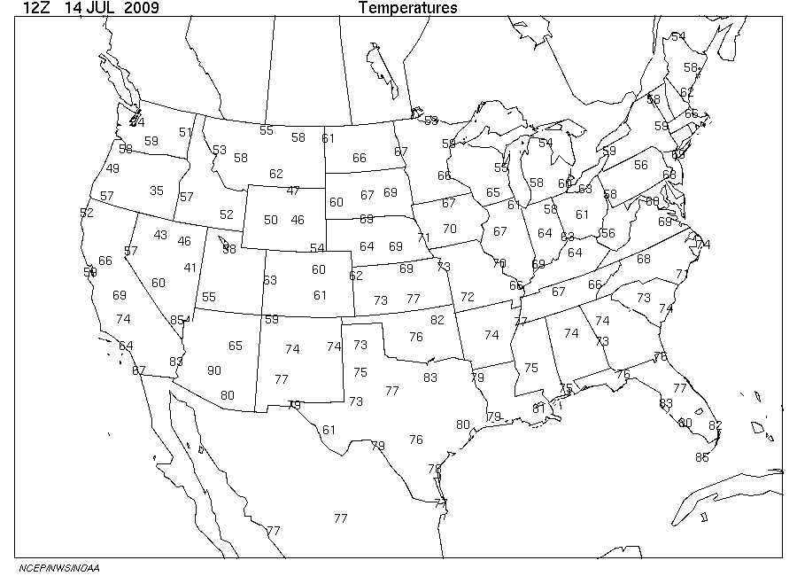
Map with temperatures

Slide 4
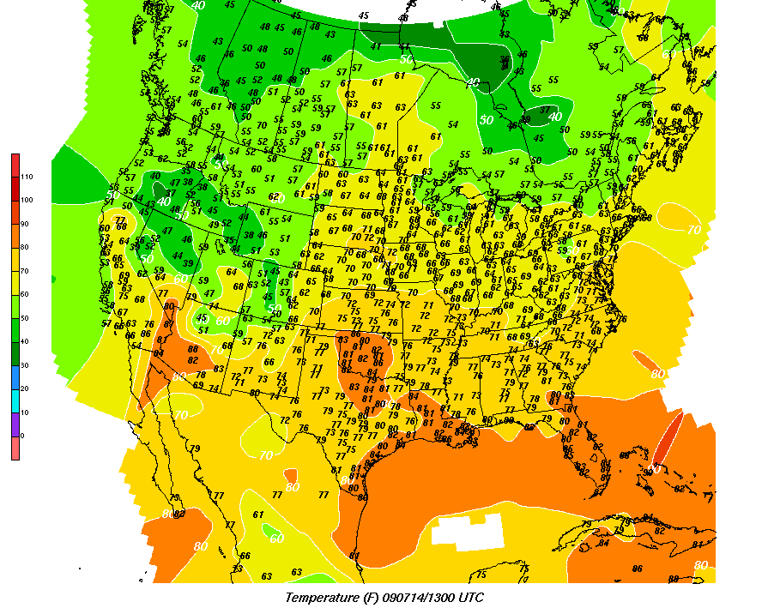
Isotherm map

Slide 5
Isotherms
Isotherms identify both warm and cold air masses
Definition: a type of equal temperature at a given date or time on a geographic map
Unit of measure – Celsius or Fahrenheit degrees
Closed loops show where the air masses are located.

Slide 6
Isotherms
Isotherms used to identify air masses
Air mass - large area of the lower atmosphere with similar weather.
Air masses may be either warm or cold

Slide 7
Isotherms
Cold masses have isotherms that decrease in temperature as you move towards the center.
Warm air masses have isotherms that increase in temperature as you move towards the center.

Slide 8
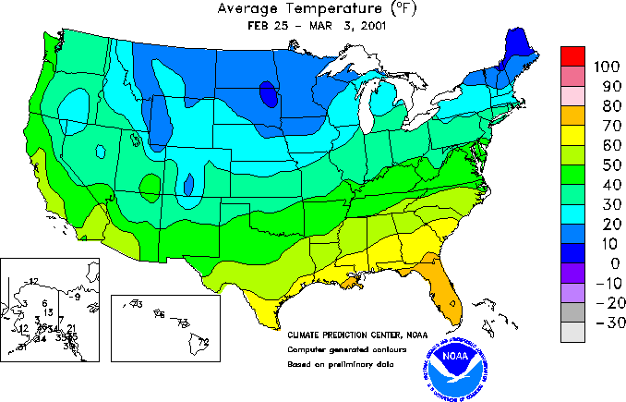
Isotherms

Slide 9
Isotherms
Air masses are also categorized as dry or humid.
Humid air masses develop over ocean
waters.
Dry air masses come from large land areas.
An air mass found over the Gulf of Mexico would be humid and warm. An air mass located in central Canada in winter would be dry and cold.

Slide 10
Isotherms
High-pressure regions are usually associated with dry weather because as the air sinks it warms and the moisture evaporates.
Low-pressure regions usually bring precipitation because when the air rises it cools and the water vapor condenses.

Slide 11
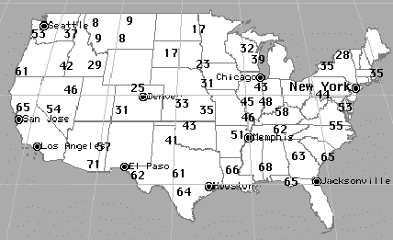
Drawing Isotherm maps
Draw lines through all similar temperatures. Some
lines will form closed loops, others will not.

Slide 12
Isobars
Isobars show areas of high and low pressure
Definition: a line connecting points of equal atmospheric pressure
Unit of Measure – millibars of pressure

Slide 13
Isobars
Isobars can be used to identify "Highs" and "Lows".
Pressure in a high is greater than the surrounding air.
Pressure in a low is lower than the surrounding air.

Slide 14
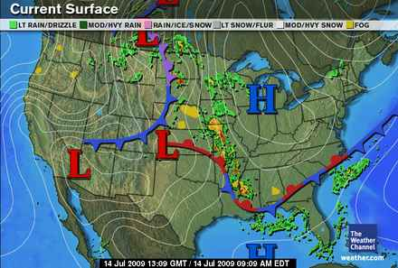
Isobars

Slide 15
Isobars
Wind blows from high pressure areas to areas of low pressure.
Strength of the wind is determined by changes in the pressure, the pressure gradient.
Large change in pressure over a short distance would indicate strong winds.
On a weather map, isobars that are close together indicate a strong pressure gradient.

Slide 16
Isobars
High-pressure regions = dry
Low-pressure regions = precipitation

Slide 17
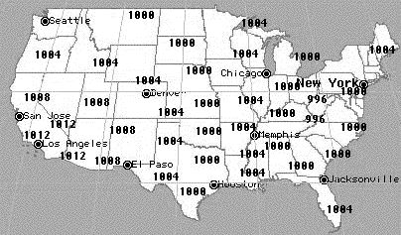
Drawing Isobar Maps
Draw lines through all similar pressures. Some
lines will form closed loops, others will not.

Slide 18
Isobars

Slide 19
Activity
Complete “Forecasting Weather Map Worksheets”

