Slide 1
Weather
Introduction

Slide 2
Initial Vocabulary
Atmosphere – the mixture of gases that surround Earth. (the atmosphere is divided into layers)
Meteorology – the study of weather
Precipitation – a form of water, such as rain, snow, sleet, or hail that develops in the atmosphere and falls to Earth’s surface
Cloud Types: (Basic: Cirrus, Cumulus, Stratus)
Front
Pressure System

Slide 3
Cloud Types

Slide 4
Cloud Formation
Clouds are formed …
In the Earths atmosphere
When water evaporates into vapor
Evaporates from oceans. lakes, ponds, and even streams and rivers;
And by evaporation or transpiration over moist areas of Earth's land surface

Slide 5
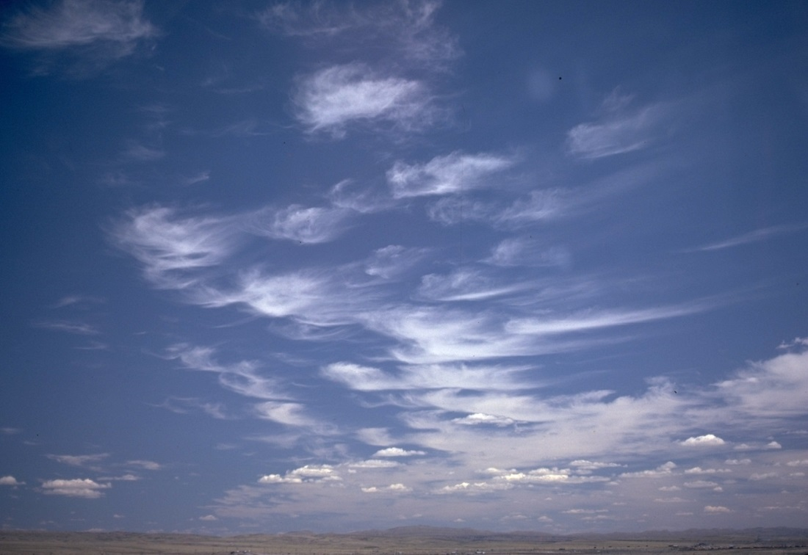
Cirrus
Cirrus clouds form at the upper levels of the atmosphere and are feathery patches, streamers or bands

Slide 6
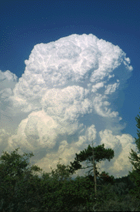
Cumulus
Cumulus clouds form at the lower levels of the atmosphere and are fluffy and billowy in shape

Slide 7
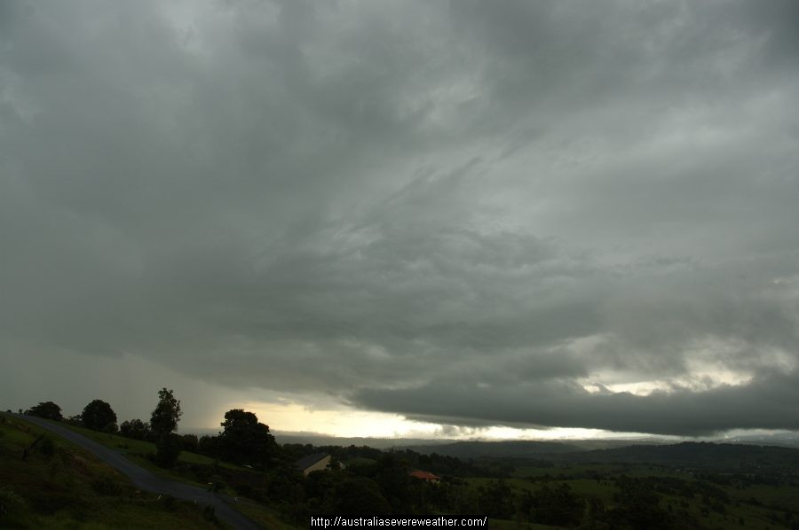
Stratus
A low-lying, grayish cloud layer that sometimes makes drizzle. Stratus clouds close to the ground are called fog.

Slide 8
High level clouds
Include: Cirrus and cirrostratus
Form above 20,000 feet (6,000 meters)
High altitude = lower temperature = clouds of ice crystals.
Typically thin and white in appearance,
(but can appear in a magnificent array of colors when the sun is low on the horizon.

Slide 9
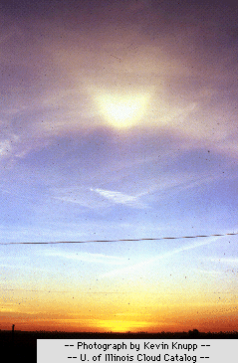
High level clouds

Slide 10
Mid level clouds
Cloud types include: altocumulus, altostratus.
Between 6,500 to 20,000 feet (2,000 to 6,000 meters).
Lower altitudes = warmer temperatures = water droplets
( however, they can also be composed of ice crystals when temperatures are cold enough )

Slide 11
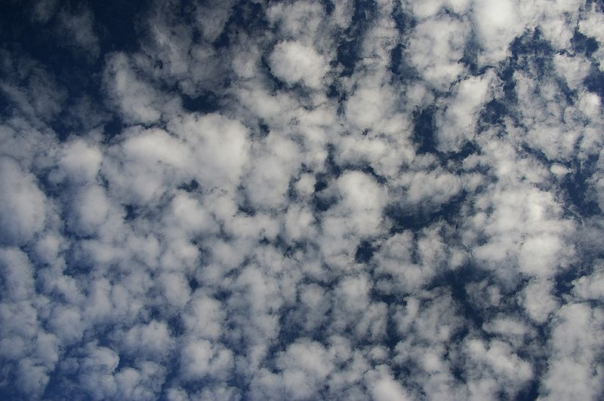
altocumulus

Slide 12
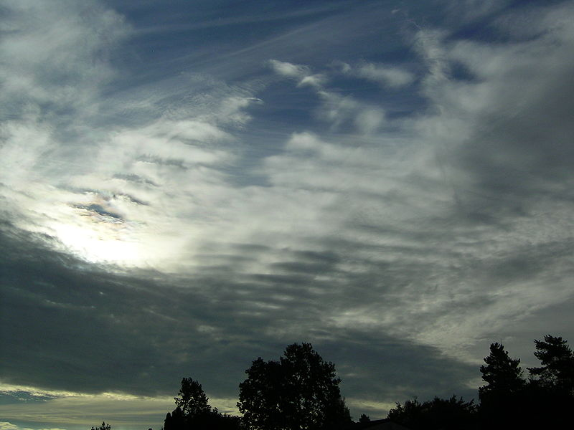
altostratus

Slide 13
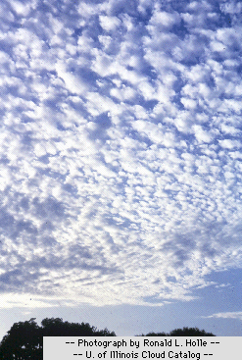
Mid level clouds

Slide 14
Low level clouds
Cloud types include: nimbostratus and stratocumulus
Low clouds of water droplets (6,500 feet (2,000 meters).
( However, when temperatures are cold enough, these clouds may also contain ice particles and snow. )

Slide 15
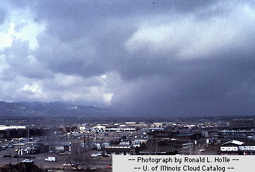
Low level clouds

Slide 16
Vertical Development
Cloud types include: fair weather cumulus and cumulonimbus
Most common cloud is the cumulus cloud.
Generated most commonly through either thermal convection or frontal lifting
Clouds can grow to heights in excess of 39,000 feet (12,000 meters),
Release incredible amounts of energy through the condensation of water vapor within the cloud itself

Slide 17
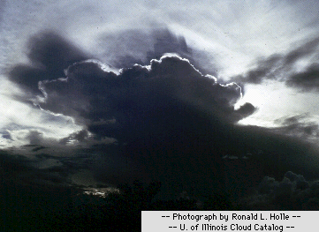
Vertically developed clouds

Slide 18
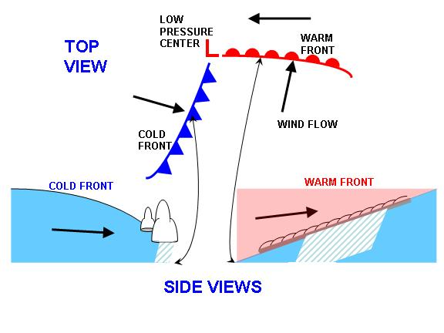
Fronts
Front - The boundary between two air masses that have different temperatures. They are often followed by rain and described as cold or warm

Slide 19
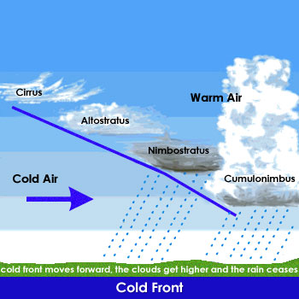
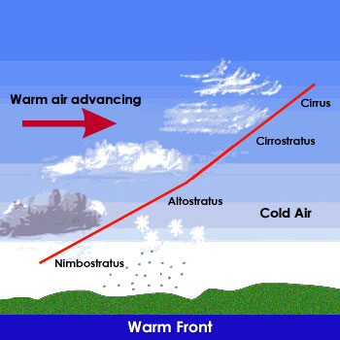
fronts

Slide 20
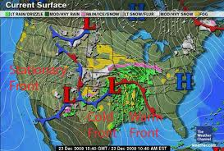
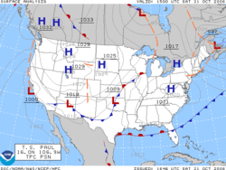
Pressure system
Pressure system - A region of Earth’s atmosphere where air pressure is unusually high or low

Slide 21
“Whole picture”
Weather and climate are often used interchangeably. However, they are two different concepts:
Weather - the state of the atmosphere at a certain time, (present time extending to weeks)
Includes: temperature, humidity, precipitation, cloudiness, and wind
Climate – description of weather over extended periods of time
Helpful to compare present weather to expected weather (gathered from observations in the past)

Slide 22
Assignment
Internet access
MULTIMEDIA FILE: “Earth’s Weather”
(www.uniteusforclimate.org/multimedia)
STUDENT WORKSHEET: “Earth’s Weather Scavenger Hunt”
Complete the worksheet by navigating through the UNITE US Multimedia: “Earth’s Weather”

