Slide 1
Unit 4
Periodic Table and Periodicity

Slide 2
Table of Contents
Development of the periodic table
Periodic families and their properties
Periodic trends: atomic radii, ionic radii, electronegativity, and ionization energy

Slide 3
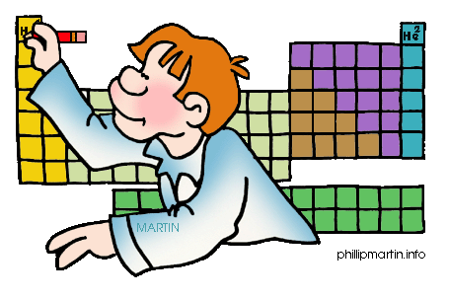
Development of the Modern Periodic Table
Formation of the Periodic Table of Elements
(C.5) (A) explain the use of chemical and physical properties in the historical development of the Periodic Table

Slide 4
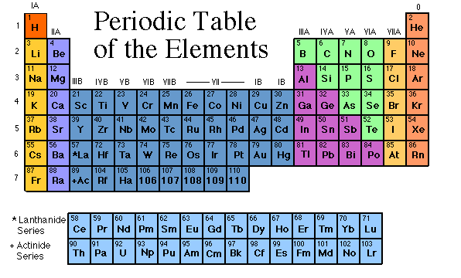
During the nineteenth century, chemists began to categorize the elements according to similarities in their physical and chemical properties. The end result of these studies was our modern periodic table.

Slide 5
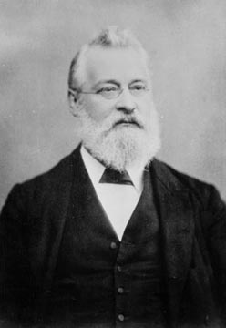
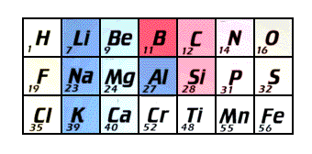
John Newlands
In 1863, he suggested that elements be arranged in “octaves” because he noticed (after arranging the elements in order of increasing atomic mass) that certain properties repeated every 8th element.
Law of Octaves

Slide 6
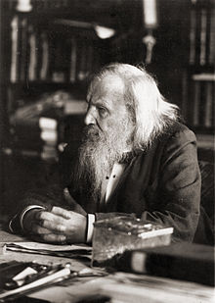
Dmitri Mendeleyev “Father of the Periodic Table”
Dmitri Mendeleyev (1834-1907), a Russian chemist, created the first published periodic table in 1869.
Mendeleyev noticed patterns in the properties of the elements [63 then-known], and ingeniously was the first to organize the elements not just according to their physical and chemical properties…but also by increasing atomic mass

Slide 7
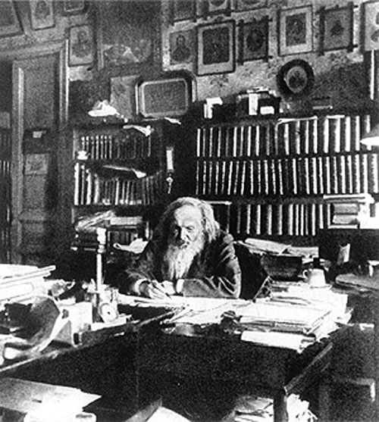
Background on Mendeleyev
Mendeleyev was born in Siberia in 1834, the seventeenth child in a very large family.
He moved to Saint Petersburg to study medicine, but he was not accepted and instead became a chemistry professor.
It is said that he went to sleep one night and dreamt of a table where the elements were organized by similar properties.

Slide 8
Mendeleyev Arrangement
Unlike the scientist before, Mendeleyev pieced the table together based on several specific elemental properties:
Atomic mass: Mendeleyev placed elements with increasing atomic mass across a row from left to right and down a column
Reactivity: Property that describes how easily an element will combine with other substances to form a new compound
Formula of Compounds: Mendeleyev paid attention to which elements combined with which, and the ratios in which their atoms combine

Slide 9
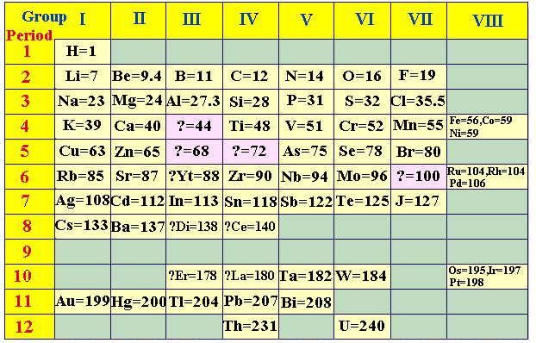
Mendeleyev's Table
Increasing atomic mass
Increasing atomic mass

Slide 10
Predictive Value
Mendeleyev was so exact with his organization of the elements that his table demonstrated predictive value.
Using his periodic table, Mendeleyev was able to corrected the atomic masses of Be, In, and U and accurately predict the discovery of Sc, Ga, and Ge.
After the discovery of the unknown elements between 1874 and 1885, and the fact that Mendeleev’s predictions for Sc, Ga, and Ge were amazingly close to the actual values, his table was generally accepted.

Slide 11
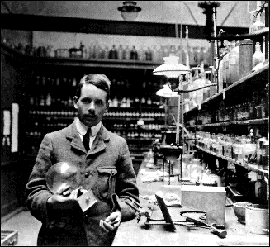
Henry Moseley
Modified in 1913 by Henry Moseley (1887-1915) into the modern Periodic Table
– Arranged in rows (periods) of increasing Atomic Number – that is, increasing number of protons
– Arranged in columns (groups or families) by repetition of physical and chemical properties

Slide 12
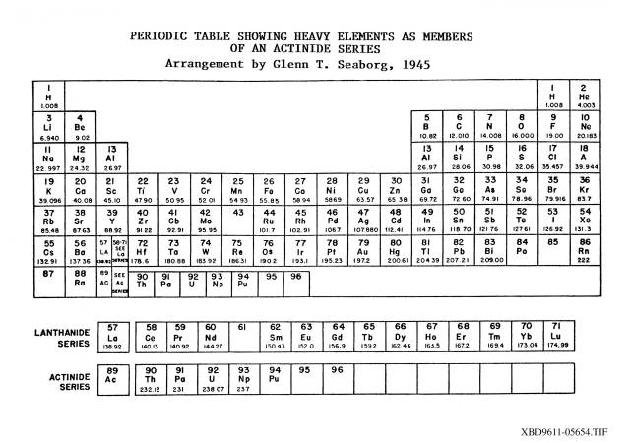
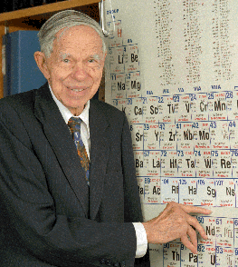
Glenn Seaborg
In 1944, he identified the Lanthanide and Actinide Series while working on the Manhattan Project during World War II.
Seaborg is credited with the discovery of 8 new elements.

Slide 13
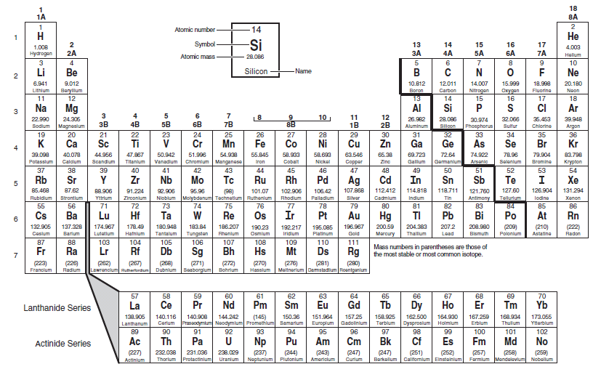
Modern Periodic Table Now
Through the laborious work of these and many more scientists the periodic table was created and a scientific masterpiece was born!

Slide 14
End of this section!

Slide 15
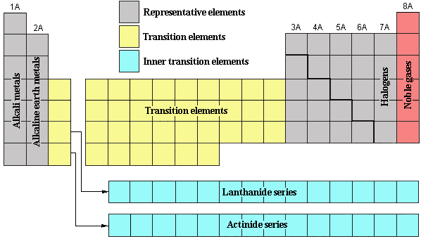
Geography is Everything
Periodic Families and their Properties
(C.5)(B) use the Periodic Table to identify and explain the properties of chemical families, including alkali metals, alkaline earth metals, halogens, noble gases, and transition metals

Slide 16
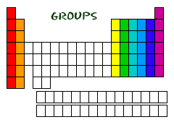
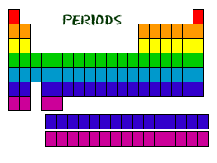
Groups and Periods
Groups
vertical columns containing elements with similar properties.
Groups are also called families due to their similar physical and chemical properties.
For this course, the groups are numbered 1-18 with Group 1 being on the far left and Group 18 being on the far right of the periodic table.
Periods
horizontal rows in order of atomic number; each period represents a finite grouping of elements
Currently, there are 7 periods

Slide 17
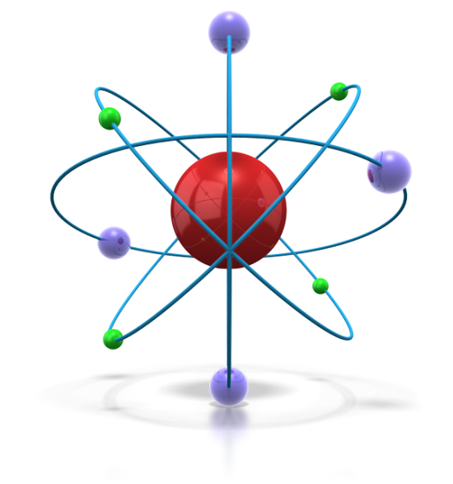
3 Types of Elements
Metals
good conductors of heat and electricity
Malleability → hammered or rolled, bendable
Ductile → can be pulled into wire
Luster → shiny when polished
Nonmetals
Brittle → not malleable or ductile
Poor conductor of heat and electricity
Metalloids
brittle solids
have some properties of metals and nonmetals
semiconductors of electricity

Slide 18
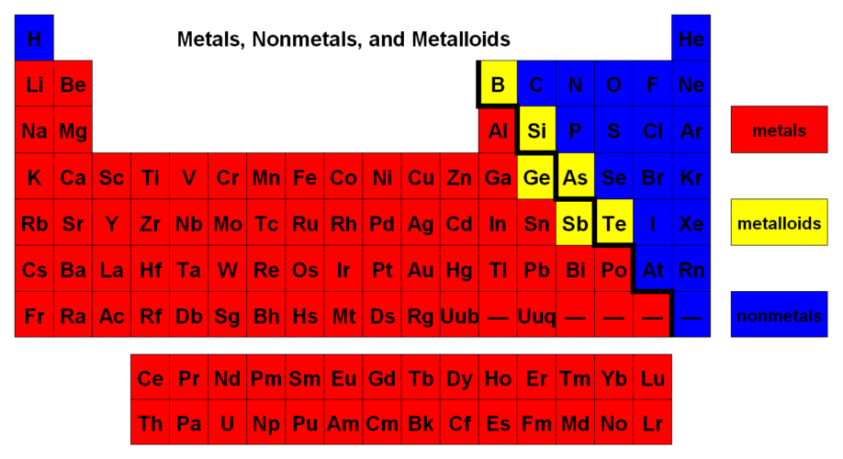
Location of Metals, Non-metals, and Metalloids

Slide 19
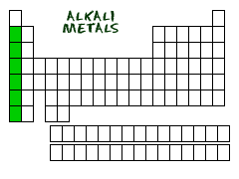
Group 1: Alkali Metals
Elements contained: Li, Na, K, Rb, Cs, Fr
have 1 electron in the outside shell
extremely reactive, reacts with water, air, and
nonmetals
silvery
soft, can be cut with a knife
they are not found as pure elements in nature

Slide 20
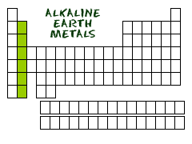
Group 2: Alkaline Earth Metals
Elements include: Be, Mg, Ca, Sr, Ba, Ra
Second most reactive group of metals
Have 2 electrons in the outside shell
Harder, denser and stronger than alkalis
They are not found as pure elements in nature

Slide 21
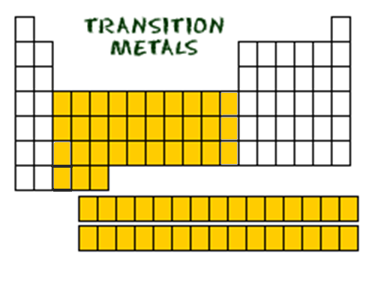
Group 3-12: Transition Metals
many of the most commonly recognized metals are in these groups
good conductors of electricity
tend to have a high luster
typically less reactive than alkali and alkaline earth elements
many are found in pure form
some are the most dense of all elements

Slide 22
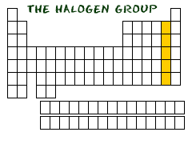
Group 17: Halogens
Contain elements: F, Cl, Br, I, At
7 electrons in outer shell
most reactive nonmetals
react with most metals to form compounds called salts
fluorine and chlorine are gases

Slide 23
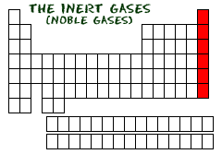
Group 18: Noble Gases
Includes elements: He, Ne, Ar, Kr, Xe, Rn
Inert gases that do not react with anything, found as individual atoms
Have 8 electrons in the outer shell (stable configuration)
Neon, Argon, Krypton, and Xenon are all used for different types of lighting
A few noble gas compounds have been formed under extreme conditions

Slide 24
Geography is Everything!
Element placement in the periodic table is key and is not by accident! Elements belonging to certain families have similar physical and chemical properties! So in periodic table, you really are who you group with!

Slide 25
This is end of the section!

Slide 26
Periodic Trends
C.5.C use the Periodic Table to identify and explain periodic trends, including atomic and ionic radii, electronegativity, and ionization energy

Slide 27
Periodic Law
The chemical and physical properties of the elements are periodic functions of their atomic numbers; properties of the elements occurred at repeated intervals called periods.
This defines the property of periodicity

Slide 28
Periodic Trends
properties that show patterns when examined across the periods or vertically down the groups
while there are many periodic trends, we will focus on
atomic radii (the plural of radius)
ionization energy
Electronegativity
Ionic radii (the plural of radius)

Slide 29
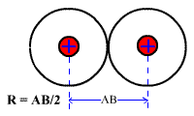
Atomic Radii
One half the distance between the nuclei of identical atoms that are bonded together.
Distance between nuclei decreases across periods because the higher nuclear charge (positive) pulls the electrons closer to the nucleus
increases down groups because energy levels are being added outside the nucleus

Slide 30
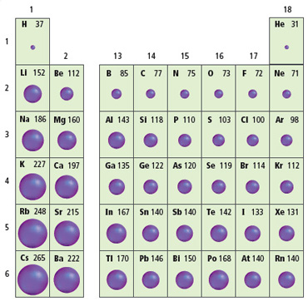
Atomic Radii Decreases
Atomic Radii Increases

Slide 31
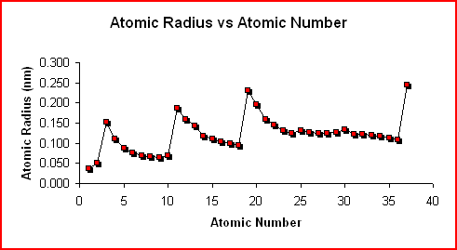
Graphing Atomic radii
The graph of Atomic Radius vs. Atomic Number shows the trend in atomic radius as one proceeds through the first 37 elements in the periodic table.

Slide 32
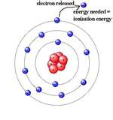
Ionization Energy
The energy required to remove one electron from a neutral atom of an element.
increases across periods because it takes more energy to overcome the electrons attraction to the increasing nuclear charge
decreases down groups because it is easier to overcome the nuclear charge for the outermost electrons as the number of energy levels increases

Slide 33
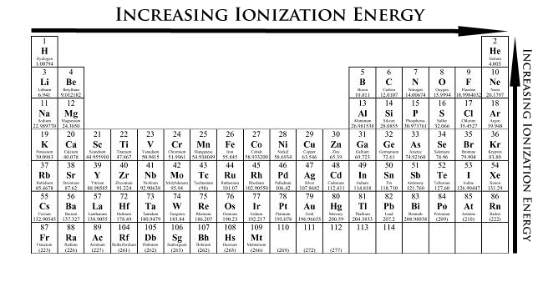

Slide 34
Graphing Ionization Energy
These trends are visible in the graph of ionization energy versus atomic number.

Slide 35
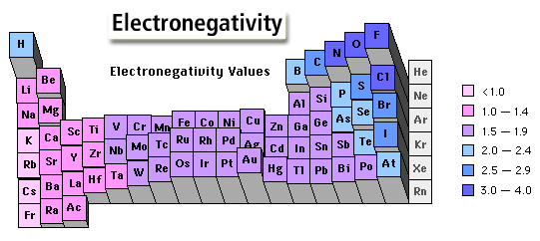
Electronegativity
a measure of the ability of an atom in a compound to attract electrons from other atoms
increases across periods as a result of the increasing nuclear charge and ability of the nucleus to attract electrons from a neighboring atom
decreases down groups because the nuclear charge is less able to attract electrons from another atom as additional energy levels are added

Slide 37
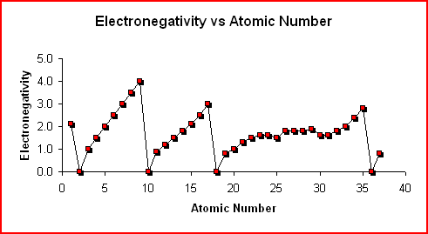
Graphing Electronegativity
The graph of Electronegativity vs. Atomic Number shows the trend in the electronegativity as one proceeds through the first 37 elements in the periodic table.

Slide 38
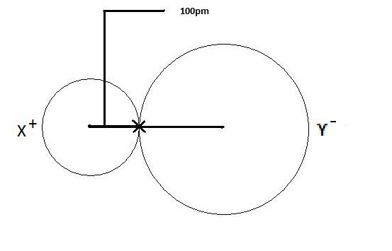
Ionic Radii
The radius of an atom forming ionic bond or an ion. The radius of each atom in an ionic bond will be different than that in a covalent bond.
The reason for the variability in radius is due to the fact that the atoms in an ionic bond are of greatly different size. One of the atoms is a cation, which is smaller in size, and the other atom is an anion which is a lot larger in size.

Slide 39
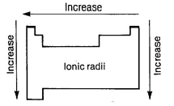
decreases across the period until formation of the negative ions then there is a sudden increase followed by a steady decrease to the end
The sudden increase on formation of negative ions is due to the new (larger) outer shell

Slide 40
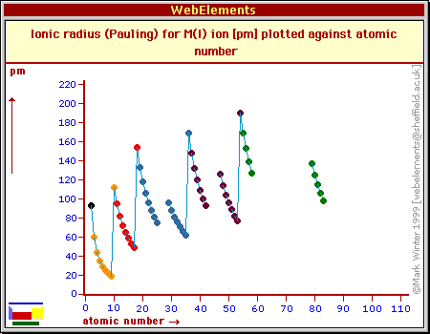
Graphing ionic radii

Slide 41
This is end of Unit 4!

