Slide 1
Matter

Slide 2
Table of Contents
2.1 Concepts of Matter Slides 3 - 9
2.2 Classification of Matter Slides 11 - 22
2.3 States of Matter Slides 24 - 31

Slide 3
Concepts of Matter
C.4.A differentiate between physical and chemical changes and properties

Slide 4
Matter:
Matter is defined as anything that has mass and takes up space
chemists use characteristic properties to tell substances apart and to separate them
a substance is matter that has a uniform and definite composition

Slide 5
Physical Properties
Any quality or condition of a substance that can be observed or measured without changing the substances identity.
Physical properties can be classified as Intensive and Extensive properties.

Slide 6
C.4.B Identify Intensive and Extensive Properties
Intensive Property is a physical property of the system that does not depend on the system size or the amount of material in the system.
Examples of intensive properties include:
* temperature
* viscosity
* density
* electrical resistivity
* melting point
* boiling point
* pressure
* spectral absorption maxima (in solution)
* flammability
Extensive Property an extensive property of a system does depend on the system size or the amount of material in the system.
Examples of extensive properties include:
* mass
* volume
* entropy
* energy
* electrical resistance
* texture
* heat

Slide 7
Physical Changes in Matter
change in a substance that doesn’t change the identity of the substance
Includes all changes of state (physical changes of a substance from one state to another)
Ex. grinding, cutting, melting, boiling

Slide 8
Chemical Properties
Chemical Property is how a substance reacts in the presence of:
Air
Acids
Water
Bases
Chemicals
Chemical Property is also: How does the substance reacts when it is heated?

Slide 9
Chemical Changes in Matter
Chemical Change is a change in which a substance is converted into a different substance
doesn’t change the amount of matter present
reactants – substances that react
products – substances that form

Slide 10
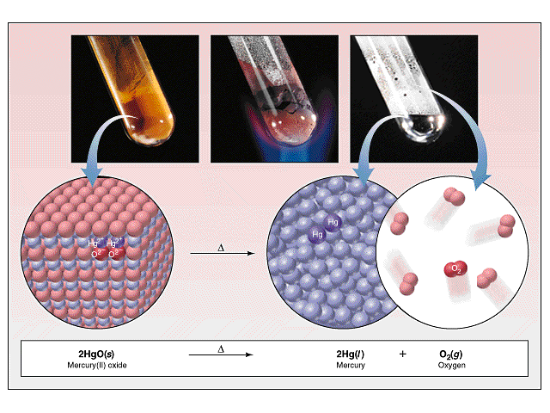
Signs of Chemical Change
Energy is always absorbed or given off
Change in color or odor
Production of a gas
Irreversibility

Slide 11


Slide 12
Classification of Matter
C.4.D classify matter as pure substances or mixtures through investigation of their properties.

Slide 13
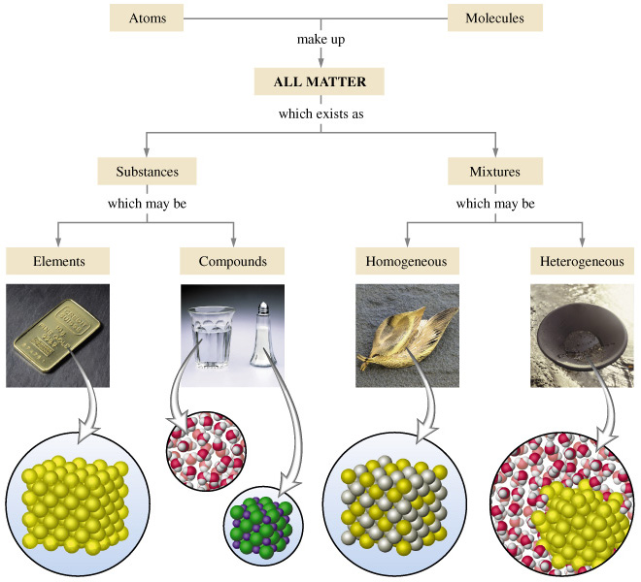
Composition of Matter :

Slide 14
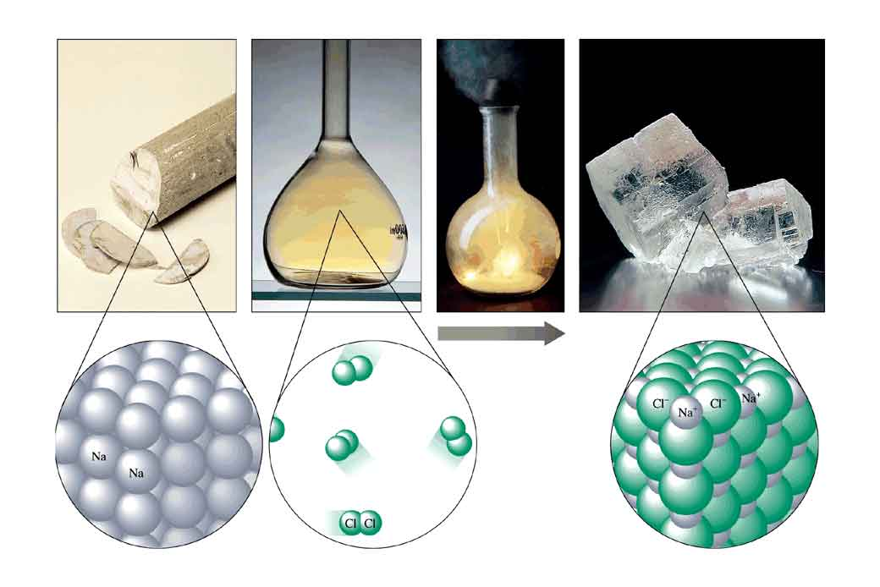
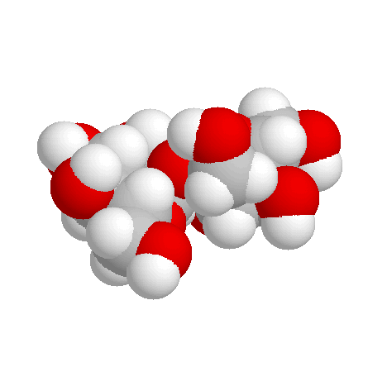
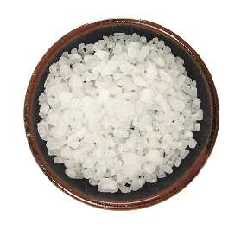
Pure Substances: C.4.D classify matter as pure substances or mixtures through investigation of their properties.
every sample has same:
  characteristic properties
  composition
are made of:
  one type of atom: element
    Ex: iron, gold, oxygen
  2 or more types of atoms: compound
    Ex: salt, sugar, water

Slide 15
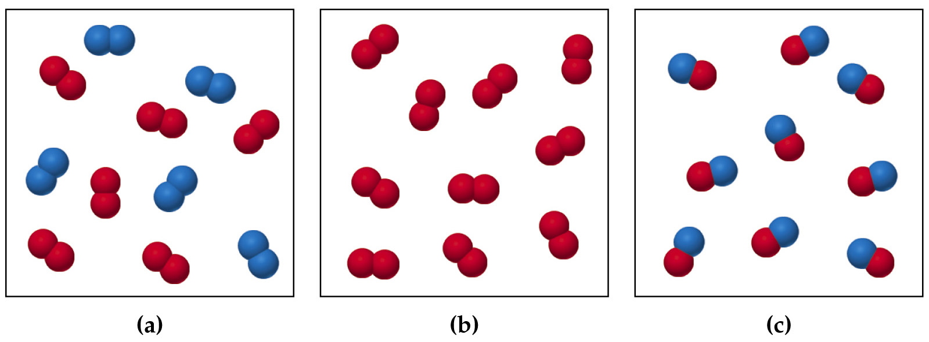
Which are pure substances?

Slide 16
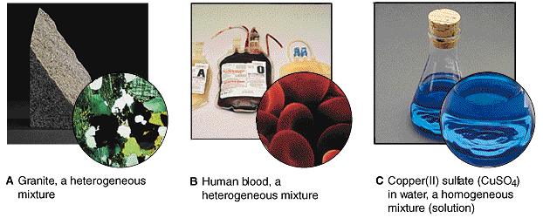
Mixtures: C.4.D classify matter as pure substances or mixtures through investigation of their properties.
blend of 2 or more types of matter
each component keeps its own identity and properties
the components are only physically mixed
can be separated using physical means
properties of the mixture are a combination of the component’s properties

Slide 17

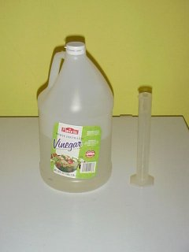
Homogeneous Mixtures
also called solution
uniform in composition
no visible parts
Ex:
vinegar
clear air
salt water
brass

Slide 18
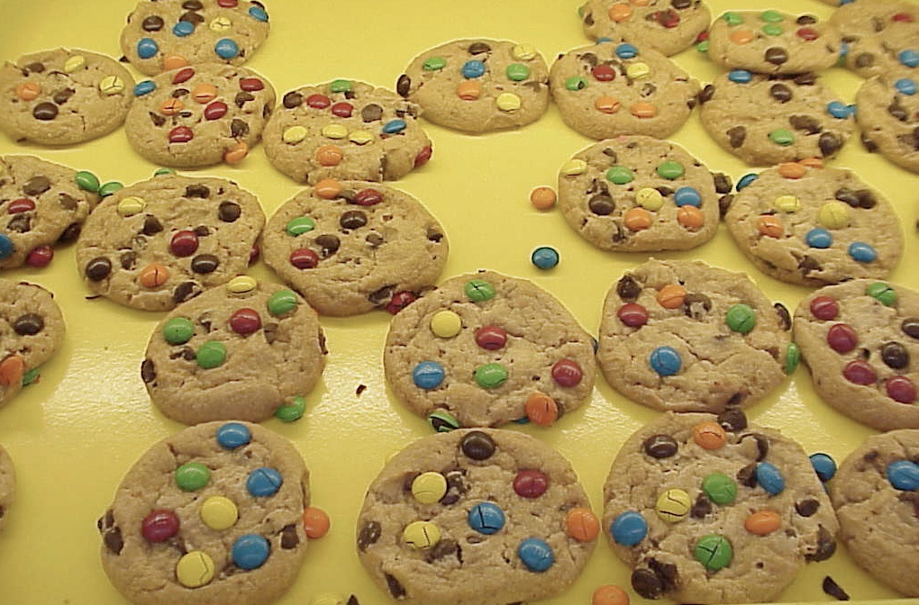
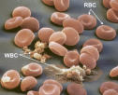

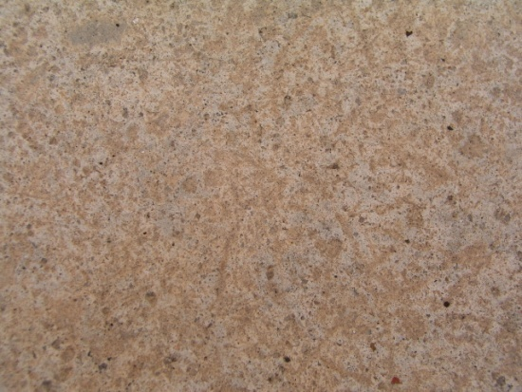
Heterogeneous Mixtures
not uniform in composition
visible parts
Ex:
soil
concrete
blood
chocolate chip cookies
sand in water
iced tea with ice

Slide 19
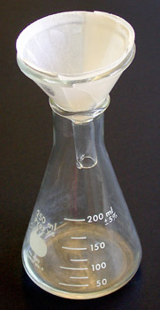
Mixture separation Techniques
Filtration- solid part is trapped by filter paper and the liquid part runs through the paper
Vaporization- where the liquid portion is evaporated off to leave solid

Slide 20
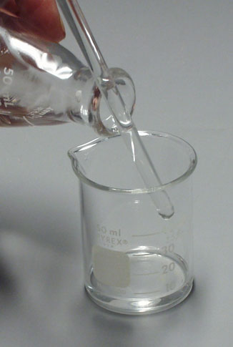
Mixture separation Techniques
Decanting- when liquid is poured off after solid has settled to bottom
Centrifuge- machine that spins a sample very quickly so that components with different densities will separate

Slide 21


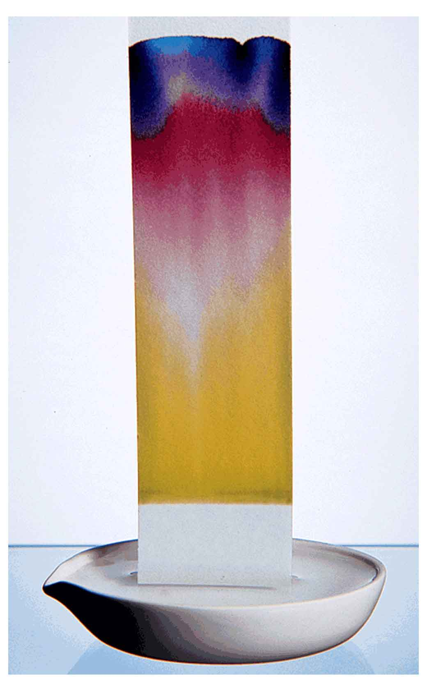
Mixture separation Techniques
Paper Chromatography- used to separate mixtures because different parts move quicker on paper than other

Slide 22
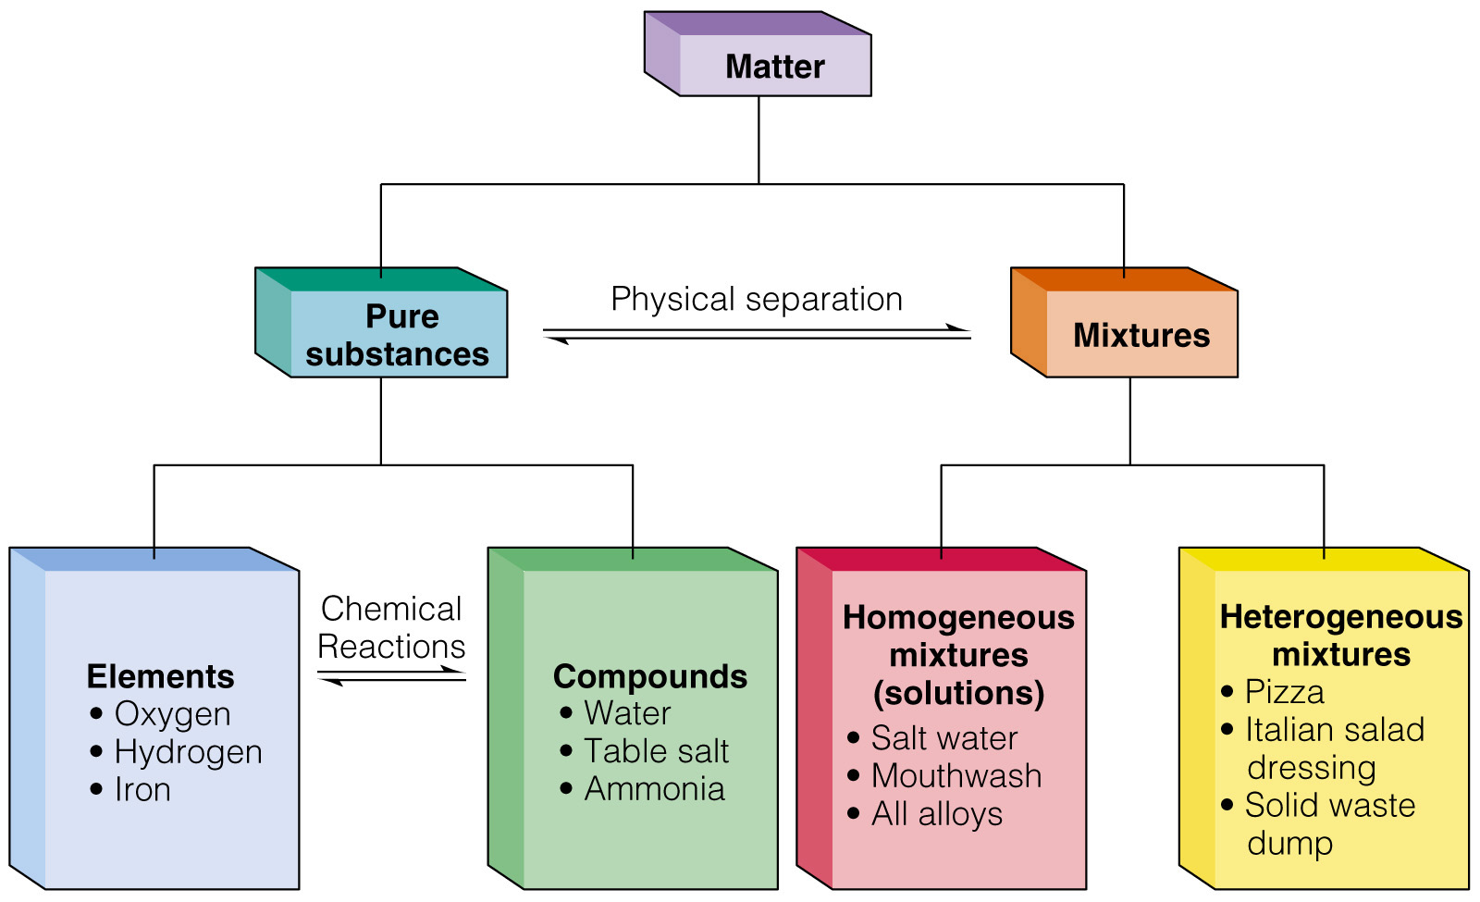
Review

Slide 23
Practice
Determine whether each of the following is element, compound, homogeneous mixture or heterogeneous mixture.
1.air
2. zinc (Zn)
3. chlorine (Cl)
4. granite
5. aluminum (Al)
6. sugar in water
7. blood
8. glucose
9. stainless steel
10. sodium chloride (NaCl)
11. brass
12. whole milk
13. apple
14. table salt
15. soft drinks
16. vinegar
17. concrete
18. sodium (Na)
19. baking soda (NaHCO₃)
20. gravel

Slide 25
States of Matter
C.4.C Compare solids, liquids, and gases in terms of compressibility, structure, Shape and volume.

Slide 26
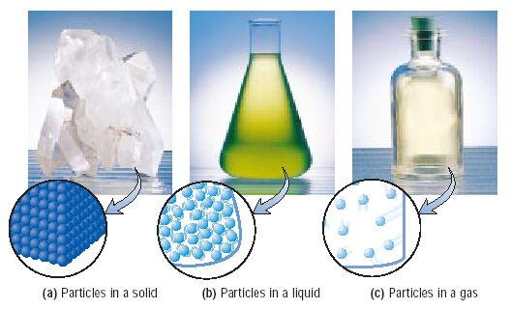
Phases of MatTer:
Solid
Liquid
Gas

Slide 27
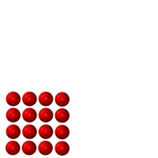
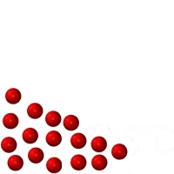
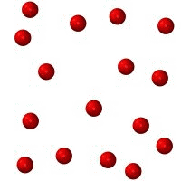
Phases of Matter: Particle Movement
Solids Liquids Gases

Slide 28
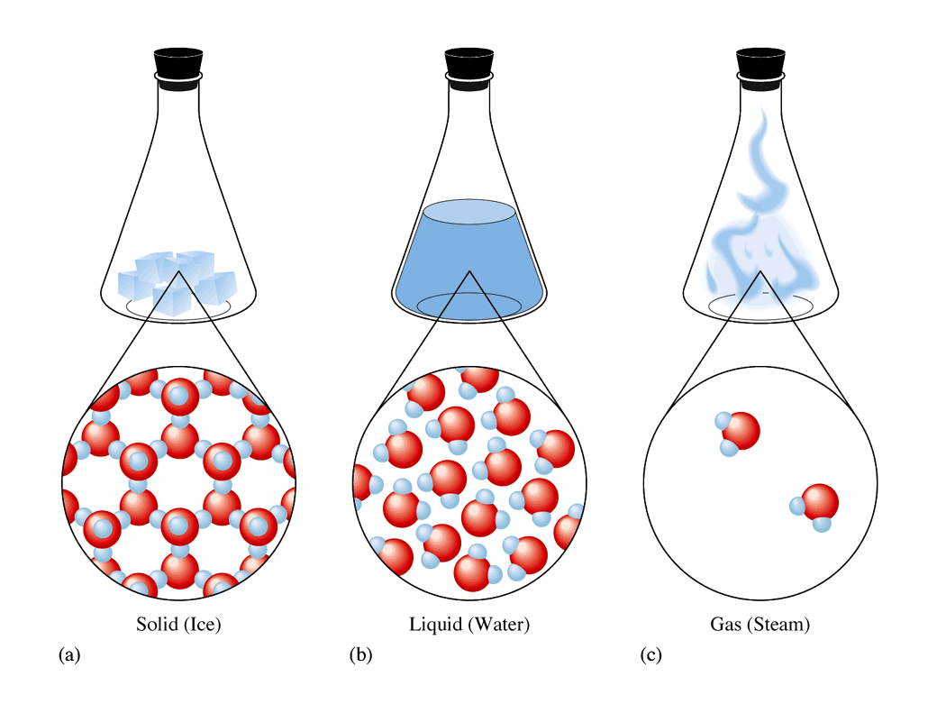
Phases of Matter: Solid
        definite shape
        definite volume
        atoms are packed together in fixed positions
        only vibrate in place
        Not easily compressible
        little free space between particles

Slide 29
Phases of Matter: Liquid
        indefinite shape
        definite volume
        atoms are close together
        not easily compressible
        little free space between particles

Slide 30
Phases of Matter: Gasses
        indefinite volume and shape
        atoms move quickly
        atoms are far apart
        compressible
        lots of free space between particles
        vapor refers to the gaseous state of a substance that is a solid or liquid at room temperature.

Slide 31
Your Turn: Is It Chemical or Physical Change?
1. A cake is baked
2. Water freezes
3. Sugar dissolves in water
4. Bread gets mold
5. An iron bench rusts
6. Paper is torn
7. A tree burns down
Physical Change | Chemical Change

