Slide 1
Unit 12: Nuclear Chemistry

Slide 2
Table of Contents
Slide #
3-15
16 - 28
Topics:
Types of radiation & Nuclear formulas
Nuclear Fission and Fusion and Half-life

Slide 3
Types of Radiation and Nuclear Equations
C.12.A describe the characteristics of alpha, beta, and gamma radiation
C.12.B describe radioactive decay process in terms of balanced nuclear equations

Slide 4
Introduction to Nuclear Chemistry
Nuclear Chemistry
Nuclear Reactions
Nuclear chemistry is the study of the structure of atomic nuclei and the nuclear change they undergo.
Characteristics:
Isotopes of one element are changed into isotopes of another element
Contents of the nucleus change
Large amounts of energy are released

Slide 5
Chemical vs. Nuclear Reactions
Chemical Reactions | Nuclear Reactions
Occur when bonds are broken | Occur when nuclei emit particles and/or rays
Atoms remain unchanged, although they may be rearranged | Atoms often converted into atoms of another element
Involve only valence electrons | May involve protons, neutrons, and electrons
Associated with small energy changes | Associated with large energy changes
Reaction rate influenced by temperature, particle size, concentration, etc. | Reaction rate is not influenced by temperature, particle size, concentration, etc.

Slide 6
Chemical Symbols
A chemical symbol looks like…
To find the number of , subtract the
from the
mass #
14
C
atomic #
6
neutrons
atomic #
mass #

Slide 7
Types of Radiation
Radioactive Decay – when unstable nuclei lose energy by emitting radiation to attain more stable atomic configurations (spontaneous process)
Alpha – radioactive decay of an atomic nucleus that is accompanied by the emission of an alpha particle( ).
Beta – Radioactive decay in which an electron is emitted ( ).
Gamma – High energy photons that are emitted by radioactive nuclei.

Slide 8
Alpha Decay
Alpha decay – emission of an alpha particle (α), denoted by the symbol , because an α has 2 protons and 2 neutrons, just like the He nucleus. Charge is +2 because of the 2 protons
Alpha decay causes the mass number to decrease by 4 and the atomic number to decrease by 2.
Atomic number determines the element. All nuclear equations are balanced.
4
He
2

Slide 9
Alpha Decay
Example 1: Write the nuclear equation for the radioactive decay of polonium – 210 by alpha emission.
Step 1: Write the element that you are starting with.
Step 2: Draw the arrow.
Step 3: Write the alpha particle.
Step 4: Determine the other product (ensuring everything is balanced).
Mass #
210
Po
206
Pb
4
He
84
82
2
Atomic #

Slide 10
Beta decay
Beta decay – emission of a beta particle (β), a fast moving electron, denoted by the symbol e⁻ or . β has insignificant mass (0) and the charge is -1 because it’s an electron.
Beta decay causes no change in mass number and causes the atomic number to increase by 1.

Slide 11
Beta Decay
Example : Write the nuclear equation for the radioactive decay of carbon – 14 by beta emission.
Step 1: Write the element that you are starting with.
Step 2: Draw the arrow.
Step 3: Write the beta particle.
Step 4: Determine the other product (ensuring everything is balanced).
Mass #
14
C
14
N
0
e
6
7
-1
Atomic #

Slide 12
Gamma decay
Gamma rays – high-energy electromagnetic radiation, denoted by the symbol γ.
γ has no mass (0) and no charge (0). Thus, it causes no change in mass or atomic numbers.
Gamma rays almost always accompany alpha and beta radiation.
However, since there is no effect on mass number or atomic number, they are usually omitted from nuclear equations.
Example: ϒ +

Slide 13
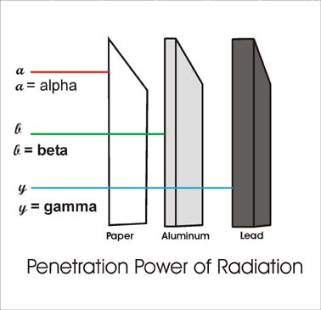
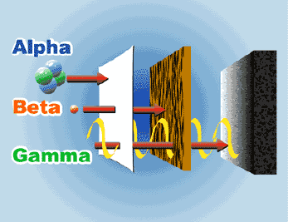
Penetration of Radiation
Alpha and beta are particles emitted from an atom. Gamma radiation is short-wavelength electromagnetic waves (photons) emitted from atoms.
The figures show the penetration of the different types of radiation.

Slide 14
Review
Type of Radioactive Decay | Particle Emitted | Change in Mass # | Change in Atomic #
Alpha | α He | -4 | -2
Beta | β e | 0 | +1
Gamma | γ | 0 | 0
4
2
0
-1

Slide 15
Stop at this slide

Slide 16
Nuclear Fission and Fusion & Half Life
C.12.C compare fission and fusion reactions

Slide 17
Nuclear Fission
Fission - splitting of a nucleus.
- Very heavy nucleus is split into two approximately equal fragments.
-Chain reaction releases several neutrons which split more nuclei.
- If controlled, energy is released slowly
(like in nuclear reactors). Reaction control depends on reducing the speed of the neutrons (increases the reaction rate) and absorbing extra neutrons (decreases the reaction rate).

Slide 18
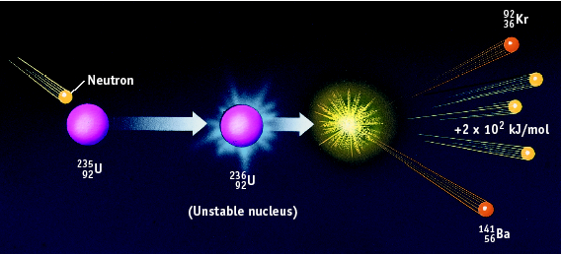
Nuclear Fission
- Examples – atomic bomb, current nuclear power plants
→ + + 2 x 10² kJ/mol

Slide 19
Nuclear Fusion
Fusion - combining of a nuclei
Two light nuclei combine to form a single heavier nucleus
- Does not occur under standard conditions (+ repels +)
- Advantages compared to fission
Inexpensive, No radioactive waste
- Disadvantages
requires large amount of energy to start, difficult to control

Slide 20
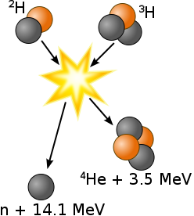
Nuclear Fusion
Examples – energy output of stars, hydrogen bomb, future nuclear power plants

Slide 21
Half-Life
Half Life is the time required for half of a radioisotope’s nuclei to decay into its products.
For any radioisotope,
# of ½ lives | % Remaining
0 | 100%
1 | 50%
2 | 25%
3 | 12.5%
4 | 6.25%

Slide 22
Half-Life
For example, suppose you have 10.0 grams of strontium – 90, which has a half life of 29 years. How much will be remaining after x number of years?
You can use a table:
# of ½ lives | Time (Years) | Amount Remaining (g)
0 | 0 | 10
1 | 29 | 5
2 | 58 | 2.5
3 | 87 | 1.25
4 | 116 | 0.625

Slide 23
Half-Life
Or an equation!
initial mass
m_{t} = m₀ x (0.5)^{n}
mass remaining
# of half-lives

Slide 24
Half-Life
Example 1: If gallium – 68 has a half-life of 68.3 minutes, how much of a 160.0 mg sample is left after 1 half life? ________
2 half lives? __________ 3 half lives? __________

Slide 25
Half-Life
Example 1: If gallium – 68 has a half-life of 68.3 minutes, how much of a 160.0 mg sample is left after 1 half life? ________
m_{t} = 160.0 mg x (0.5)¹ = 80.0 mg
2 half lives? __________
m_{t} = 160.0 mg x (0.5)² = 40.0 mg
3 half lives? __________
m_{t} = 160.0 mg x (0.5)³ = 20.0 mg

Slide 26
Half Life
Iodine-131 is a radioactive isotope with a half-life of 8 days. How many grams of a 64 g sample of iodine-131 will remain at the end of 8 days? ________
How many grams of a 64 g sample of iodine-131 will remain at the end of 32 days? ________

Slide 27
Half Life
Iodine-131 is a radioactive isotope with a half-life of 8 days. How many grams of a 64 g sample of iodine-131 will remain at the end of 8 days? ________
M_{t} = 64 g x (0.5)¹ = 32 g
How many grams of a 64 g sample of iodine-131 will remain at the end of 32 days? ________
First how many ½ lives have gone by.
32/8 (the ½ of iodine-131) = 4
Then plug 4 into formula.
M_{t} = 64 g x (0.5)⁴ = 4 g

Slide 28
Stop at this Slide

