Slide 1
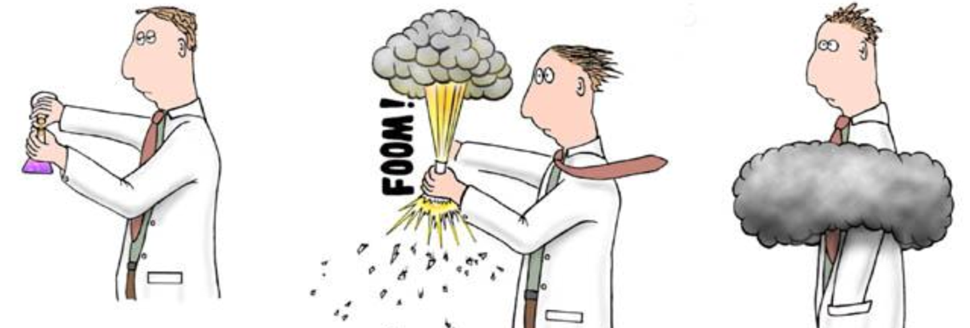
Unit 11 ThermoChemistry

Slide 2

Table of Contents
Forms of Energy
Law of Conservation of Energy & Heat Transfer
Thermochemical Equations
Specific Heat
Calorimetry

Slide 3
Understanding Energy and it Forms
C.11.A Understand energy and its forms, including kinetic energy, potential energy, and thermal energy.

Slide 4
ENERGY
Energy is the measure of the ability to cause change to occur (work)
The property of an object that enables it to do work
Units of energy:
Joule (J) = newton x meter
J = N x m

Slide 5





Types of Energy
Energy appears in many forms. There are five main forms of energy:
Mechanical (Kinetic and Potential)
Chemical
Electromagnetic
Heat (Thermal)
Nuclear

Slide 6


Kinetic Energy
Kinetic energy is energy of motion.
Kinetic energy depends on both mass and velocity.
The faster the object moves- the more kinetic energy

Slide 7
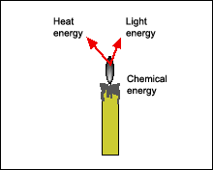
Potential Energy
The amount of energy that is stored
3 types of potential energy
  Elastic
    Ex. Pulling a rubber band back and holding
  Chemical
    Ex. Burning a match
  Gravitational
    A bolder resting on top of a hill
    Objects at high positions have greater gravitational potential energy then objects in lower positions

Slide 8
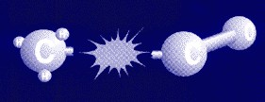
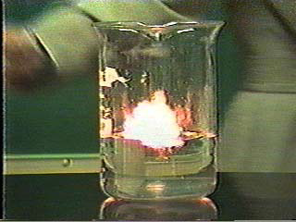
Chemical Energy
Chemical energy is the energy stored in the bonds of atoms and molecules.
This a form of potential energy until the bonds are broken.
Fossil fuels and biomass store chemical energy.
Examples:
  Digesting food…bonds are
  broken to release energy for
  your body to store and use.
  • Sports… your body uses energy
  stored in your muscles obtained
  from food.
  • Fire–a chemical change.

Slide 9
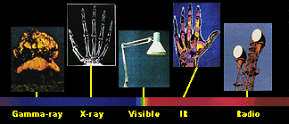
Electromagnetic Energy
a form of energy that is reflected or emitted from objects in the form of electrical and magnetic waves that can travel through space
Moving electric charges
Examples:
Power lines carry electricity
Electric motors are driven by electromagnetic energy
Light is this form of energy (X-rays, radio
waves, laser light etc.)

Slide 10
Thermal Energy
The internal energy or thermal energy of a substance is determined by the movement of the molecules and the potential energy of the arrangement of molecules.
Temperature is the measure of the
average kinetic energy of the
molecules.
Heat energy is the energy transferred
from a warmer substance to a
colder one by the collisions of
molecules.

Slide 11
Units of Thermal Energy
The unit for all energy is the joule.
However, sometimes the calorie is used for heat.
The calorie is defined as the amount of heat needed to raise 1 g of a substance 1 degree Celsius.
  A Calorie (food calorie, with a capital C) is 1000 cal
1 cal = 4.18 joules or 1kcal = 4180 J
To convert joules to calories
divide by 4.18.
To convert calories to joules multiply the calories by
4.18.

Slide 12
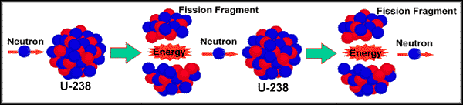
Nuclear Energy
When the nucleus of an atom splits, nuclear energy is released.
Nuclear energy is the most concentrated form of energy.
Fission/fusion

Slide 13

This is end of the section!

Slide 14
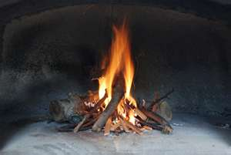
Law of Conservation of Energy and Heat Transfer
Chem.11B Understand the law of conservation of energy and the processes of heat transfer.

Slide 15
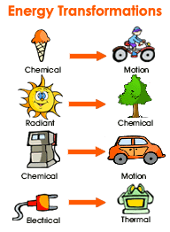
Law of Conservation of Energy
Conservation of energy (1st law of thermodynamics) is one of several conservation laws.
It states that the total inflow of energy into a system must equal the total outflow of energy from the system
In other words, energy can be converted from one form to another, but it cannot be created or destroyed.

Slide 16
Heat Energy
The law of conservation of energy is also true of heat energy.
If a substance gets hotter something else must get colder.
heat_{lost} = heat_{gained}
For example 200 g of water at 80 degrees C is mixed with 200 g of water at 10 degree C. What is the final temperature?
The 80 degree water will lose heat and the 10 degree water will gain heat. They will eventually come to thermal equilibrium and be at the same temperature.

Slide 17
Relating Temperature to Energy Transfer as Heat
Heat, q, is energy that transfers from one object to another because of a temperature difference.
The transfer of energy always takes place from a substance at a high temperature to a substance at a lower temperature.

Slide 18
Examples
Example : You are holding a hot water bottle what will happen:
    The warmer object (hot water bottle) will transfer energy to the cooler object (your hand).
    When energy is transferred as heat, the temperature of the water falls while the temperature of your skin rises.
    The great the difference in temperature of the two object, the more energy that will be transferred.
    This explains why hot things always cool down.

Slide 19
Let’s Look @ Temperature
The internal energy or thermal energy of a substance is determined by the movement of the molecules and the potential energy of the arrangement of molecules.
Temperature measures the average kinetic energy of the particles in a sample of matter
(Kinetic Energy = ½ mv²).
The greater the kinetic energy (the faster the molecules are moving), the higher the temperature, and the hotter it feels. When the kinetic energy decreases (molecules slow down), the temperature decreases.
A substance can change in temperature due to heat transfer.

Slide 20
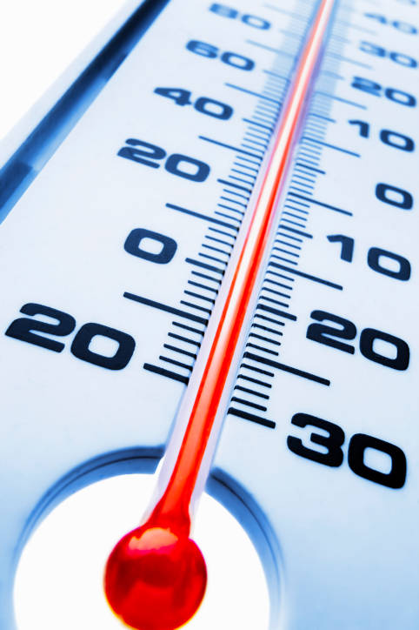
Measuring Temperature
Thermometers are device that is used to measure kinetic energy not temperature.
Thermometers rely on a simple physical property of all substances
  MOST OBJECTS EXPAND WHEN THEIR TEMPERATURE INCREASES
  Thermometers use liquids substance like mercury and colored alcohol that expand as their temperatures increase and contract as temperature decreases

Slide 21
Temperature Scales
Fahrenheit Scale
  Most familiar to you from your friendly weather reports
  Units called DEGREES FAHRENHEIT [ °F]
  Water freezes at 32 °F and Boils at 212 °F
Celsius Scale
  Widely used in science and other countries
  Units called DEGREES CELSIUS [°C]
  Celsius scale is based the values of 0 °C to freezing point of water and a value of 100 °C to boiling point of water (at standard pressure)
Kelvin Scale
  Based on absolute zero the temperature at which an objects energy is minimal
  Units called KELVIN [K]
  On the Kelvin scale zero Kelvin is absolute zero

Slide 22
Methods of Energy Transfer
Energy transfer as heat from a hot object can occur in 3 ways
  Conduction
  Convection
  Radiation
Heat transfer will stop when thermal equilibrium is reached, that is the rate at which energy flows out of a substance equals the rate that energy flows into the substance.

Slide 23
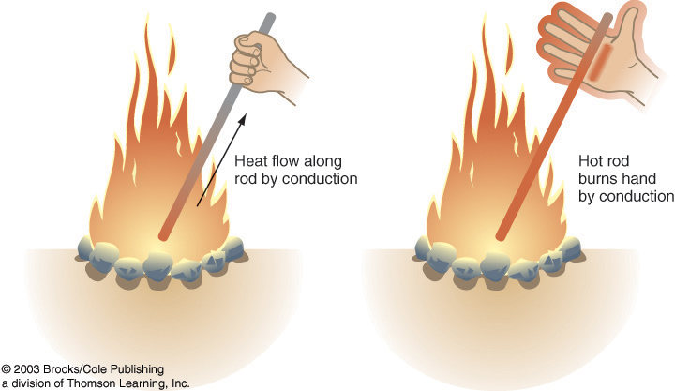
Conduction
The transfer of energy as heat between particles as they collide with a substance or between 2 objects in contact
Energy transfer through solids
Example: Heating marshmallows with a metal rod, as the marshmallow cook, the wire you are holding is getting hotter.

Slide 24
Convection
The transfer of energy by the movement of fluid with different temperature
During convection, energy is carried away by a heated gas or liquids that expand and rises above cooler, denser gas or liquid
Energy transfer through gases and liquids (both fluids)
The cycle of a heated fluid that rises and then cools and fall is called convection current

Slide 25
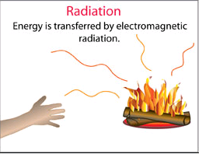
Radiation
The transfer of energy by electromagnetic waves
Energy transfer that does not need any material to transfer to, it travels in waves
Example: You stand near the heat of the fire and feel the heat, energy is transferred as eat from the fire in this case in the form of electromagnetic waves
Radiation differs from conduction and convection in that it does not involve the movement of matter

Slide 26
Main Ideas
The law of conservation of energy: energy cannot be created or destroyed. It can only be transferred from one form to another.
Heat is the transfer of energy from the particles of one object to those of another object due to temperature difference between the two objects.
Also remember that, transfer of energy always takes place from a substance at a higher temperature to a substance at a lower temperature
Three methods of energy transfer: conduction, convection and radiation

Slide 27
This is end of the section!

Slide 28
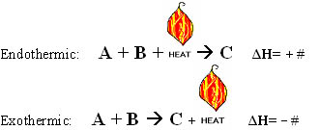
Thermochemical Equations
C.11.C use thermochemical equations to calculate energy changes that occur in chemical reactions and classify reactions as exothermic or endothermic

Slide 29
Thermochemical Equations
A Thermochemical Equation is a balanced stoichiometric chemical equation that includes the enthalpy change, ΔH.
  Enthalpy (H) is the transfer of energy in a reaction (for chemical reactions it is in the form of heat) and ΔH is the change in enthalpy.
    By definition, ΔH = Hproducts – Hreactants
    Hproducts < Hreactants, ΔH is negative
    Hproducts > Hreactants, ΔH is positive

Slide 30
Thermochemical Equations
In working with thermochemical equations you will find the following rules helpful.
  When a thermochemical equation is multiplied by a factor, the value of H for the new equation is obtained by multiplying the value of H by the same factor.
  When a chemical equation is reversed, the sign of H is reversed.

Slide 31
Writing Thermochemical Equations
Thermochemical equations show the exchange of heat in a chemical reaction.
  For example, Burning one mole of wax releases 20,000 kJ of heat energy.
    This could be written as:
      C₄₀H₈₂ + 60.5 O₂ → 40 CO₂ + 41 H₂O + 20,000 kJ
    Instead we usually write:
      C₄₀H₈₂ + 60.5 O₂ → 40 CO₂ + 41 H₂O ΔH = -20,000 kJ

Slide 32
Practice
Write the following thermochemical equations showing ∆H.
  Reacting 2 moles of solid sodium with 2 moles of water to produce 2 mole of aqueous sodium hydroxide and 1 mole of hydrogen gas will release 367 kJ of energy
  184.6 kJ of energy is needed to produce 1 mole of hydrogen gas and 1 mole of chlorine gas from 2 moles of hydrogen chloride gas.
  2Na (s) + 2 H₂O (l) → 2 NaOH (aq) + H₂ (g) + 367 kJ or
  2Na (s) + 2 H₂O (l) → 2 NaOH (aq) + H₂ (g) ∆H=- 367 kJ
  2 HCl (g) + 184.6 kJ → H₂ (g) + Cl₂ (g) or
  2 HCl (g) → H₂ (g) + Cl₂ (g) ∆H= + 184.6 kJ

Slide 33
Thermochemical equations using Standard Heat of Formations
C₂H₂(g) + 2 H₂(g) → C₂H₆(g)
  Information about the substances involved in the reaction represented above is summarized in the following tables.
  Write the equation for the heat of formation of C₂H₆(g)
Substance | ΔH°f (kJ/mol)
C₂H₂(g) | 226.7
C₂H₆(g) | -84.7

Slide 34
Thermochemical equations using Standard Heat of Formations
  Write the equation for the heat of formation of C₂H₆(g)
Substance | ΔH°f (kJ/mol)
C₂H₂(g) | 226.7
C₂H₆(g) | -84.7
  1st: Using our balanced chemical
  equation, we see how many moles of each compound we have.
  C₂H₂(g) + 2 H₂(g) → C₂H₆(g) [(H₂) does not have a ΔH°f ]
      1 mol of C₂H₂(g) and 1 mol C₂H₆(g)
  2nd: We plug in the ∆H°f for each of our compounds, remembering that
    ∆H° = [∆H°f products] – [∆H°f reactants]
    ∆H° = [C₂H₆(g)] – [C₂H₂(g)] =
  3rd: We solve for ∆H°
    ∆H° = [-84.7] – [226.7] = -331.4 kJ/mol

Slide 35
Practice Problems
Substance | ΔH°f (kJ/mol)
CaCO₃(s) | -1207.6
CaO(s) | -634.9
C ₄H₁₀ (g) | -30.0
H₂O (g) | -241.82
CO₂ (g) | -393.5
Solve for the ΔH_{rx} and write the following thermochemical equations.
  1. What is the ΔH_{rx} for the process used to make lime (CaO)?
    CaCO₃(s) → CaO(s) + CO₂(g)
  2. What is the ΔH_{rx} for the combustion of C₄H₁₀(g)?
    2 C₄H₁₀ (g) + 13 O₂ (g) → 10 H₂O (g) + 8 CO₂ (g)

Slide 36
Practice Problems
Solve for the ΔH_{rx} and write the following thermochemical equations.
  1. What is the ΔH_{rx} for the process used to make lime (CaO)?
    CaCO₃(s) → CaO(s) + CO₂(g)
Substance | ΔH°f (kJ/mol)
CaCO₃(s) | -1207.6
CaO(s) | -634.9
C ₄H₁₀ (g) | -30.0
H₂O (g) | -241.82
CO₂ (g) | -393.5
ΔH_{rx} = [ΔH°f (CaO) + ΔH°f (CO₂)] – [ΔH°f (CaCO₃)]
ΔH_{rx} = [(-634.9)+(-393.5)] – [(-1207.6)]
ΔH_{rx} = [ -1028.4] – [-1207.6] = +179.2 kJ
CaCO₃(s) → CaO(s) + CO₂(g) ΔH_{rx} = 179.2 kJ/mol

Slide 37
Practice Problems
Substance | ΔH°f (kJ/mol)
CaCO₃(s) | -1207.6
CaO(s) | -634.9
C ₄H₁₀ (g) | -30.0
H₂O (g) | -241.82
CO₂ (g) | -393.5
Solve for the ΔH_{rx} and write the following thermochemical equations.
  2. What is the ΔH_{rx} for the
  combustion of C₄H₁₀(g)?
    2 C₄H₁₀ (g) + 13 O₂ (g) → 10 H₂O (g) + 8 CO₂ (g)
ΔH_{rx} = [ΔH°f (H₂O) + ΔH°f (CO₂)] – [ΔH°f (C₄H₁₀)]
(We do not include O₂ because its ΔH°f is 0.)
ΔH_{rx} = [10(-241.82)+8(-393.5)] – [2(-30.0)]
ΔH_{rx} = [ -5566.2] – [-60.0] = -5506.2 kJ
    2 C₄H₁₀ (g) + 13 O₂ (g) → 10 H₂O (g) + 8 CO₂ (g) ΔH_{rx} = -5506.2 kJ/mol

Slide 38
Thermochemical & Endothermic/ Exothermic equations
In the previous slides, we saw how ΔH° could be both positive or negative.
Depending on the sign of ΔH°, the reaction can either be exothermic or endothermic.
  Exothermic reactions release heat from the system to the surroundings so the temperature will rise.
    ΔH° will be negative because the reaction loses heat.
    ΔH° can be written into the chemical equation as a product.
  Endothermic reactions absorb heat from the surroundings into the system so the temperature will decrease.
    ΔH° will be positive because the reaction absorbs heat.
    ΔH° can be written into the chemical equation as a reactant.

Slide 39
Classify the following as endothermic or exothermic
Ice melting
2 C₄H₁₀(g) + 13 O₂(g) → 10 H₂O(g) + 8 CO₂(g) ΔH_{rx} = -5506.2 kJ/mol
2 HCl (g) + 184.6 kJ → H₂ (g) + Cl₂ (g)
Water vapor condensing
Endothermic
Exothermic
Endothermic
Exothermic
Notes:
Discuss why ice melting and water vapor condensing are exothermic or endothermic.

Slide 40
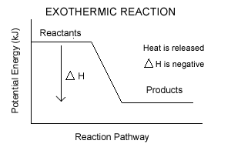
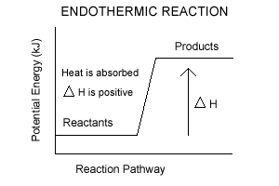
Exothermic vs. Endothermic
Exothermic
Endothermic
A change in a chemical energy where energy/heat EXITS the chemical system
Results in a decrease in chemical potential energy
ΔH is negative
A change in chemical energy where energy/heat ENTERS the chemical system
Results in an increase in chemical potential energy
ΔH is positive

Slide 41
This is end of the section!

Slide 42

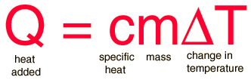
Specific Heat: The Equation
C.11.D perform calculations involving heat, mass, temperature change, and specific heat

Slide 43
Temperature and Energy
We relate energy and temperature by discussing a substance’s heat capacity.
  Heat Capacity = heat required to raise temp. of an object by 1ºC
    more heat is required to raise the temp. of a large sample of a substance by 1ºC than is needed for a smaller sample
Specific Heat Capacity
  a physical property of matter that describes matter’s resistance to a change in temperature. The symbol for specific heat is C_{p}.
    Not all substances heat up at the same rate. Some get hot quickly and some more slowly.

Slide 44
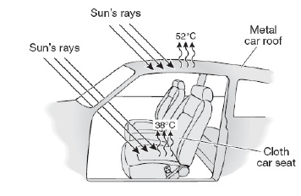
Example
If you have ever touched the metal on a car and the fabric on the car seat on a hot day, you have experienced the affect of specific heat. The metal seems much hotter than the fabric seat even if after receiving the same amount of energy from the sun. This is caused by the difference in the specific heat of each of the materials. The metal has a lower specific heat and gives up its thermal energy at a much higher rate than does the fabric which has a much higher specific heat.

Slide 45
High Specific Heat and Water
Water has a very high specific heat compared to other matter; therefore ocean water stays about the same temperature throughout day and night despite the differences in temperature between night and day. That also explains why water is used in car radiators to cool the engine.
  Low specific heat = less energy required to change the temperature
  High specific heat = more energy required to change the temperature

Slide 46
Practice
Which would get hotter if left in the sun?
Penny vs. Water
Keys vs. soccer ball
Plastic recycling bin vs. metal trash can

Slide 47
Specific Heat Capacity
Temperature change of a substance depends on three things:
  Mass, m
  Amount of energy added, Q
  Specific Heat, C_{p}
Final
temperature
Initial
temperature
Q = m x C_{p} x (T_{f} – T_{i})
or
Q = m x C_{p} x (∆T)
Temperature change

Slide 48
Specific Heats of Common Substances

Slide 49
Using Q = m x C_{p} x (T_{f} – T_{i})
The following problems will show you how to solve for different variables in our equation.
How much energy does it take to raise the temperature of 50 g of aluminum (c_{p} = 0.9025 J/gC⁰) by 10 ⁰C?
Q = (m) (c_{p}) (T_{f} - T_{i})
Q = (50g) (0.9025 J/gC⁰) (10⁰C)
Q = 451.25 Joules

Slide 50
Using Q = m x C_{p} x (T_{f} – T_{i})
If we add 30 J of heat to lead (cp = 0.1276J/gC⁰) with a mass of 10 g, how much will its temperature increase?
Q = (m) (c_{p}) (T_{f} - T_{i})
30J = (10g) (0.1276 J/gC⁰) (x)
30J = (1.276 J/⁰C) (x)
23.5⁰C = x = temperature increase

Slide 51
This is end of the section…now you try!

Slide 52
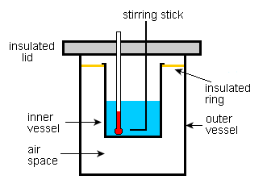
Calorimetry
C.11.E use calorimetry to calculate the heat of a chemical process

Slide 53
Calorimetry
Calorimetry is the science of measuring the heat of chemical reactions or physical changes.
  Calorimetry is also known as a laboratory procedure that measures the amount of heat transferred to the surroundings by a reaction.
    Calorimetry can be calculated when heat of combustion is given and the mass of the substance is known or,
    During a calorimetry procedure, the heat released during a chemical or physical change is transferred to another substance, such as water, which undergoes a temperature change.

Slide 54
Calorimetry Calculations
Example 1: Propane is a commonly used fuel. 1 mol of C₃H₈ releases 2,220 kJ of heat during combustion. The molar mass of C₃H₈ is 44.1 g/mol. How much heat is released if a firework contains 67.8 g of C₃H₈?
  1st convert the grams of C₃H₈ to moles of C₃H₈.
    67.8 g C₃H₈ x 1 mol C₃H₈ = 1.53 mol C₃H₈
    44.1 g C₃H₈
  2nd use the heat of combustion of propane to calculate energy (heat) released
    1.53 mol C₃H₈ x 2,220 kJ = 3413.06 kJ => 3410 kJ released
    1 mol

Slide 55
Calorimetry Calculations
The temperature change, fuel mass, and water volume data from a calorimetry procedure can be used to determine how much heat is transferred during a combustion reaction.
  The amount of energy transferred from a substance during combustion depends on the identity and mass of the substance.
  The equation can be seen as q₁ = - q₂. One will be losing energy, the other will be gaining energy.

Slide 56
Calorimetry Calculations
Example 2: 175 grams of hot aluminum (100.°C) is dropped into an insulated cup that contains 40.0 mL of ice cold water (0.0°C). Follow the example above to determine the final temperature, x.
  1st set up expressions for energy released and energy absorbed.
    Q = - (175 g) (0.900 J/g●◦C) (x -100 ◦C) for silver and Q = (40.0 g) (4.184 J/g●◦C) (x -0.0 ◦C) for cold water
  2nd put expressions together.
    - (175 g) (0.900 J/g●◦C) (x -100 ◦C) = (40.0 g) (4.184 J/g●◦C) (x -0.0 ◦C)
  3rd solve for x.
    - 157.5 (x – 100) = 167.4 (x - 0.0)
    - 157.5 x + 1575 = 167.4 x
    1575 = 324.9 x => x = 48.5 ◦C

Slide 57
This is end of the Unit 11!

