Slide 1
The Universe
ESS: Unit 10 - Universe and Stars

Slide 2
The Universe
Astronomers refer to all of the matter and energy in space as the UNIVERSE.
Includes :
Solar system
Stars
All other objects in space

Slide 3
(2012) view – each light speck is a galaxy – some of these are as old as 13.2 billion years – the visible Universe is estimated to contain 200 billion galaxies.

Slide 4
Origin of the Universe
Astronomers think there are billions of galaxies in the universe
All appear to be moving away from each other at tremendous speeds
Two main hypotheses that attempt to explain the origin of the universe based on the outward movement of galaxies:
The big bang theory
The steady-state theory

Slide 5
Big Bang Theory
This theory states that: a violent explosion spread hydrogen in all directions with a “big bang” 15-20 billion years ago
Expanding cloud of hydrogen gas, mixed with dust particles and other gases, gradually condensed into galaxies

Slide 6
Big Bang Theory

Slide 8
Oscillating Universe Hypothesis
Related to Big Bang Theory
States: universe periodically oscillates (expands and contracts)
According to this theory – galaxies moving away from one another will eventually slow down and stop….
Then will begin to move toward one another
In time, all galaxies will form a huge mass of densely packed matter, which will again undergo a violent explosion (or big bang)

Slide 9
Steady-State Theory
Less-widely accepted theory
States the universe is continually being renewed
According to this theory – as galaxies move outward new galaxies take their place
No evidence that new matter is being created between the galaxies

Slide 11
Size of the Universe
Too large to measure in “usual” measurements – such as kilometers
Astronomers use an extremely large unit of distance – a light year….
A LIGHT YEAR is the distance that light travels in one year (about 10 trillion kilometers; or 6 trillion miles)
EXAMPLE: the star Alpha Centauri is about 43 trillion km from Earth or 4.3 light years

Slide 12
Light Year

Slide 13
Light year………..

Slide 14
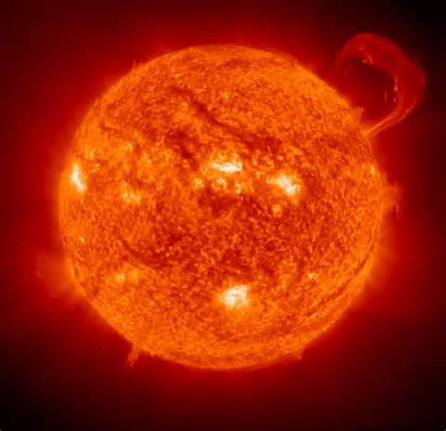
Size of the Universe
The Sun is 150 million km from Earth, slightly more than eight light minutes away –
it takes sunlight about eight minutes to travel from the sun to Earth.

Slide 15
Composition of the Universe
Originally identified individual stars and “hazy” regions
Hazy regions in the night sky - called NEBULAE, from a Latin word meaning clouds.
Later discovered to be large groups of stars
GALAXY – an enormous group of stars

Slide 16
Spiral Galaxy

Slide 17
Barred Spiral Galaxy

Slide 18
Nebula
NEBULA – a cloud of dust and gas in space
Sometimes glow by reflected starlight

Slide 19
Orion Nebula – 1500 light yrs

Slide 20
Space “Cloud”

Slide 21
Galaxies
Two galaxies closest to Earth…
Magellanic Clouds
100,000 light years away
Andromeda Galaxy
2,000,000 light years away

Slide 22
Galaxies

Slide 23
Andromeda Galaxy

Slide 24
Milky Way
Composed of Billions of stars - enormous amounts of gas in between
Also: Dust particles and light gases (such as hydrogen) that have escaped from the inner planets after they formed
(However, the dust particles and gas molecules are very far apart – so astronomers consider space almost a total vacuum)

Slide 25
Earth’s Galaxy
Milky Way – a spiral galaxy
100,000 light years in diameter
10,000 light years thick
Shaped like a flattened spiral
A huge disk with long, thin arms spiraling outward
Consists of billions of stars
Sun – A star within the Milky Way galaxy

Slide 26
Milky Way

Slide 27
Milky Way

Slide 28
Constellations
Ancient people looking at night sky observed that groups of stars formed patterns
Some named for animals and some named for humans
The swan, the bear, the hunter
Ancient names for these patterns still used when referring to these groups of stars, which astronomers call CONSTELLATIONS

Slide 29
Hyena Constellation

Slide 30
Constellations

Slide 31
Constellations

Slide 32
In Northern Hemisphere, two familiar constellations: Ursa Major (big bear) and Ursa Minor (little bear)
The Big Dipper - a smaller constellation within Ursa Major
The Little Dipper - a smaller constellation inside Ursa Minor
Both are referred to as CIRCUMPOLAR CONSTELLATIONS
because their positions make them visible throughout the year, and they appear to revolve around Polaris (the North Star)

Slide 33
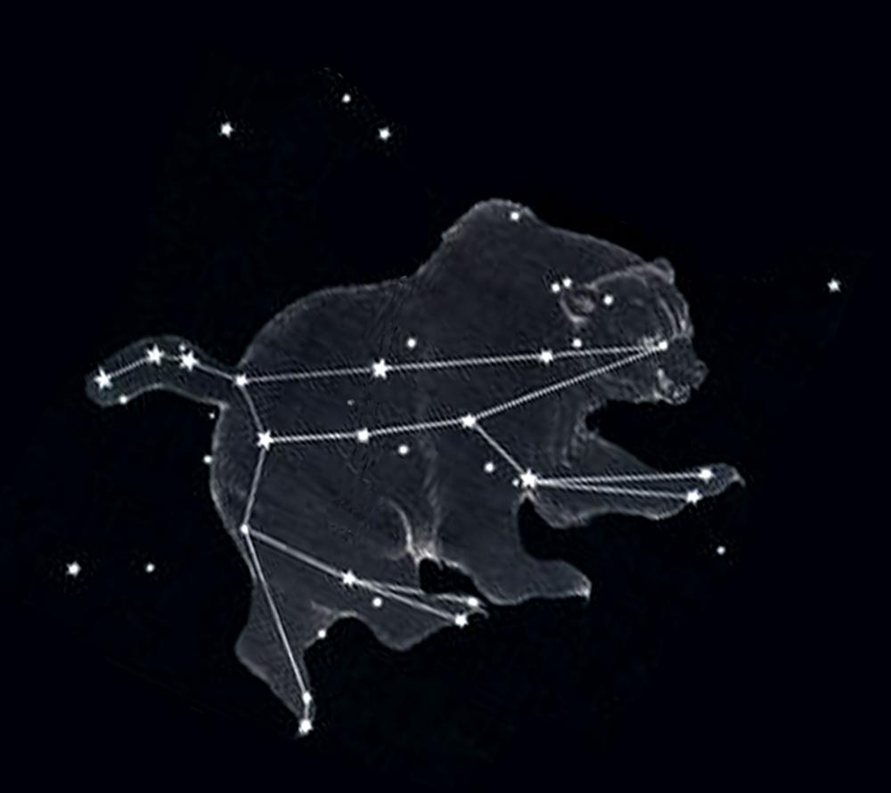
Ursa Major

Slide 34
Ursa Major

Slide 35
Ursa Minor and Ursa Major

Slide 36
“Dippers”

Slide 37
Stars
Stars differ in:
Size
Brightness
Color
Composition
Age

Slide 38
Size of Stars
Range in diameter from < 100 km to several billion km
Smallest – dwarfs
Largest – supergiants
Main difference between dwarfs and supergiants - density

Slide 40
Density of Stars
Dwarfs – very dense
A cubic centimeter weighs more than one ton
Supergiant – much less dense than dwarf
Matter is so spread out – it is thinner than our atmosphere

Slide 41
Magnitude of Stars
Ancient Greek astronomers classified stars numerically according to their brightness
Brightest = can be seen from Earth – called first magnitude stars
Sixth magnitude stars – the faintest stars that can been seen from Earth
Astronomers still use this system when comparing brightness of stars by apparent magnitude (how bright a star appears from Earth)

Slide 42
Magnitude of Stars

Slide 43
Apparent Magnitude
To an observer on Earth:
A first magnitude star is 100 times brighter than a sixth-magnitude star
Apparent magnitudes of stars brighter than first magnitude are expressed as values less than 1.0
Example: Sirius (the brightest star in the night sky) has an apparent magnitude of nearly -1.5

Slide 44
Apparent Magnitudes of Some Celestial Bodies
Celestial Body | Apparent Magnitude
Sun | -26.5
Full moon | -12.5
Venus (at brightest) | -4.0
Sirius | -1.5
Canopus | -0.7
Alpha Centauri | -0.3
Altair | 1.0
Polaris (North Star) | 2.0

Slide 45
Temperature of Stars
Stars (on a clear night) appear red, yellow, or blue
Color depends on surface temperature
Red – surface temp. about 3,000⁰C
Blue – surface temp. 30,000⁰C+
Yellow – (like the Sun) surface temp. of
about 5,500⁰C

Slide 48
Composition of Stars
Astronomers discovered many elements on Earth also present in stars
Stars consist mainly of hydrogen and helium with traces of other elements
Example: The Sun is made of 82% hydrogen and 17% helium – other one percent composed of many other elements

Slide 49
Distances to Stars
Astronomers use procedure called PARALLAX METHOD to determine a star’s distance from Earth
Measures change in position of nearby stars
Compare photographs of stars position 6 months apart

Slide 51
Calculating Distance

Slide 52
Life Cycle of a Star
Astronomers think that stars form from clouds of dust and gas in outer space
Dust and gas particles in clouds exert gravitational force on each other
Cloud begins to contract and grow warmer
Over millions of years, cloud of dust and gas eventually becomes hot enough to glow

Slide 54
Life Cycle of a Star
After it begins to glow, a star passes through several stages
New stars appear dull red because it is still relatively cool
As a young star contracts, it becomes hotter
Color changes …
dull red ->bright red -> orange ->yellow and finally to bright blue-white

Slide 55
Life Cycle of a Star

Slide 56
Life Cycle of a Star
When stars interior temperature reaches several million degrees Celsius – hydrogen atoms are changed into helium by thermonuclear fusion
Our Sun is currently in this stage of its “life”
In this stage, the star stops contracting and glows steadily

Slide 57
Life Cycle of a Star
Finally – no more hydrogen for thermonuclear fusion
Core of star collapses
Generates tremendous heat
Heat causes star to expand by millions of kilometers
Star becomes much cooler red giant or supergiant

Slide 59
Life Cycle of a Star
In short time –
Red giant collapses completely with a bright explosion (outer layer removed)
Bright explosion of red giant is called nova
Star then shrinks - becomes white dwarf
In time, star contracts further to small solid body of heavier elements (iron and carbon)

Slide 60
Red Supergiant

Slide 61
Nova

Slide 62
White Dwarf

Slide 63
Life Cycle of a Star
Red super giants may explode violently
Then collapse into objects so dense that their gravitational forces do not allow light rays to escape
These invisible objects are called BLACK HOLES
Astronomers think black holes may exist at the centers of many galaxies

Slide 65
Life Cycle of a Star
Life cycle of a star estimated to be about 10 billion years
Our Sun is about halfway through its life cycle
Expected to continue to generate heat and light at its current rate for at least another 5 billion years

Slide 67
Studying the Stars

Slide 69
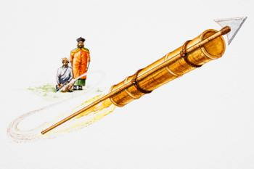
Rockets and Space Exploration
Chinese - first rockets propelled by gunpowder – 1040
Used to ward off evil spirits, as weapons and for fireworks

Slide 70
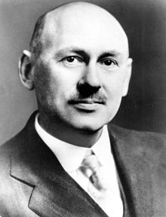
First American rocket – 1926 – Physicist Robert H. Goddard
Used liquid fuel
By 1930 – he had built bigger/better rocket
Travelled 800 km/hr reached altitude >600 meter

Slide 71
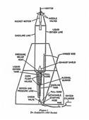
Goddards’ Rockets

Slide 72
Rockets
During World War II, German Scientists built rocket weapons that travelled 5,000 km/hr and carried one-ton bombs a distance of almost 250 km.
German troops loading rockets into a 15 cm nbw 41 launcher

Slide 73
German V2 rocket

Slide 74
History of German Rockets

Slide 75
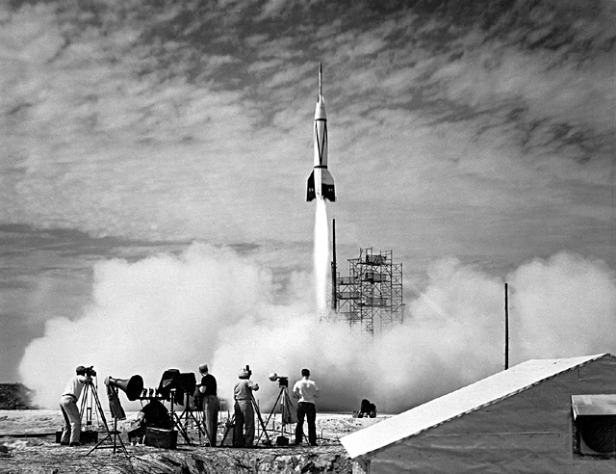
By late 1950’s the USA and the Soviet Union had built rockets that could travel into space

Slide 76
Memorial to first Soviet Rocket

