Slide 1
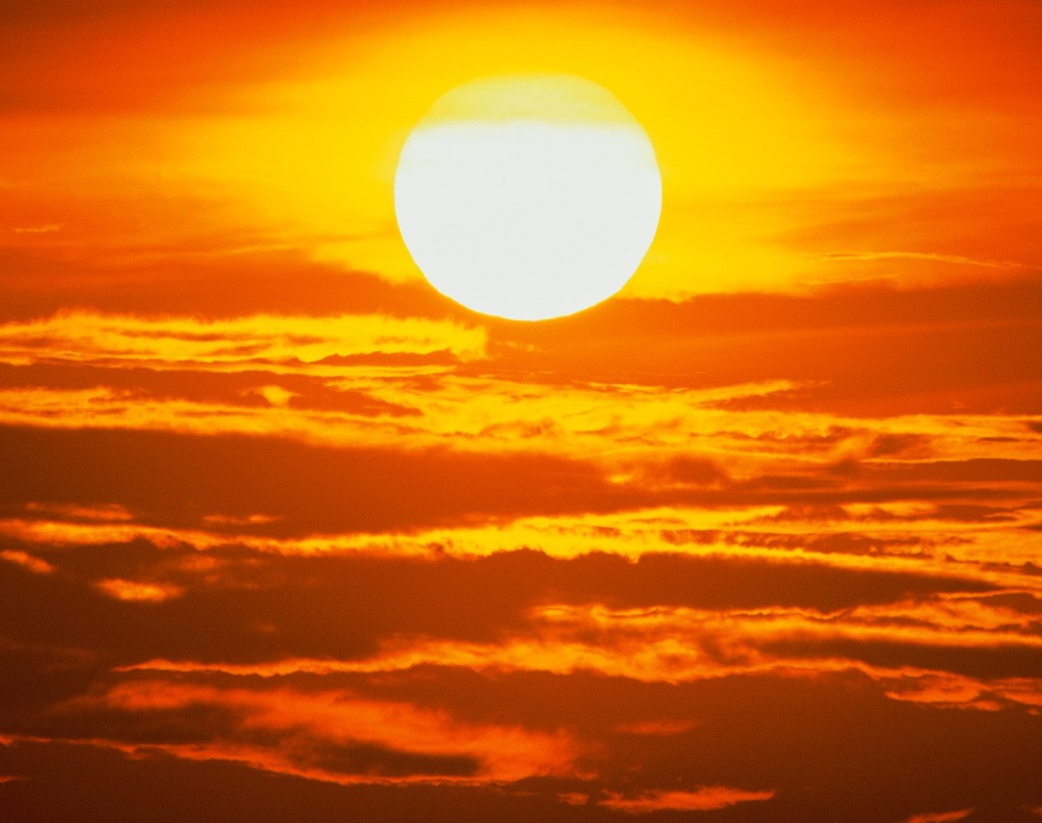
The Sun
Our Star
Earth Science – Tarbuck/Lutgens/Tasa

Slide 2
Test your knowledge: Pre-Quiz
Answer these questions……..
1. Why is the Sun so important to inhabitants of Earth?
2. Why is the Sun significant to the study of astronomy?
3. Describe the Sun in relationship to other stars in the universe.

Slide 3
Our Star
An “average” star
Diameter equal to 109 Earth diameters
Provides energy that allows life to flourish
Volume1.25 million times as great as that of Earth
Eight light minutes away from us (compared to 4 light years for the next nearest star)

Slide 5
Importance of Sun
Primary source of energy
Everything – from food we eat to fossil fuels we burn in vehicles and power plants is ultimately derived from solar energy
Important in Astronomy – the only star close enough to permit easy study of its surface
Compared to other stars (many of which are larger, smaller, hotter, cooler, more red, or more blue) the Sun is an “average” star

Slide 6
Structure of the Sun
Because the Sun is gaseous throughout, no sharp boundaries exist between the layers
However, for convenience of discussion……
Generally divided into four parts:
The solar interior
The visible surface (photosphere)
Two layers of its atmosphere:
Chromosphere
Corona

Slide 7
The suns interior makes up all but a tiny fraction of the solar mass.

Slide 8
Photosphere
Photos = light; sphere = ball
Radiates most of the sunlight we see
Appears as the bright disk of the Sun
Although it is considered to be the Sun’s “surface” it is unlike most surfaces to which we are accustomed

Slide 9
Photosphere
Consists of a layer of incandescent gas less than 500 kilometers (300 miles) thick
Pressure less than 1/100 of our atmosphere
Neither smooth, nor uniformly bright
Has numerous blemishes

Slide 10
Photosphere
When viewed telescopically, photosphere has a grainy texture
Grainy texture results from numerous comparatively small, bright markings called granules (granuum = small grain that is surrounded by narrow dark regions)

Slide 11
Granules
Granules are about the size of Texas and owe their brightness to gases that are rising from below
As this gas spreads laterally, the cooling causes it to darken and sink back into the interior
Each granule survives for only 10-20 minutes
Combined motion of old granules being replaced by new ones gives the appearance of boiling

Slide 12
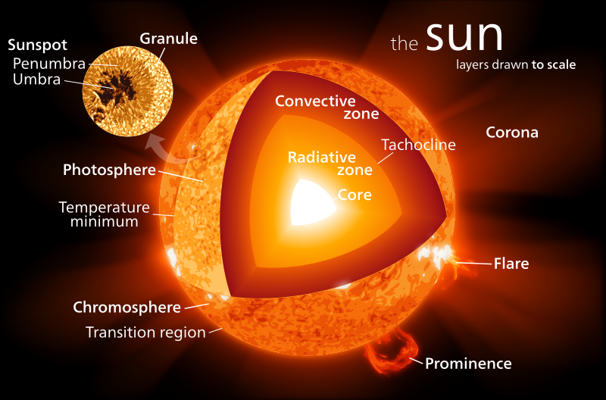

Slide 13
Granules
Granules of the
solar photosphere.
Granules appear as
yellow-orange patches.
Each granule is about
the size of Texas and
lasts for only 10-20
minutes before being
replaced by a new
granule.

Slide 14
Convection
The up and down movement of gas is called convection (occurs in all fluids)
Convection produces the grainy appearance of the photosphere
Is responsible for the transfer of energy in the uppermost part of the Sun’s interior

Slide 16
Chromosphere
Chromosphere (color sphere)
Just above photosphere
Relatively thin layer of hot, incandescent gases a few thousand kilometers thick
Observable for a few minutes during a solar eclipse; or by using a special instrument that blocks out the light from the photosphere

Slide 17
The chromosphere
appears as a thin red rim around the Sun. Hydrogen
output accounts for this spheres red color.

Slide 18
Chromosphere
The top of the chromosphere contains numerous spicules (spica = point)
Flame-like structures that extend upward about 10,000 kilometers into the lower corona
Spicules are produced by the turbulent motion of the granules below

Slide 21
Corona
Outermost portion of the solar atmosphere is the corona (corona = crown)
Visible only when photosphere is blocked
Envelope of ionized gases extends about 1 million kilometers or so from the Sun
Produces a glow about half as bright as the full Moon

Slide 22
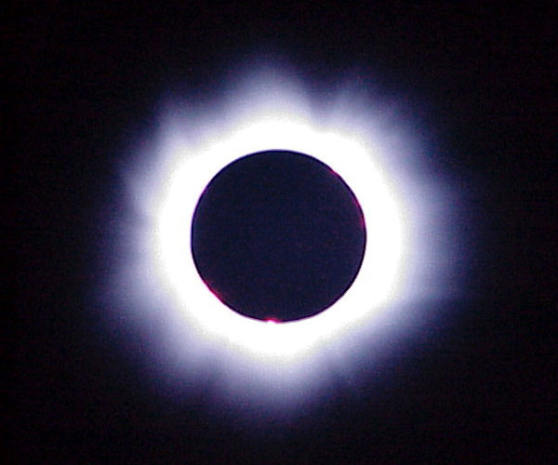
Corona
Corona at Total Solar Eclipse

Slide 23
Corona
Temperature increases upward from the photosphere exceeding 1 million K at the top of the corona
NOTE: Although the coronal temperature exceeds that of the photosphere by many times, it radiates much less energy overall because of its very low density.

Slide 24
Corona
High temperature of corona probably caused by sound waves generated by convection motion of photosphere.
….Just as boiling water makes noise, energetic sound waves generated in the photosphere are believed to be absorbed by the gases of the corona, thereby increasing the temperature

Slide 26
CONCEPT CHECK
Answer these questions………..
1. Describe the photosphere, chromosphere, and corona.
2. Why are there no distinct boundaries between the layers of the Sun?
3. Why is the photosphere considered the Sun’s surface?

Slide 27
Solar Wind
At outer fringe of corona, ionized gases have speeds great enough to escape the gravitational pull of the Sun.
The streams of protons and electrons that boil from the corona constitute the solar wind.
Solar winds travel outward through the solar system at high speeds (250-800 km/sec)
Much of it is lost to interstellar space

Slide 28
Solar Wind

Slide 29
Solar Wind
Solar winds interact with the bodies in the solar system
Bombard lunar rocks and alter their appearance
Earth’s magnetic field prevents the solar winds from reaching the surface; however these streams of charged particles interact with gases in our atmosphere

Slide 30
The Active Sun
Most of the Sun’s energy that reaches Earth is the result of a rather steady, continuous emission from the photosphere
In addition to this predictable aspect of our Sun’s energy output is a much more irregular component, characterized by explosive surface activity that includes sun spots, prominences, and solar flares.

Slide 31
Sunspots
The most conspicuous features on the Suns surface
1610 Gallileo observed sunspots and from their motion, deduced that the Sun rotates on its axis about once per month
Later observations indicated that the rotation varied by latitude – between 25 & 33 days for one rotation (varies due to gaseous state)

Slide 34
Sunspots
Begin as small, dark pores about 1,600 km in diameter
Most last only a few hours; some grow very large (larger than Earth) and last for months
Largest often occur in pairs surrounded by several smaller sunspots

Slide 36
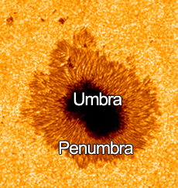
Sunspots
An individual sunspot contains a black center - the umbra (umbra = shadow)
Rimmed by a lighter region – the penumbra (paene = almost ; umbra = shadow)

Slide 37
Sunspots
During the 19th century it was believed that a tiny planet named Vulcan (SPOCKS home?) orbited between Mercury and the Sun
In the search for Vulcan an accurate record of sunspot occurrences was kept
Although the planet was never found (☹) the sunspot data showed that the number of sunspots on the solar disk varies in an 11 year cycle.

Slide 39
Sunspot cycles
First – the number of sunspots increases to a maximum (100 or more at one time)
Then over a period of 5-7 years, numbers decline to a minimum (few to none visible)
Cycle repeats about every 11 years

Slide 41
Prominences
Prominence (prominere = to jut out)
A spectacular features of the active Sun
Huge cloud-like structures
Consist of concentrations of chromospheric gases
Best observed on the “edge” of the Sun
Appear as bright arches that extend into the corona

Slide 43
Types of Prominences
Quiescent prominences – seem to hang motionless for days at a time
Photographs reveal that material within them actually falls like luminescent rain
Eruptive prominences – rise explosively
Reach speeds of 1,000 km/sec; may leave the Sun entirely

Slide 45
Solar Flares
Solar flares – brief outbursts that normally last an hour or so
Appear as a sudden brightening of the region above a sunspot cluster
During their existence, enormous quantities of energy are released across the entire the entire EM spectrum (much of it in the form of UV, radio, and X-ray radiation)

Slide 46
Solar Flare

Slide 47
Solar Flare
Fast-moving atomic particles are ejected from solar flares
These ejected particles cause the solar wind to intensify
Although a major flare could endanger a manned space flight, these are rare events
Within hours after large outbursts the ejected particles enter Earth’s ionosphere affecting radio communications

Slide 48
Solar Flares
The most spectacular effects of solar flares are the auroras (also called the Northern and Southern lights)
Following a strong solar flare Earth’s upper atmosphere is set aglow for several nights
These auroras vary in intensity with the 11-year sunspot cycle

Slide 53
CONCEPT CHECK
Answer these questions……………
Briefly describe the solar wind.
What did Galileo learn about the Sun from his observations of sunspots?
Briefly describe the 11-year sunspot cycle.
What are prominences?
How do solar flares affect the solar wind?

Slide 54
The Solar Interior

Slide 55
CONCEPT CHECK
Answer these questions………..
What is the source of the Sun’s energy?
What “fuel” does the Sun consume?
What happens to the matter that is consumed in the proton-proton chain reaction?

