Slide 1
The History of Earth
Earth Science Work-Text
Chapter 12

Slide 2
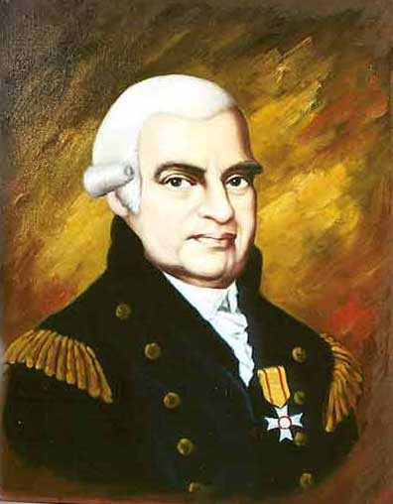
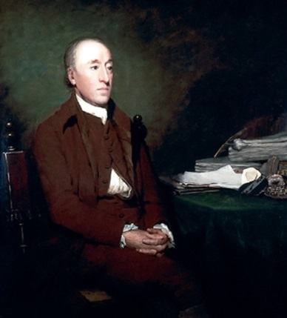
The Age of the Earth
19th century – believed to be 6,000 years old
Early challengers of this age:
Abraham Werner (German geologist)
James Hutton (Scottish geologist)
Hutton
Werner

Slide 3
Abraham Werner (1750-1817)
Noticed rocks arranged in layers (strata)
Suggested entire Earth covered by ocean
Mud settled on ocean floor- hardened to rock
Granite – heaviest rock on bottom
Bottom rock = oldest rock / granite is oldest
Younger rock = top layers
Concluded ALL rocks of Earth’s crust formed in the same way

Slide 6
James Hutton (1726 – 1797)
Disagreed with Werner’s theory about origin of granite
Thought granite was related to lava/volcanoes
Granite often in cracks of other layered rocks
Limestone in contact with granite had a “baked appearance (as if heated)
Concluded – magma forced into limestone, cooled, and then hardened into granite

Slide 8
AArizona

Slide 9
Agreement…..
People who accepted Hutton’s theory – also thought:
Rock particles were formed by erosion of preexisting rocks
When rock particles settle on ocean floor, they form layers of sedimentary rock
Hutton’s theory – formation of rock strata from sediments had taken many millions of years

Slide 10
Determining Earth’s Age
In 1850 – methods of estimating Earth’s age were very crude:
Estimating the rate at which sediments are deposited
Estimating the rate at which rocks erode, and
Estimating the time required for the oceans to become as salty as they are today

Slide 11
Estimating sedimentation…..
Using rate of erosion and rate of sedimentation – determined…….
Takes between 12,000 and 30,000 years to form about 1 meter (m) of sedimentary rock
Therefore – sedimentary rock 4 kilometers (km) thick would take about 50 million years

Slide 12
Estimating erosion rates…..
Geologists determined the Colorado River erodes the Grand Canyon at the rate of 1 m every 3,000 years
Currently the Grand Canyon is about 2,000 m deep
Therefore – Colorado River took about 6 million years to carve the Grand Canyon

Slide 14
Comparing total salts……
Comparison of total amount of salt in ocean today and amount of carried in yearly –
Estimate it took about 500 million years for oceans to reach current salinity of 3.5%
At this rate – Earth would have to be older than 6,000 years – at LEAST 500 million years old

Slide 15
Absolute Dating
Discovery of radioactivity and more modern instruments allows for more accurate age dating methods
Use of radioactivity to make accurate determinations of Earth’s age is called absolute dating.
Absolute dating compares amounts of radioactive material in a rock with the amount that has decayed into another element

Slide 16
Radioactive Elements
Most accurate method – studying radiation given off by atoms of radioactive elements
Radioactive elements are unstable
Unstable atoms continuously break down or decay (radioactive decay)
In radioactive decay different kinds of rays and particles , called radiations are emitted from atoms

Slide 17
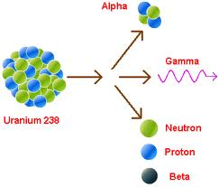

Slide 18
Parent / Daughter Elements
As a radioactive element decays, it changes into another element
Radioactive element that decays = parent element
New element that results from radioactive decay = daughter element
Example: radioactive decay of uranium-238 results in formation of lead-206

Slide 19
Radioactive Decay

Slide 20
Radioactive Decay
Rate at which a parent element decays into a daughter element is constant and not affected by heat, pressure, or ordinary chemical or physical reactions
Time required for one half of a given amount of a radioactive element to decay is called the half-life of that element
Example: half-life of uranium-238 is about 4.5 billions years, so after 4.5 billons years only half of an original block of uranium-238 in a rock would remain.

Slide 21
Uranium – 238 half life of 4.5 billion years….
After one half-life
has passed – half
is uranium-238 and
half is lead
After a second half-life(9 billion years)
has passed only one-fourth of the original
sample is still uranium -238, three-fourths
has decayed into lead.

Slide 22
Half-Life
Half-lives of radioactive elements range from milliseconds to billions of years
Uranium-238 (half-life of 4.5 billions years) is commonly used to calculate ages of very old rocks
Carbon-14 (half-life of about 5,700 years) is used to date fossils < 50,000 years old

Slide 23
Half-Life Graph

Slide 24
Uranium Dating
Comparing amount of lead-206 in a rock to amount of uranium-238, geologists can calculate the rocks age…..
Black Hills of North Dakota about 1.5 billion yrs
Rocks in northern Canada about 4 billion yrs
Earth must have existed before the oldest rocks, so Earth must be older than 4 billion years
Therefore, estimate of Earths age: 4.6 billion yrs

Slide 27
Carbon Dating
All plant and animal cells contain both carbon-12 (ordinary carbon) and carbon-14 in fixed proportions
When a plant or animal dies – carbon-14 in it begins to decay into nitrogen
Carbon-14 decays at a steady rate but the amount of carbon-12 does not change
Geologists measure the proportion of carbon-14 to carbon-12 (carbon dating) to calculate the age of the substance

Slide 28
Carbon Dating
Example: Suppose a geologist determined that half of the carbon-14 in a fossil had changed into nitrogen. The geologist could then infer that the fossil must be about 5,700 years old. (Carbon -14 half-life is 5,700 yrs)
Carbon -14 (radioactive carbon) is used to date fossils that range from about 1,000 yrs to 44,000 yrs old.
Dead Sea Scrolls – dated at 2,000 yrs old (written on parchment, an ancient writing material made out of animal skins)

Slide 29
Calculations Assignment
Math Skills Workbook
Calculating Half-Life

Slide 30
Half-Life “How-to”
At “0” time – full amount of parent is present
At time of “1” half life – 1/2 of parent remains
At time of “2” half lives –1/4 of parent remains
At time of “3” half lives - 1/8 of parent remains
At time of “4” half lives – 1/16 of parent remains
And so on…….

Slide 31
Half-Life “How to”
0.500 = 1/2 = 1 half life
0.250 = 1/4 = 2 half lives
0.125 = 1/8 = 3 half lives
0.0625 = 1/16 = 4 half lives
0.03125 = 1/32 = 5 half lives
Divide amount of daughter by parent to determine a ratio (0.5, 0.25, 0.125…) - tells you how many half lives have passed

Slide 32
Geologic Time and The Evolution of life
Geologists think:
Earth formed from
clouds of contracting gas
and dust particles in space

Slide 34
Geologic Time and The Evolution of life
Heavy meteor showers occurred early and often in earth’s history

Slide 36
Geologic Time and The Evolution of life
Original surface covered by molten material
Volcanic eruptions occurring regularly
Volcanic eruptions = gases formed Earth’s first atmosphere…..
CO₂, NH₄, CH₄, and H₂O vapor

Slide 38
Earth’s formation….
Surface cooled = original crust
Some elevated areas - some large basins
Water vapor in air cooled – condensing into raindrops
Rained continuously millions of years
Rain collected in the large basins to form ocean

Slide 40
Beginnings of Life
Living things evolved in early oceans – about 3 billion yrs ago
First life – single celled organisms- microscopic
After 100’s of millions of yrs larger, complex organisms evolved (worms, jellyfish) – soft body parts
Animals with hard parts (shells, bones) appeared much later
Next major group of animals were fish

Slide 41
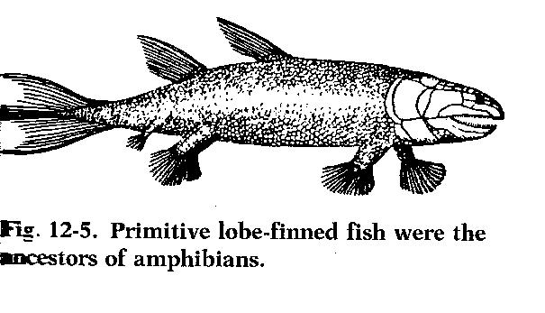

Slide 42
Primitive fish
First fish had gills – breathing underwater
Some gills evolved into lungs
Lungs allow ….
breathe air from atmosphere
Primitive fish evolved into amphibians (frogs, newts)

Slide 43
Amphibians
Have gills at birth –first part of life underwater
Lungs develop as they grow – can live on land
However, amphibians MUST lay their eggs in water
Some amphibians evolved into reptiles
Some reptiles evolved into birds & mammals

Slide 44
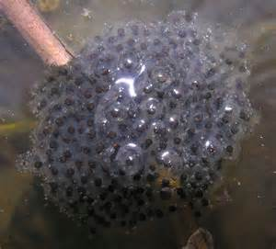

Slide 45
Fossils
Evidence of extinct plants and animals – found in sedimentary rocks = fossils
A fossil is the remains or trace of an ancient organism that has been preserved naturally in Earth’s crust.

Slide 47
Fossils in Rocks
Virtually NONE in igneous rocks
Few found in metamorphic rocks
Usually found in sedimentary rocks.
Oldest known fossils – traces of 3.5 billion year old bacteria
Fossils indicate :
Form and behavior, as well as how it became a fossil

Slide 48
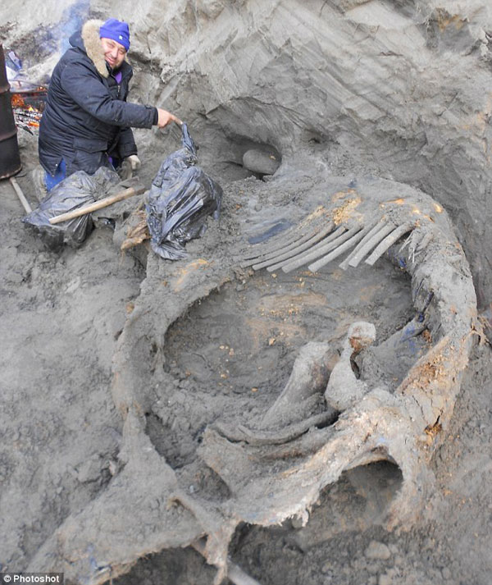
Fossils in Ice
Soft animal parts are often preserved in ice. Wooly mammoths lived during the last Ice Age, about 15,000 years ago.

Slide 49
Fossils in Tar
Some of best preserved animal remains discovered in tar pits (La Brea tar pits in Los Angeles California)
When animals fell in – they could not get out
Bones of the extinct saber-toothed cat were found in the tar pits

Slide 50
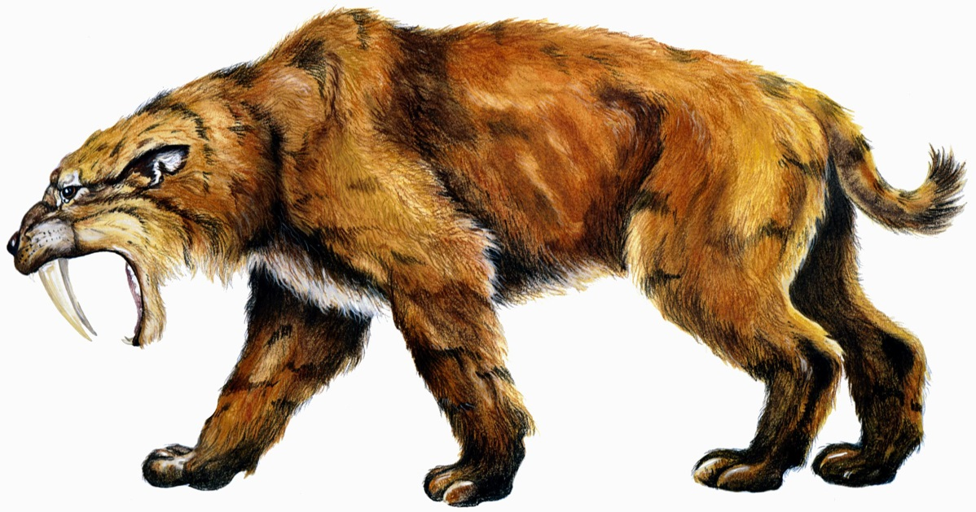

Slide 51
Fossils in Amber
Pine trees produce sticky substance - resin
Resin hardened and turned into amber (or fossil resin)
Millions of years ago, insects sometimes became trapped in this hardening resin

Slide 52
Praying Mantis in Amber

Slide 53
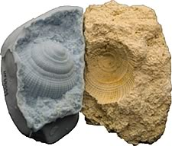
Fossil Molds and Casts
Mold
When bones and shells dissolve completely -may leave a mold of the shape of the organism
Molds often filled with sediments (or minerals) that harden - a cast of the original organism
Cast

Slide 54
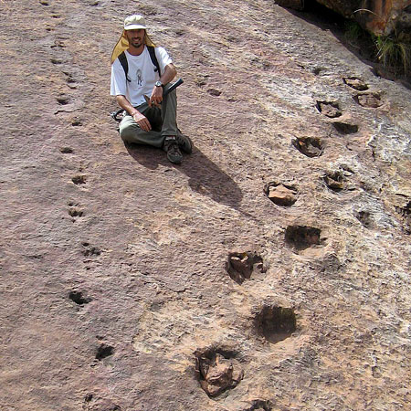
Fossil Tracks
When birds or other animals walk over mud they leave tracks or footprints
Mud hardens into stone – imprints remain and become fossilized

Slide 55
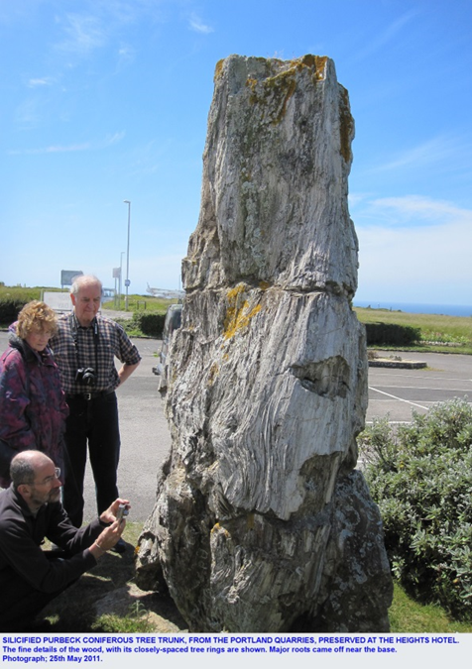
Replaced Fossil Remains
Fossils that have different composition from the living specimen are called replaced remains
Petrified trees original wood has been changed to stone (or petrified)

Slide 56
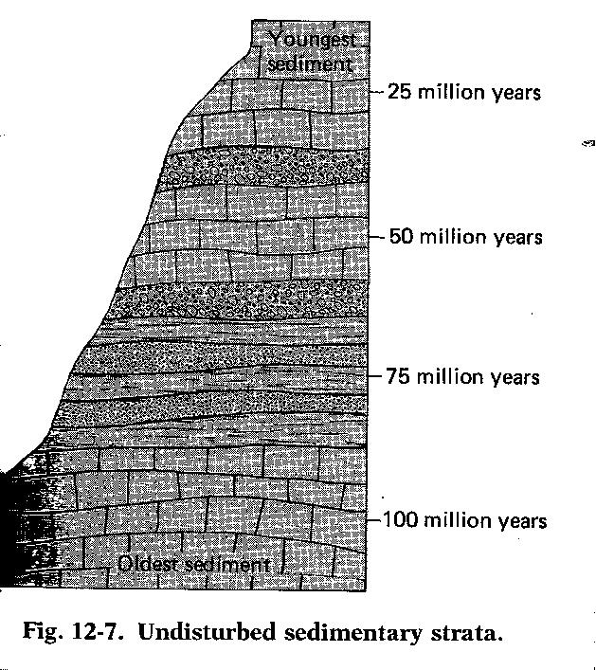
Fossil Record
Principle of Superposition – When sedimentary rock strata are not disturbed by natural forces, the oldest strata are on the bottom and more recent strata are on top.
Using this principle, geologists determine relative ages of undisturbed sedimentary rock strata and fossils in them

Slide 57
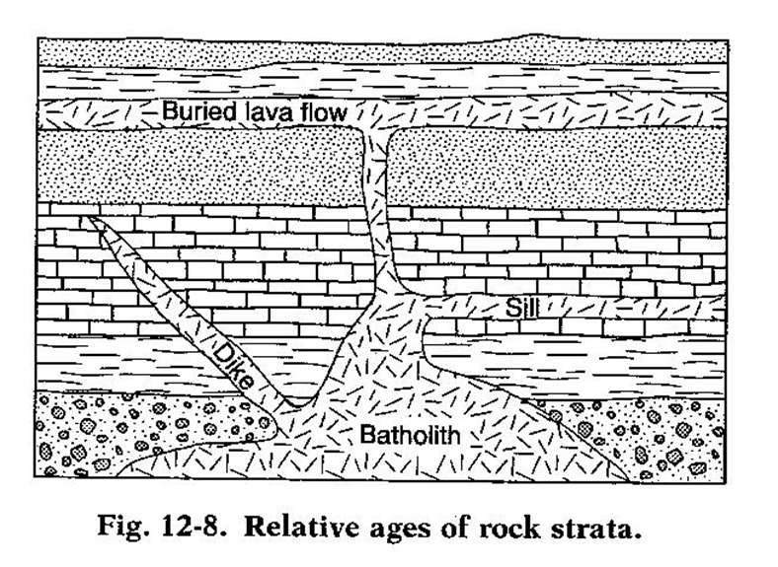
Geologic Time
Igneous rock masses called batholiths, dikes, sills, and lava flows indicate the relative age of sedimentary rock and fossils.
Any intrusive igneous body is younger than the sedimentary strata that it intrudes

Slide 58
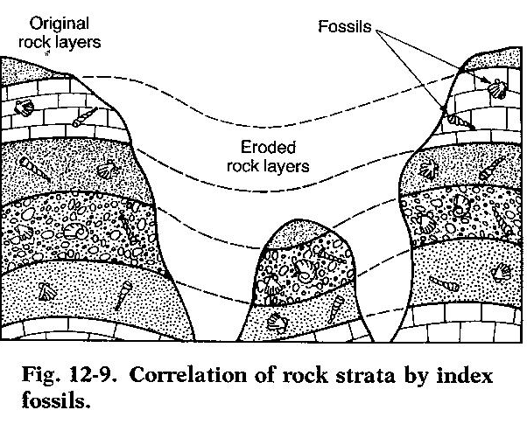
Index Fossils
Fossils most useful in dating strata of rock are called index fossils

Slide 59
Precambrian Time
Most of earth’s history
Little known about this time
Comprised of:
Proterozoic Eon
Archean Eon
Hadean Eon

Slide 60
Paleozoic Era – 570 mya
Divided into three ages:
Age of invertebrates
Animals with No backbones
Dominate life - trilobites
Age of Fishes
First animal WITH backbone
Plants also appeared here
Age of Amphibians
Earliest frogs, toads, salamanders
END OF PALEOZOIC – Trilobites became extinct

Slide 61
Mesozoic Era – 245 mya
Age of Reptiles
Dinosaur dominant life form
“Cousins” of dinos = snakes, turtles, lizards
Birds likely evolved from dinosaurs
END OF MESOZOIC – Dinosaurs became extinct

Slide 63
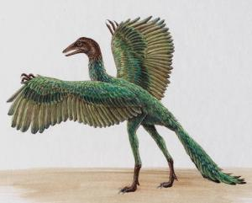

Slide 64
Cenozoic Era – 65 mya
Most recent era of Geologic time
Age of Mammals
Small mammals in Mesozoic
Larger – dominant species in Cenozoic
Mammals:
Have hair or fur
Mothers provide milk for their young
END OF LAST ICE AGE IN EARLY CENOZOIC – Larger mammals extinct

Slide 65
Human Beginnings
Apelike humans - australopithecines
about 1-4 million yrs ago
Homo habilis – 1.5 million yrs ago
Homo erectus – 1 million to 500,000 yrs ago
First “true” humans – Homo sapiens – 200,000 yrs ago (Neanderthals)
More modern Homo sapiens – 35,000 yrs ago (Cro-Magnons – good hunters/fishers)

Slide 66
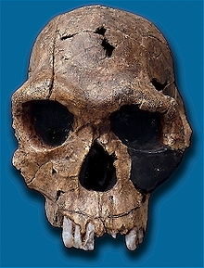
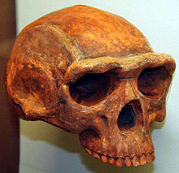
australopithicenes
Homo habilis
Homo erectus

Slide 67
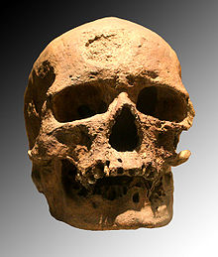
Homo sapiens - Neanderthal
Homo sapiens – Cro-Magnon

