Slide 1
Rocks in Earths Crust

Slide 2
How rocks were formed
Igneous Rocks – form as molten material cools
Sedimentary Rocks – form when particles of sand, silt, and clay are transported and deposited by moving water
Metamorphic Rocks – form by rocks that have been changed from their original form by heat, pressure or chemical action
Rocks – are composed of minerals (either only one or a combination of minerals)
Two of the most common minerals: quartz and feldspar
Other common minerals in rocks: mica, augite, and hornblende

Slide 3
Igneous Rocks
Inside earth – molten rock is called magma
Molten material on the surface – called lava
Rocks characterized by texture (size, shape, and arrangement of particles in rock)
Magma cooling slowly = larger crystals in the rock
Rocks with large crystals – coarse-grained texture
Rock example: granite
Lava cooling quickly = small crystals in rocks
Rocks with small/no crystals – fine-grained texture
Rock example: basalt
Rocks cooling TOO quickly to form crystals = glassy texture
Rock example: obsidian (“volcanic glass”)

Slide 4
Igneous Rocks
Gabbro and Basalt
Diorite and Andesite
Granite (left) and
Rhyolite (right)

Slide 5
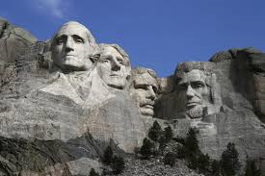
Light-colored igneous rocks
Light-colored rocks – consist mainly of minerals quartz and feldspar
Main difference is crystal size
Granite – usually pink or gray in color
Pumice – lightweight, sponge-like rock full of holes
Pegmatite – similar to granite but with larger crystals
Mount Rushmore National Monument in
South Dakota – is carved out of granite.

Slide 6
Dark-colored igneous rocks
Minerals – feldspar, augite, olivine
Rocks – basalt, diabase, gabbro,
Basalt and diabase – referred to as traprock
Basalt – dark color caused by dark minerals; most abundant igneous rock
- small mineral grains
Diabase – similar to basalt but with coarser texture
Gabbro – coarsest grained of the dark-colored rocks (“black granite”)

Slide 7
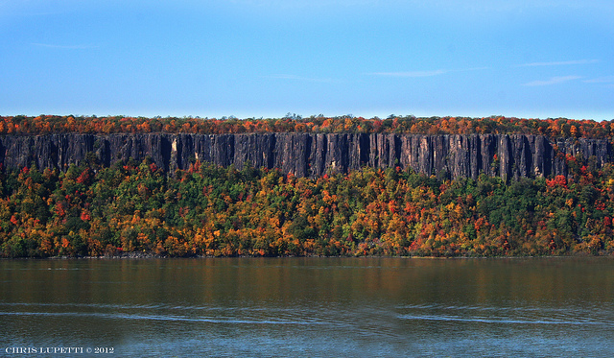
allli
Large lava deposit of basalt
Pallisades – along the Hudson River
consist largely of diabase

Slide 8
Sedimentary rocks
Particles (sediments) originate in three ways:
- weathering action of water, wind, and ice
- water dissolution of minerals
- organic sediments settled to ocean floor

Slide 9
Sedimentary form from rock fragments
Weathering –causes loose particles to collect at the base of mountains

Slide 10
Layers of sedimentation

Slide 11
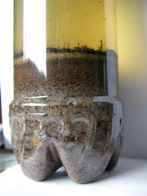
Rock fragments
Rock fragments are categorized by size:
- larger than 25 cm = boulders; then by
decreasing order…….
- cobbles, pebbles, gravel, sand, silt, and clay
Larger particles – carried short distances
Smaller particles – carried longer distances
- by water, and wind
Larger, heavier particles – first to settle out
and be deposited

Slide 12
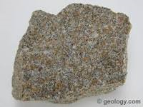
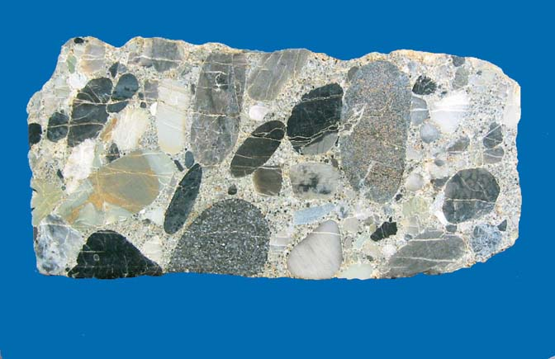
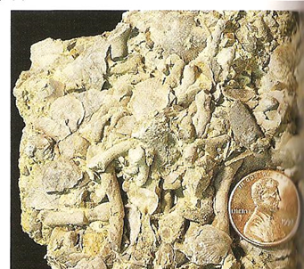
Classifying sedimentary rocks
Sorting of particles results in two types of sedimentary rocks:
- chemical
- organic
Most common types: sandstone,
shale, and conglomerate
Sandstone
Fossiliferous
Limestone
Conglomerate

Slide 13
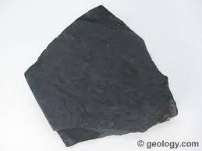
Sedimentary Rocks
Sandstone – contains grains of quartz sand
– feels gritty
- large spaces between sand grains
- very porous
Shale – composed of clay and silt
- resembles hardened mud
Conglomerate – one of the easiest sediment rocks to identify …….
– made of round pebble-sized fragments
Shale

Slide 14
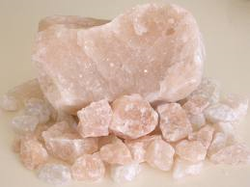
Rocks formed by chemical action
Rain seeping into the crust dissolves minerals from rocks
Dissolved minerals carried by running water to oceans and other bodies of water
When water evaporates, the dissolved minerals may separate and re-solidify
Solid matter formed in this way is called chemical sediment
Most common sedimentary rocks formed by chemical action are limestone, gypsum, and rock salt
Rock Salt

Slide 15
Dissolution of Minerals

Slide 16
Evaporites

Slide 17
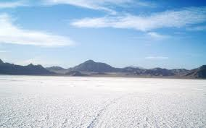
Rocks Formed by chemical action
Bonneville Salt Flats
In Utah – Rock Salt
White Sands New Mexico
Gypsum

Slide 18
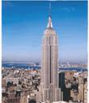
Limestone
Consists mainly of calcium carbonate (or calcite)
Limestone is easily identified by performing an acid test:
- bubbles of carbon dioxide gas appear on the surface of limestone when drops of dilute hydrochloric acid or vinegar are placed on it
Limestone is widely used for buildings
The Empire State Building in New York City and the Pentagon in Washington DC are both built with large amounts of limestone.

Slide 19
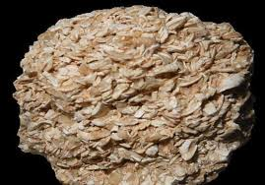
Rocks formed from organic materials
Rocks that form from the piling up of remains of plants and animals are called organic sedimentary rocks
Among the most important of these are organic limestone and coal
Three different organic limestones are:
coquina, chalk, and coral limestone
Coquina – made up of loosely cemented shell fragments. Common along the Florida coast.

Slide 20
Chalk – White Cliffs of Dover in England
Chalk consists of the shells of billions of microscopic
organisms that piled up in deep layers on the ocean
floor over thousands of years.

Slide 21
coal
The remains of dead plants and animals are the sources of coal. Coal is made up mainly of the element carbon

Slide 22
Formation of coal
Major stages in the formation of coal are:
Peat formation
Lignite formation
Bituminous coal formation
Anthracite coal formation

Slide 23
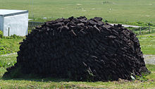
Peat formation
First stage of coal formation –
Remains of plants become peat.
Peat - loosely packed, brownish -decayed leaves, twigs, and other plant parts.
Carbon content of peat avg about 55 %
Peat stack in Scotland

Slide 24
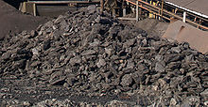
Lignite formation
Further decay compression of peat = lignite, or brown coal.
Lignite - harder and more compressed than peat.
Carbon content avg about 73 %.
Lignite Coal

Slide 25
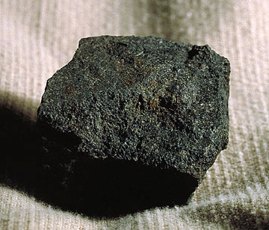
Bituminous coal formation
Changes in lignite = bituminous, (soft coal)
Bituminous coal is black.
Carbon content about 83 %.
Bituminous Coal

Slide 26
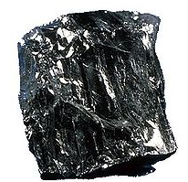
Anthracite coal formation
Continued heat and pressure = anthracite, or hard coal.
Carbon content avg about 94 %,
Higher Carbon makes it a better fuel than peat, lignite, or bituminous coal.
*(Because of the changes it has undergone, anthracite is classified with the metamorphic rocks)
Anthracite Coal

Slide 27
Oil and natural gas
Ancient sea plants and animals - source of today’s deposits of petroleum and natural gas.
Remains of these tiny organisms settled on the bottoms of seas and swamps
They mixed with sediments to form deposits
Chemical reactions changed these remains into oil and natural gas
Eventually oil collected in open spaces of sandstone or in cracks of limestone
Today these bodies of trapped oil are called reservoirs (or pools of oil)
Underground structures where oil has accumulated are called traps
When an oil drill breaks into a deposit of oil, pressure of natural gases forces the oil up the drilled hole - a gusher

Slide 28
Metamorphic rocks
Rocks changed in form or composition as a result of high temperatures or great pressures
Metamorphism – the process of this change
Reasons Rocks change - because:
- large sections of Earth’s crust moving sideways may fold and/or break
- molten materials may flow through breaks in the crust
Metamorphic rocks classified into two groups:
- foliated (leaf-like) rocks
- consist of compressed, parallel bands of minerals (look striped)
- unfoliated rocks
- these are not banded

Slide 29
Foliated metamorphic rocks
Common foliated rocks are slate, schist, and gneiss
Slate – formed from compressed shale
- highly foliated – splits easily into thin smooth slabs
- used for roofs, sidewalks, billiard tables, and chalkboards
- occurs in many colors: black, blue, green, and red
Schist – formed from continued metamorphism of slate; or metamorphism of basalt
- very thin, parallel bands or flakes, of minerals
- several types, named for the most abundant mineral
(Example: mica schist has LOTS of mica, talc schist has more talc)

Slide 30
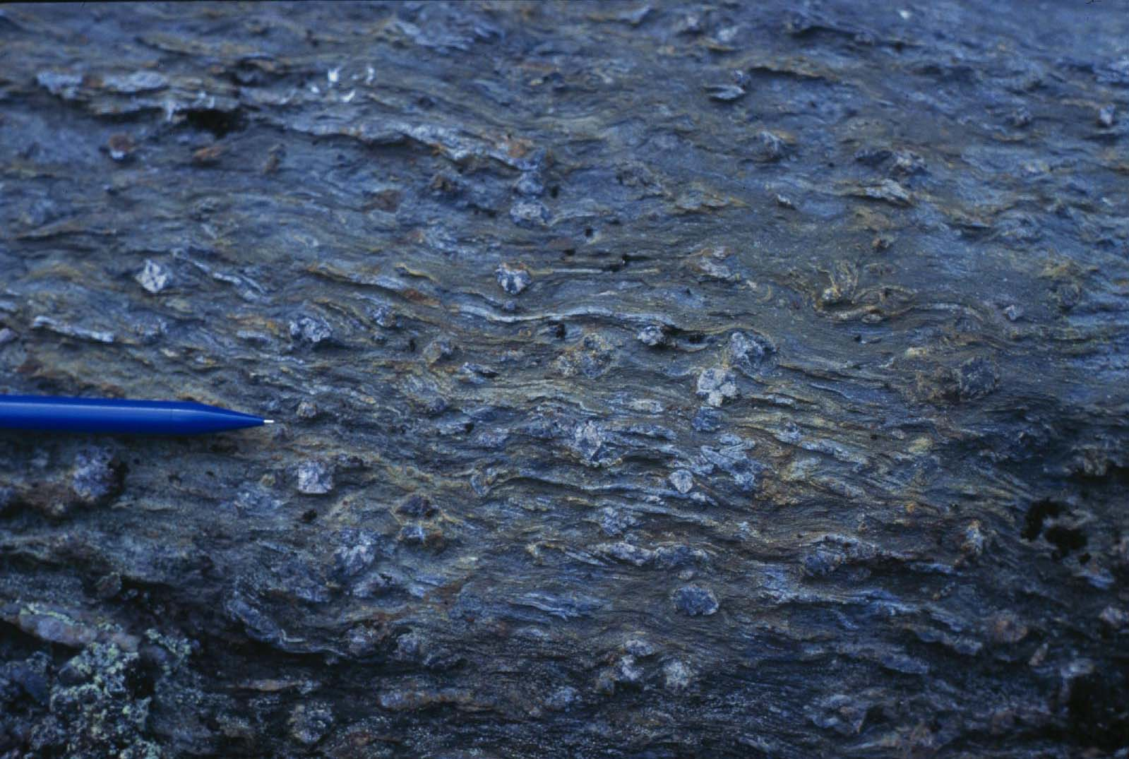
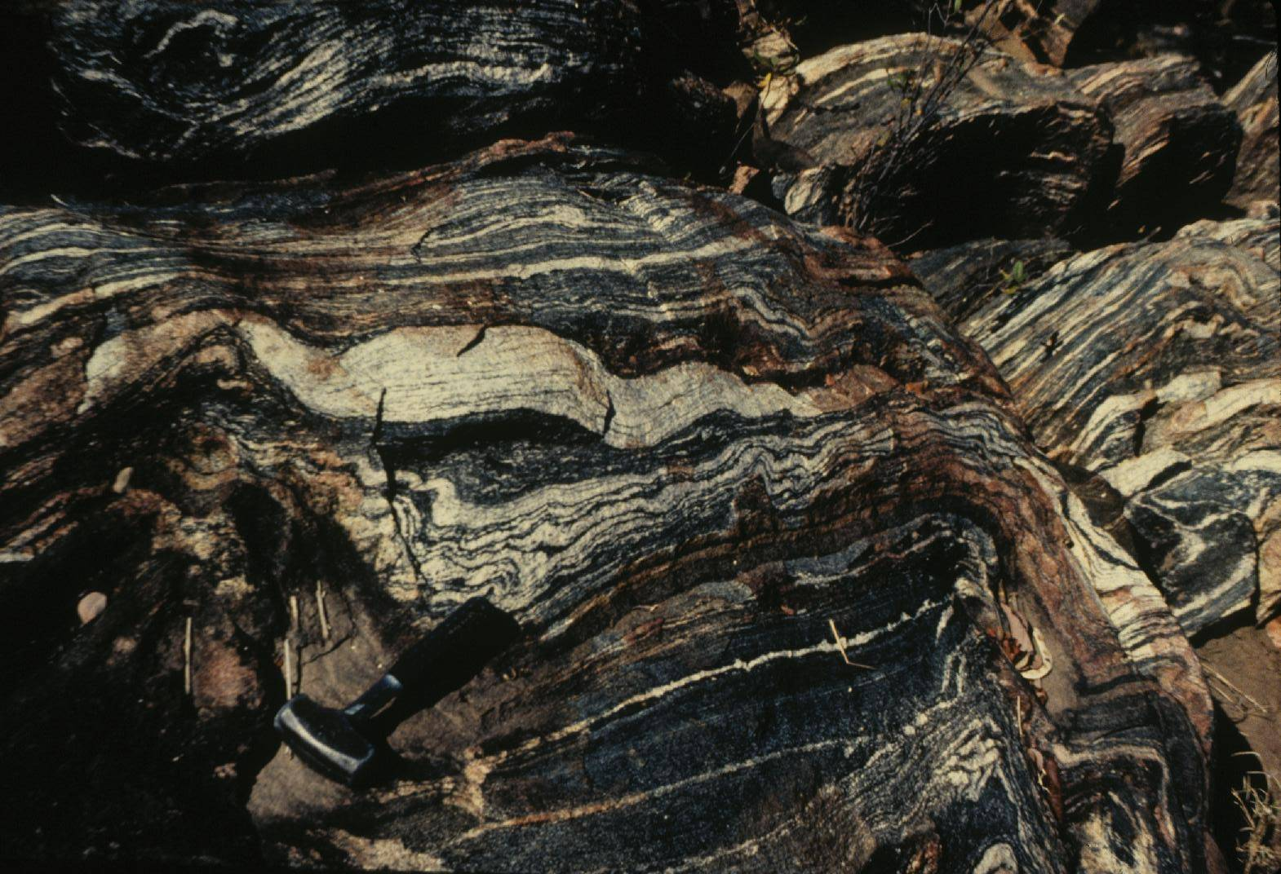
Schist
Gneiss

Slide 31
Foliated metamorphic rock
Gneiss – formed from further metamorphism of schist or the metamorphism of granite
- minerals appear in parallel bands
- bands are much thicker than schist
- often used as building stone

Slide 32
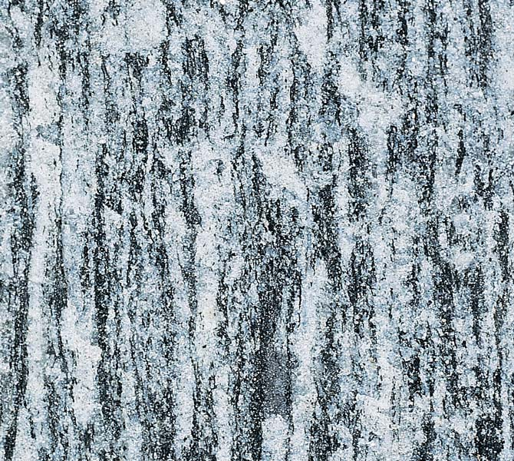
Foliated metamorphic rocks
granite
Metamorphism →
gneiss

Slide 33
Unfoliated metamorphic rocks
Quartzite – when quartz sandstone metamorphoses
- very hard and durable
- resembles sandstone (BUT – is not porous)
- not used for building stone as it is full of cracks
Marble – limestone that undergoes metamorphism
- harder, coarse, and more crystalline than limestone
- occurs in many colors
- used for sculptures and monuments
Anthracite – metamorphosed bituminous coal
- greater pressures may even change the anthracite into graphite

Slide 34
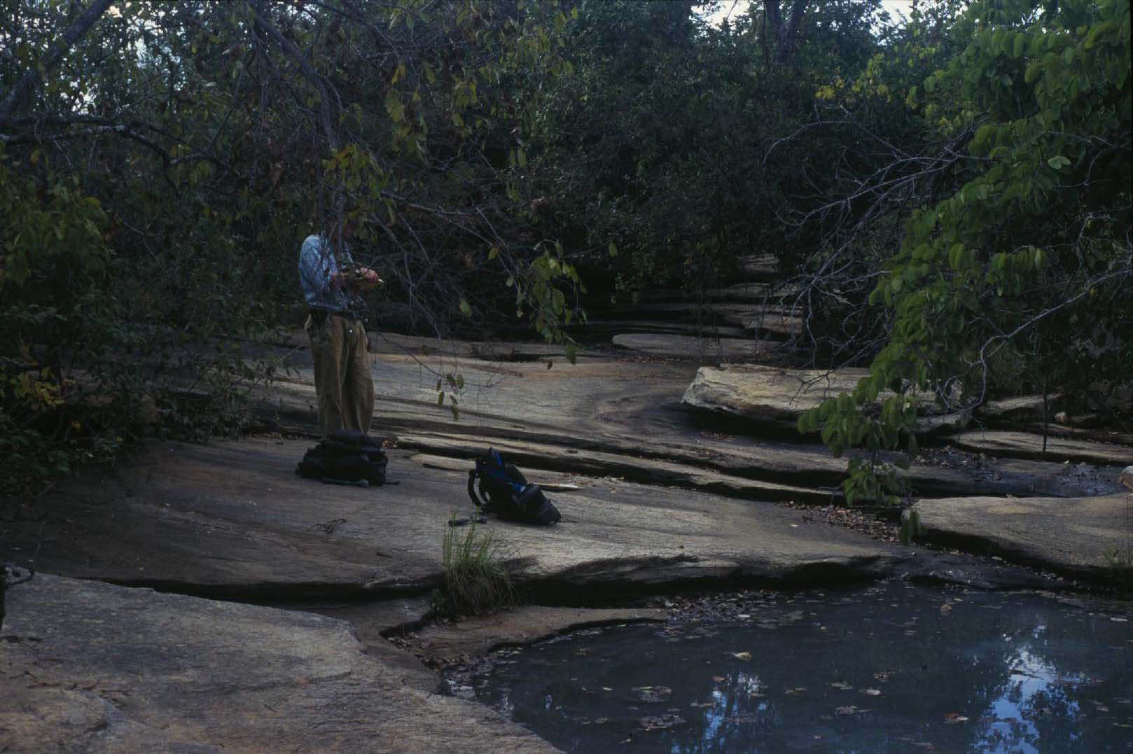
Quartzite
Marble

Slide 35
Metamorphism of five common rocks
Source rock
Metamorphic rock
Shale -→ | Slate -→ | Schist → | Gneiss
Sandstone → | -----------------------→ | -----------------------→ | Quartzite
Limestone → | -----------------------→ | ----------------------→ | Marble
Basalt → | ----------------------→ | ----------------------→ | Schist
Granite → | ----------------------→ | ----------------------→ | Gneiss
----------------------> Increasing heat, pressure. and time ------------------------ >
---------------

Slide 37
Rock cycle
Three types of rocks are continually being created, changed, and destroyed, and created anew.
This process is called the Rock Cycle
Another important material than comes from rocks is topsoil.
- a mixture of rocks particles and the remains of plants and animals
- Topsoil provides the environment in which plants live and grow
Life on Earth would be impossible without topsoil…….but that’s for another day ☺

