Slide 1
Rocks
Materials of the Lithosphere

Slide 2
Objectives (1)
Diagram and discuss the rock cycle
List the geologic processes involved in the formation of each rock group
Briefly explain crystallization of magma
List the criteria used to classify igneous rocks
List the names, textures, and environments of formation for the most common igneous rocks
Discuss the origin of materials that accumulate as sediment
List the criteria used to classify sedimentary rocks

Slide 3
Objectives (2)
Explain the difference between detrital and chemical sedimentary rocks
List the names, textures, and environments of formation for the most common sedimentary rocks
List the common features of sedimentary rocks
Describe the agents of metamorphism
List the criteria used to classify metamorphic rocks
List the names, textures, and environments of formation for the most common metamorphic rocks
Discuss metallic and nonmetallic mineral resources

Slide 4
Rock Cycle
Shows relations among the 3 rock types
Proposed by James Hutton – late 1700’s
Cycle:
Magma
crystallization
Igneous rock
weathering, transportation, deposition
Sediment
lithification
Sedimentary rock
metamorphism
Metamorphic rock
melting
Magma

Slide 5
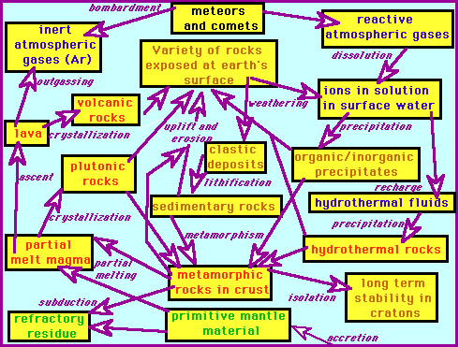
Rock Cycle

Slide 6
Rock Cycle
Full cycle does not always take place due to “shortcuts” or interruptions
For example:
Sedimentary rock melts
Igneous rock is metamorphosed
Sedimentary rock weathers
Metamorphic rock weathers

Slide 7
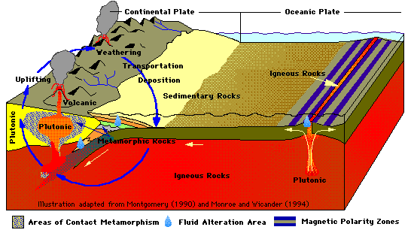
Rock Cycle

Slide 8
Igneous Rocks
Form as magma cools and crystallizes
Rocks formed inside Earth
Mineral crystals cool slowly
Called plutonic or intrusive rocks
Rocks formed on surface
Minerals cool quickly
Called volcanic or extrusive rocks

Slide 9
Igneous Rock - Crystallization of Magma
Ions are arranged in orderly patterns
Crystal size determined by rate of cooling
Slow rate forms large crystals
Fast rate forms microscopic crystals
VERY fast rate forms glass

Slide 10
Igneous Rock – Classification
Classification based on rock’s texture and mineral composition
Texture:
Size and arrangement of crystals
Types
Fine-grained – fast rate of cooling
Coarse-grained – slow rate of cooling
Porphyritic – two crystal sizes; two rates of cooling
Glassy – very fast rate of cooling
Mineral composition:
Explained by Bowen’s Reaction Series
Shows the order of mineral crystallization
Influenced by crystal settling in the magma

Slide 11
Igneous Rock – Naming
Basaltic Rocks
Derived from the first minerals to crystallize
Rich in iron and magnesium
Low in silica
Common rock is basalt
Granitic Rocks
From the last minerals to crystallize
Mainly feldspar and quartz
High silica content
Common rock is granite

Slide 12
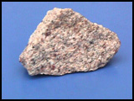
Granite

Slide 13
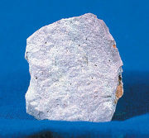
Rhyolite

Slide 14
Sedimentary Rocks
Form from sediment
Weathered products
Form about 75% of the rock outcrops on the continents
Used to construct much of earth’s history
Clues to past environments
Provide information about sediment transport
Rocks often contain fossils
Economic importance
Coal
Petroleum and natural gas
Sources of iron and aluminum

Slide 15
Sedimentary - Classification
Two groups based on source of material
Detrital rocks
Material is solid particles
Classified by particle size
Common rocks:
Shale (most abundant), sandstone, conglomerate, siltstone
Chemical rocks
Derived from material once in solution and precipitates to form sediment
Directly precipitated or
Through life processes (biochemical origin)

Slide 16
Sedimentary – Chemical Rocks
Common Chemical Sedimentary Rocks
Limestone
Most abundant chemical rock
Travertine
Microcrystalline quartz
Chert
Flint
Jasper
Agate
Evaporites
Rock salt
Gypsum
Coal
Lignite
Bituminous

Slide 17
Sedimentary - Lithification
Lithification – the process of forming rock
Loose sediments are transformed into solid rock
Lithification processes
Compaction
Cementation by the materials
Calcite
Silica
Iron oxide

Slide 18
Sedimentary Rock Features
Strata (or beds) most characteristic
Bedding planes separating strata
Fossils
Traces or remains of prehistoric life
Most important inclusion
Help determine past environments
Used as time indicators
Used for matching rocks from different places

Slide 19
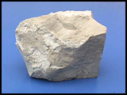
Limestone

Slide 20
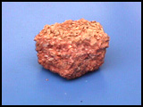
Conglomerate

Slide 21
Metamorphic Rocks
“Changed form” rocks
Can form from
Igneous rocks
Sedimentary rocks
Other metamorphic rocks
Degrees of metamorphism
Shown in the rocks texture and mineralogy
Types
Low-grade metamorphism (shale becomes slate)
High-grade metamorphism (causes the original features to be obliterated)

Slide 22
Metamorphic Settings
Regional metamorphism
Over extensive areas
Produces the greatest volume of metamorphic rock
Contact metamorphism
Near a mass of magma
“Bakes” the surrounding rock

Slide 23
Metamorphic Agents
Heat
Pressure
From burial
From stress
Chemically active fluids
Water (most common fluid)
Ion exchange among minerals

Slide 24
Metamorphic Textures
Textures
Foliated
Minerals in parallel alignment
Minerals perpendicular to the force
Nonfoliated
Contain equidimensional crystals
Resembles a coarse igneous rock

Slide 25
Metamorphic Classification
Based on texture
Two groups – foliated and nonfoliated
Foliated rocks
Slate
Fine-grained
Splits easily
Schists
Strongly foliated
“Platy”
Types based on composition (example: mica schist)
Gneiss
Strong segregation of silicate minerals
“Banded” texture

Slide 26
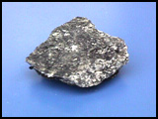
Schist

Slide 27
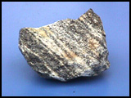
Gneiss (pronounced “nice”)

Slide 28
Metamorphic Classification (2)
Nonfoliated
Marble
Parent rock – limestone
Calcite crystals
Used as a building stone
Variety of colors
Quartzite
Parent rock – quartz sandstone
Quartz grains are fused

Slide 29
Rock and Mineral Resources
Metallic and nonmetallic mineral resources
Metallic resources:
Examples: Gold, silver, copper
Produced by
Igneous processes
Metamorphic processes
Hydrothermal (hot-water) solutions
Hot
Contain metal-rich fluids
Associated with cooling magma bodies
Types
Vein deposits occur in fractures or bedding planes
Disseminated deposits are distributed throughout the rock

Slide 30
Rock and Mineral Resources
Nonmetallic mineral resources:
Make use of the materials
Nonmetallic elements
Physical or chemical properties
Two broad groups
Building materials
Example: limestone, gypsum
Industrial minerals
Example: Flourite, corundum, sylvite

Slide 31
Key Terms
Chemical sedimentary rock
Coarse-grained texture
Contact metamorphism
Crustallization
Detrital sedimentary rock
Disseminated deposit
Evaporite deposit
Extrusive (volcanic)
Fine-grained texture
Foliated texture
Glassy texture
Hydrothermal solution

Slide 32
Key Terms
Igneous rock
Intrusive (plutonic)
Lava
Lithification
Magma
Metamorphic rock
Nonfoliated
Porphyritic texture
Regional metamorphism
Rock cycle
Sediment

Slide 33
Key Terms
Sedimentary rock
Strata (beds)
Texture
Vein deposit

