Slide 1
Oceans
Physical and Chemical Oceanography

Slide 2
The World Ocean
Topics to cover………….
Composition of ocean water
Temperature of ocean water
Effect of the ocean on climate
The ocean floor
Movements of ocean water
Effects of the ocean on the shoreline
Future of the ocean

Slide 3
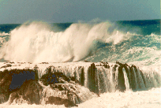
Physical Oceanography
How and why ocean currents flow, air-sea interactions such as the generation of waves by the wind.

Slide 4
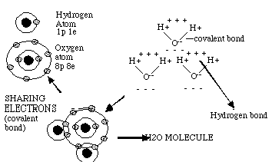
Chemical Oceanography
Composition of sea water and the processes controlling and altering its composition, including marine pollution.

Slide 5
The Hemispheres of the Earth
Northern Hemisphere is approximately 39% land.
The Southern Hemisphere is approximately 19% land.

Slide 6
The World Ocean
Covers about 71% of Earth’s surface
Subdivided into 5 smaller bodies also called oceans: (in order of size)
Pacific Ocean – world’s largest ocean
Atlantic Ocean
Indian Ocean
Antarctic Ocean
Artic Ocean

Slide 7
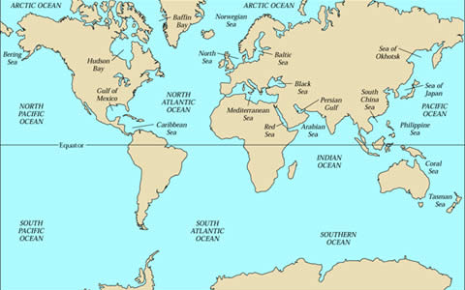
Earth’s Oceans and Seas

Slide 8
The World Ocean
Ocean floor lies farther below sea level than the continents rise above sea level
average depth of ocean floor is about 4 kilometers below sea level; average height of the continents is about 0.8 km above sea level
Deepest part of the world ocean is the Mariana Trench (in Pacific Ocean)
- the bottom of the Mariana Trench is almost 11 km below sea level; top of the highest mountain on land (Mr. Everest) is about 8.8 km above sea level

Slide 9
Composition of Ocean Water
Dissolved solids
75% of salt is sodium chloride; remainder consists of other salts (MgCl and Mg SO4)
Weight of salts in a given volume of water is a measure of salinity
Average salinity about 35% (One kg of seawater contains about 35 grams of salts)
Gold, silver, uranium, and iodine are a few other solids also found in seawater (in small amounts)

Slide 10
Most Abundant Salts in Seawater
Salts | Approximate weight by percent
Sodium chloride, NaCl | 2.70
Magnesium chloride, MgCl2 | .38
Magnesium sulfate, MgSO4 | .17
Calcium sulfate, CaSO4 | .13
Potassium sulfate, K2SO4 | .08
Calcium Carbonate, CaCO3 | .01
Magnesium bromide, MgBr2 | .008

Slide 11
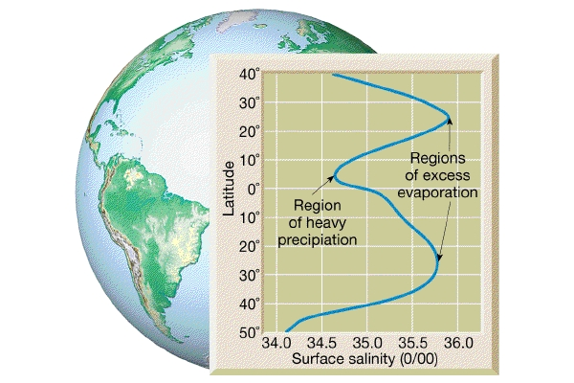

Slide 12
Composition of Ocean Water
Dissolved gases
Gases include nitrogen, oxygen, and carbon dioxide
Dissolved oxygen and dissolved carbon dioxide in seawater are important for survival of ocean organisms (fish, lobsters, clams, seaweed, algae)

Slide 13
What is Ocean Water Composed of?

Slide 14
Temperature of Ocean water
Temperature varies with depth and latitude
Fairly uniform to a depth of 90 meters
This results from surface winds churning the warm, upper layers of water
From a depth of about 90 m to 900 m, at the equator, temperature falls rapidly
In general, surface temperature of ocean water becomes gradually colder traveling from the equator to either pole

Slide 15
Ocean Temperature at the Equator
Zone | Depth (meters) | Temperature (Celsius)
Surface layer | 0 | 25 degrees
Zone of rapid change In temperature | 90 300 600 900 | 24 15 10 5
Zone of gradual change in temperature | 1200 1500 1800 | 4 4 4
Zone of deepest water | Below 1800 | Just above freezing point of seawater
Pure water freezes at 0 degrees, because of dissolved salts, seawater freezes at about -2

Slide 16
Temperature of Ocean Water
Temperature of surface water at the equator may be as high as 33⁰C
Surface water at the poles may be as low as ----2⁰C (close to freezing)
Temperature of surface water changes throughout the year

Slide 17
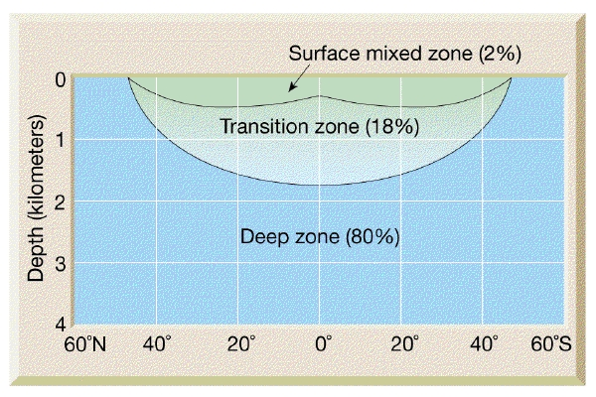
Our Layered Oceans
Surface mixing zone is warmest; saltiest near bottom of zone.
Transitional zone contains thermocline and halocline.
Deep zone is 2 tons per square inch and coldest in temperature.

Slide 18
Effect of the Ocean on Climate
Large bodies of water greatly influence the average temperature of nearby coastal regions
Water ….
absorbs heat slowly
holds heat well, and
gives off heat slowly
In winter, water acts like a radiator; in summer like an air conditioner

Slide 19
Salinity
Remember, in general, the following are true:
Surface salinities increase near the 20-degree latitudes in the Atlantic and Pacific Oceans.
Salinities decrease with depth at the halocline near the equator and the Tropics, but increase at high latitudes where there is no halocline.

Slide 20
Halocline
In oceanography, a halocline is a subtype of chemocline caused by a strong, vertical salinity gradient within a body of water.
Because salinity (with temperature) affects the density of seawater, it can play a role in its vertical stratification.
This Increase in salinity by one kg/m³ results in an increase of seawater density of around 0.7 kg/m³

Slide 21
Salinity
Remember, in general, the following are true:
(continued)
Temperature and density are mostly inversely proportional to each other.
Temperatures in the oceans drop at the thermocline except for at high latitudes where they remain constant.

Slide 22
Thermocline
A thermocline is a thin but distinct layer in a large body of fluid in which temperature changes more rapidly with depth than it does in the layers above or below.
In the ocean, the thermocline may be thought of as an invisible blanket which separates the upper mixed layer from the calm deep water below.

Slide 23
Ocean Floor

Slide 24
The Ocean Floor
Exploring the ocean floor
Sailors sounded (determined ocean depth) by dropping a measured line with weight tied to it over the side of a ship
Today, oceanographers use echo sounding
Sends out sound waves through the water
Bathyscaphs – submarines specially built to explore the ocean floor

Slide 25
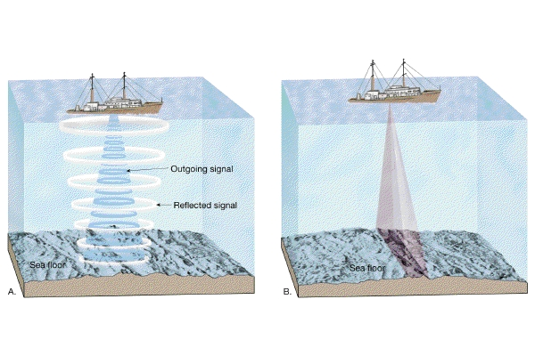
Echo Sounding Used for Mapping Ocean Floor

Slide 26
Ocean Floor
Probably have accurately mapped only 5% of the ocean floor.
Currently also using dense satellite altimeter measurements to construct a uniform resolution map of the seafloor topography.
These maps do not have sufficient accuracy and resolution to be used to assess navigational hazards but they are useful for such diverse applications as locating the obstructions/constrictions to the major ocean currents and locating shallow seamounts where fish and lobster are abundant.

Slide 27
Satellite Mapping

Slide 28
Ocean Topography
*Oceanographers studying the oceans and ocean floor have delineated three (3) major units:
1. Continental margin
2. Ocean basin floor
3. Mid-oceanic ridges

Slide 29
Continental Margin
The continental margin includes:
Continental shelf -- very gentle slope (submerged
land)
Continental slope -- steep slope on edge of continental shelf.
Continental rise -- gentle slope where trenches do not exist
Deep sea fans exist where sediment is accumulated and falls off of the continental slope.
Mixture of sediment-laden heavy water forms submarine turbidity currents.

Slide 30
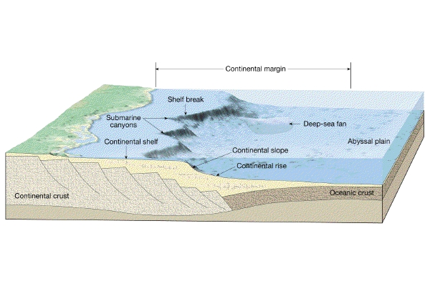
Ocean Topography
Seamount

Slide 31
What else is at the bottom of the ocean?
Answer: Hydrothermal vents …a.k.a…
Black smokers!

Slide 32
Oceanic zones
The oceanic zone is subdivided into several zones:
Euphotic (photic) zone
Disphotic
Aphotic zone

Slide 33
Euphotic Zone
Also called photic or sunlit zone
receives enough sunlight to support photosynthesis
temperatures range anywhere from 40 to −3 °C

Slide 34
Coral Reefs and Atolls
Reefs - develop usually in relatively shallow water
where light is present
organisms can thrive on nutrients and food sources in a warm water setting
Atolls develop in response to a sinking of the oceanic crust.

Slide 35
Disphotic Zone
Where only small amounts of light penetrate
lies below the euphotic zone
referred to as Twilight Zone (scarce amount of light)
temperatures range from 4 to 5 °C
pressure higher, can be up to 1,470 psi (10,100,000 Pa) and increases with depth

Slide 36
Aphotic zone
90% of the ocean in aphotic zone
no light penetrates.
also called the midnight zone
water pressure is very intense
temperatures near freezing range 0 to 6 °C

Slide 37
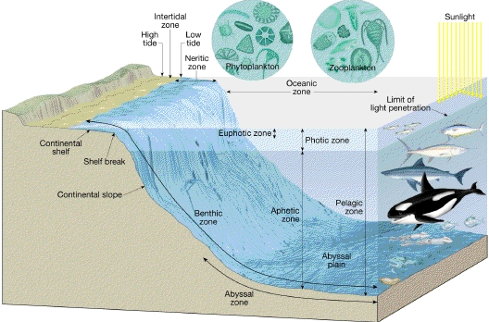
Dynamics of Our Ocean Depths

Slide 38
Deep Sea Ocean Zones
Pelagic zone - the ecological realm that includes the entire ocean water column. Of all the inhabited Earth environments, the pelagic zone has the largest volume
Benthic zone - The benthic zone is the ecological region at the lowest level of an ocean or a lake

Slide 39
Deep Sea
Deep ocean trenches (deepest part of ocean) some as deep as 36,000 feet
Abyssal plains are the flat portions of the deep ocean, likely to be the flattest portions of the earth.
Isolated volcanic peaks (mantle hot spots) are referred to as "seamounts".
Likewise volcanic cones near mid-oceanic ridges are called seamounts as well. Harry Hess called these “guyots”.

Slide 40
The Deep Sea
Mid-oceanic ridges
divergent plate boundaries occur (Mid-Atlantic)
narrow region at the ridge crest is called the rift zone.

Slide 41
Ocean Currents, Tides and Waves
Ocean circulation:
surface currents and deep-water masses
Some are short-lived: seasonal and local
Others are permanent and extend over globe
Generally, circulation patterns related to climatic conditions and heating of the Earth by the sun

Slide 42
Surface Currents
Important "river" of ocean is "Gulf Stream"
Flows - response to atmospheric conditions
Direct relationship with climatic conditions
Ocean currents move clockwise in northern hemisphere and counterclockwise in southern hemisphere
Directly related to Coriolis Effect,
a deflective force resulting from the Earth's rotation that often causes currents to move against the winds.

Slide 43
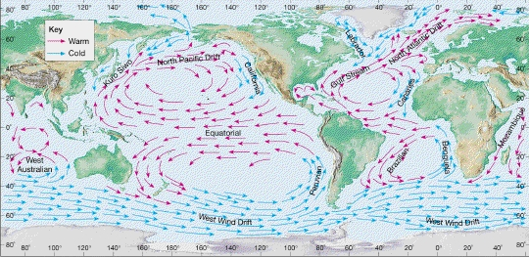
Shallow Ocean Currents
El Niño and
La Niña

Slide 44
Deep Ocean Currents
driven by gravity and density differences.
Two factors important for dense mass of moving water:
Temperature
Salinity
Cold, salty water is denser than warmer, less salty water.
deep ocean circulation is referred to as thermohaline circulation.

Slide 46
Thermohaline Circulation
Cooler water at surface becomes saltier and denser - sinks to the bottom.
As sinks it replaces lighter less dense water
So, cold dense waters flow away from sources at the poles and are replaced by warmer waters from lower latitudes.
It takes many years, possibly centuries for the dense, saline waters to migrate to the coastlines where upwelling may occur.

Slide 47
Oceanic Conveyor Belt

Slide 48
Deep Ocean Currents
Deep ocean currents vertical
(not horizontal like surface patterns)
- Caused primarily by a response to density differences in ocean and contrasts in temperature and salinity.

Slide 49
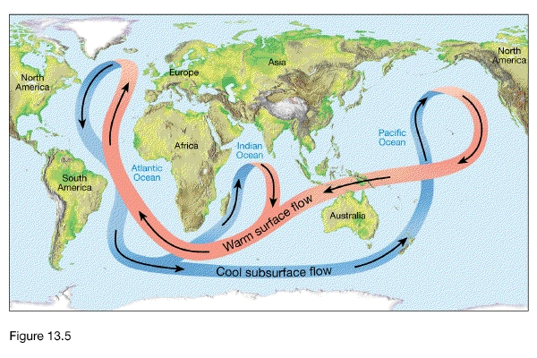
Deep Ocean Currents

Slide 50
Longshore Current
Waves that crash against shorelines develop currents that take sand and sediment headlong parallel to the beach and is referred to as longshore current.
Process is significant - measured to carry millions of tons of sand and sediment away from the beaches along the California Coast every year.

Slide 51
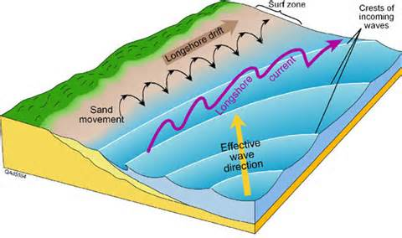
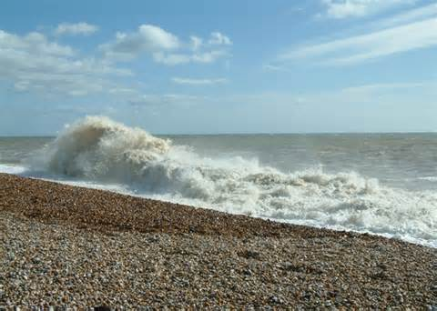
Longshore

Slide 52
Tides
Tides -daily fluctuations in elevations of ocean waters.
Caused by gravitational attractions by moon and sun
Portion of Earth facing moon will show a small bulge at oceans because of attraction for water to moons gravitational forces
The side of Earth directly opposite the moon will also bulge as a counterbalance to the gravitational pull of the moon.

Slide 54
Tides
New and full moon = highest tides; called spring tides
First and third quarter phases of moon = lowest tidal range – the neap tides
One high and one low tide per day – tides are called daily or diurnal
Two high tides and two low tides per day – tides are called semi daily or semidiurnal

Slide 57
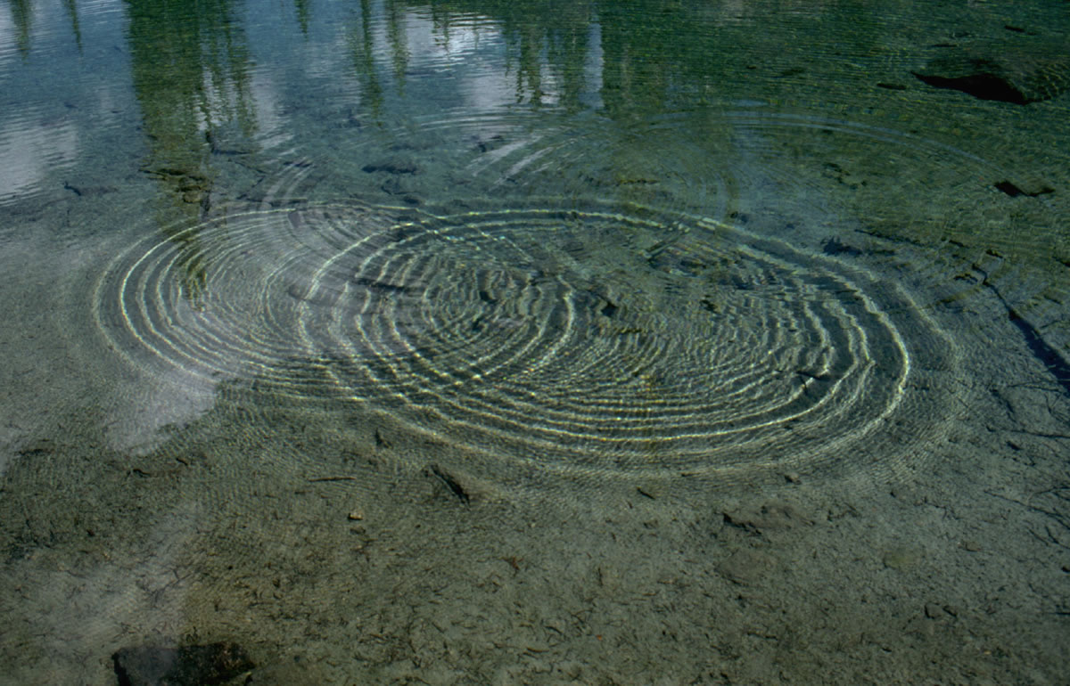
Waves

Slide 58
Waves
Wave characteristics:
Wave length
Wave height (Amplitude)
Wave period
Fetch/Duration
Crest
Trough

Slide 59
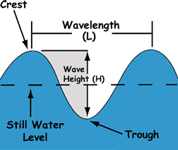
Waves

Slide 60
Waves
Wavelength is the horizontal distance, either between the crests or troughs of two consecutive waves.
Wave height is a vertical distance between a wave's crest and the next trough.
Wave period measures the size of the wave in time.
A wave period can be measured by picking a stationary point and counting the seconds it takes for two consecutive crests or troughs to pass it.

Slide 61
Waves

Slide 62
Waves
Distance wind blows (fetch) and
length of the gust (duration) determine how big the ripples will become.
Waves are divided into several parts:
The crest = highest point on a wave
The trough = lowest point

Slide 63
Coastlines
Waves tend to reach the shoreline at an angle and no two waves are identical.
But the backwash tends to be perpendicular to the shape of the beach, thus a "zigzag" pattern develops.
This is referred to as beach drift and its action can cause beach erosion as well as movement of sediment and particles many feet down the beach.

Slide 64
Two Types of Coastlines
1. Emergent coastline: where land that was formerly below sea level has been exposed due to crustal uplift or a drop in sea level.
2. Submergent coastline: where land that was formerly above sea level has been submerged due to rise in sea level or a crustal dropping (subsidence).

Slide 65
Upwelling
Upwelling - the force that vertically moves cooler water from approximately 1000 feet below the surface to the near surface.
Where winds blow towards the equator and parallel to the coastline
(ex: west coast of California), surface water movement is deflected away from the coast and deeper water is thrust upward to the surface.

Slide 66
Upwelling
Creates a vertical component that causes temperature drops in surface waters to nearly 10-15 degrees.
Extensive nutrients (nitrates and phosphates) are "upwelled" to the surface and plankton and other fish populations flourish.

Slide 67
Cold Water Upwelling
Hurricane causing algal bloom in upper portion of ocean.

Slide 68
Ocean Pollution
coastal areas most impacted- especially wetlands and estuaries, coral reefs, & mangrove swamps;
half of world's population lives within 100 km (60 miles) of oceans & 14 of 15 largest cities coastal;
in U.S. about 35% of municipal sewage discharged virtually untreated in marine waters;
ocean ultimate repository of waste;
dumping of industrial waste directly into ocean off U.S. coasts stopped, but many countries still dump large quantities of toxic substances.

Slide 69
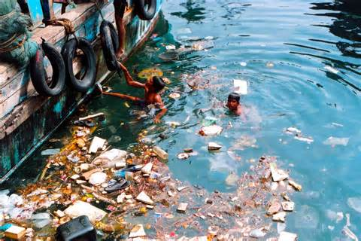

Slide 70
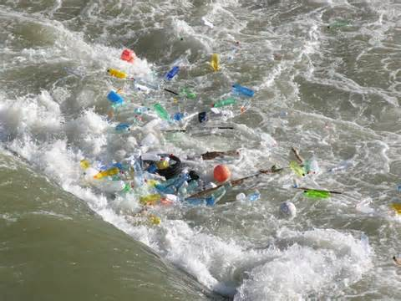

Slide 71
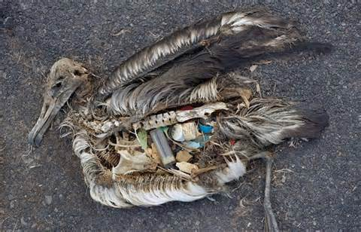

Slide 72
Oil Spills
crude & refined petroleum accidentally & deliberately released into environment;
most from normal operation of offshore wells, washing tankers, & leaks of pipeline & storage tanks;
tanker & offshore drilling rig accidents can release large amounts in short time;

Slide 73
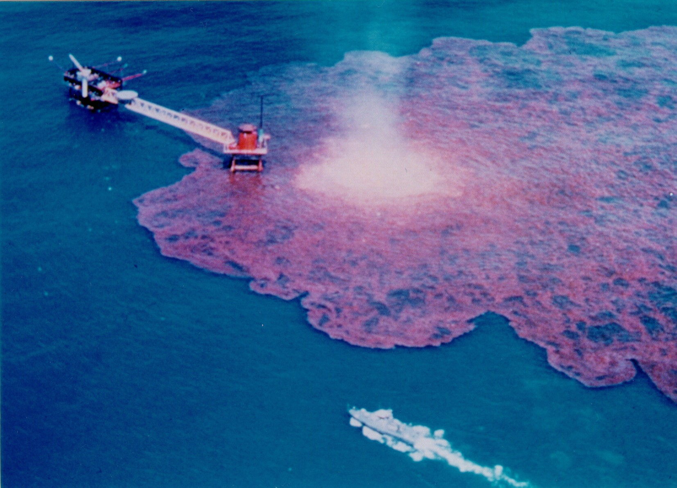

Slide 74
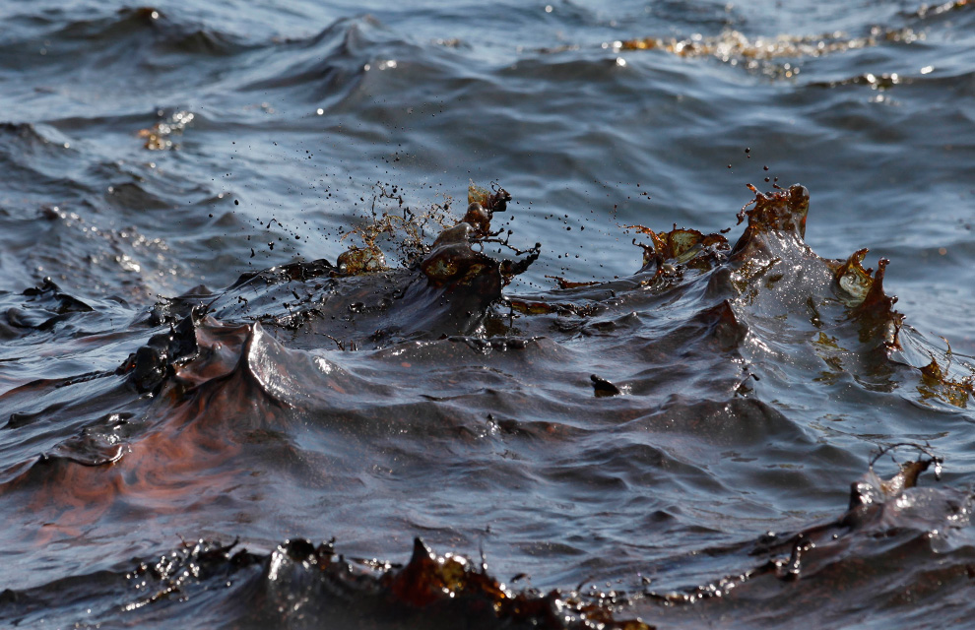

Slide 75
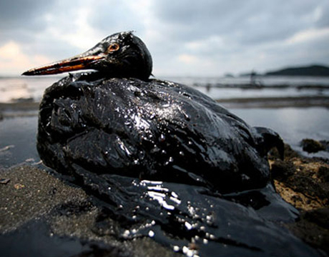

Slide 76
