Slide 1
Movements of Earth’s Crust
Earthquakes
Vulcanism
Landforms

Slide 2
Earthquakes
Earthquake - A sudden movement of the crust, accompanied by noticeable shaking of the ground
Fault – a fracture in Earth’s crust along which sections of the crust slide past each other
Slippage – the movement of rocks along a fault
Seismic waves – the vibrations in the crust

Slide 3
Liquefaction

Slide 4
What Causes Earthquakes?
Forces within Earth push, pull, and twist rock
Forces too great = break in crust
Broken sections of Earths crust vibrate
Vibrations of the crust = earthquake
MOST earthquakes occur along faults
SOME are caused by erupting volcanoes

Slide 5
Earthquake Regions
MOST earthquakes take place in regions called earthquake belts
Major earthquake belts - around Pacific Ocean and through Mediterranean Sea
In North America – likely places for earthquakes are California and Alaska
San Andreas Fault (in California) extends for over 1,000 kilometers (km) through the state

Slide 6
San Andreas Fault

Slide 7
Effects of Earthquakes
Earthquakes on Land:
“tear” in earth’s surface
Displacement of fences
Land drop-down areas
Damage to buildings
Depends on intensity of earthquake
Depends on type of material on which the structures are built
IF built on bedrock – less likely to be damaged

Slide 8
Effects of Earthquakes
Earthquakes under water:
May produce fast-moving waves called tsunamis
Tsunamis also caused by underwater volcanic eruptions and landslides
Tsunamis – wave speeds to 800 km/hr
Open ocean waves no higher than ordinary; waves closer to shore up to 20 meters high
Tsunamis “give warning” – minutes before arriving - water near the shore suddenly drains seaward, then with a loud hissing sound the wave rushes across the water-less beach with great force, and may pound the shore for hours

Slide 10
Earthquakes and Earth’s Interior
Vibrations of earthquakes travel through Earth as seismic waves
Some travel on surface, others through interior
Different waves travel at different speeds
Speed varies with density of material*
Waves measured with a seismograph
Seismograph firmly anchored to bedrock
*major factor in determining that the outer core is liquid, inner is solid

Slide 12
Seismographs
Detect – focus (the point underground where rocks first fracture)
Waves of different speeds reach the seismograph at different times
Use three locations (triangulation - using the intersection of three circles on a map) to find the epicenter
Epicenter – the point on the surface directly above the focus
MOST earthquakes within 50 km of surface
SOME deep earthquakes up to 700 km

Slide 15
Vulcanism
Vulcanism – the movement of magma through the crust or its emergence as lava onto Earth’s surface
Volcano – an opening in the crust through which molten materials and rock particles reach the surface and pile up
Volcanic mountain – built up by successive deposits of volcanic materials (commonly called a volcano)

Slide 16
Vulcanism
Ring of Fire – a curving belt of active faults and volcanoes (along rim of Pacific Ocean)
MOST of the worlds active volcanoes found along Ring of Fire
Active volcano – presently erupting
Dormant volcano – between eruptions
Extinct volcano – no longer capable of erupting

Slide 17
Ring of Fire

Slide 18
Volcanic Eruptions
Top of a volcano – bowl-shaped depression called a crater
Within the crater is a vent
Two types of eruptions:
Quiet eruption – lava flows freely from crater or fissures on the side of a volcano
Explosive eruption – molten rock explodes forcefully from the volcano in billowing clouds of volcanic ash and cinders

Slide 19
Mount Cameroon craters

Slide 20
Quiet eruption – Mauna Loa

Slide 21
Explosive eruption – Mt. St. Helens

Slide 22
Volcanic Mountains
“Famous” volcanic mountains:
Mount Etna (in Sicily)
Mount Kilimanjaro (in Africa)
Three types of volcanic mountains:
Shield Volcanoes
Cinder Cones
Composite Volcanoes

Slide 23
Mount Etna - Sicily

Slide 24
Mount Kilimanjaro - Africa

Slide 25
Volcanic Mountains
Shield – repeated lava flows; broad, massive mountain with gentle slopes; LARGEST type of volcanic mountain (Mauna Loa- the largest volcano on Earth)
Cinder – explosive eruptions; ashes and cinders pile up around the volcano vent to form steep, cone-shaped hill (Paracutin, Mexico 150 meters high in 6 days – after 7 months 450 m high)
Composite – layers of lava and layers of ash and cinders; not as big as shield, but bigger than cinder cones (Mount Fuji in Japan; Mount Vesuvius in Italy; and Mount St. Helens in USA)

Slide 26
Mauna Loa - Hawaii

Slide 27
Paracutin, Mexico

Slide 28
Mount Fuji - Japan

Slide 29
Mount Vesuvius - Italy

Slide 30
Mount St. Helens - USA

Slide 31
Dome Mountains
Sometimes a large quantity of magma pushes up through the crust BUT fails to break through to the surface
INSTEAD magma forces overlying rock to arch upwards forming a large dome mountain
Resembles a huge blister on Earth’s surface
In time the top layers of rock erode away exposing the solidified magma
(Examples: The Henry Mountains of Utah and the Orange Mountains of New Jersey)

Slide 32
Henry Mountains - Utah

Slide 33
Half – Dome Yosemite

Slide 34
Vulcanism Inside the Crust
Other underground geologic features:
Batholith – a huge mass of coarse-grained igneous rock that forms deep under the surface (may be thousands of square kilometers)
Sill – formed when magma flows parallel between layers of sedimentary rock
Dike – forms when magma forces its way into a fracture that cuts across sedimentary rock layers

Slide 35
Exposed Dike

Slide 36
Slow Movements of the Crust
Gradual movements produce dramatic changes at Earth’s surface
Adirondack Mountains (northern New York state) getting taller by about 3 millimeters per year….
Himalayas also “growing”
Geologists believe that slow movements of large sections of the crust have produced all the great mountain ranges on Earth

Slide 37
Landforms Produced by Crustal Movements
All movements of the crust, whether sudden or gradual, cause major changes in Earth’s surface features over time
Slow or sudden – both produce major landforms
These landforms include:
Mountains
Plateaus
Plains

Slide 38
Mountains
Mountain – a part of Earth’s crust that has been raised high above the surrounding landscape
TALLEST mountain in the world – Mount Everest (in the Himalayas) about 9 km above sea level
MOST mountain ranges formed by processes of folding and faulting

Slide 39
Mt. Everest

Slide 40
Fold Mountains
Fold Mountains – mountains formed by crustal movements that press layers of sedimentary rock together, squeezing them into wavelike folds.
Up-folded sections of rock = anticlines
Down-folded sections of rock = synclines
(Appalachian Mountains are a series of anticlines and synclines formed by folded rock layers)

Slide 41
Appalachians

Slide 42
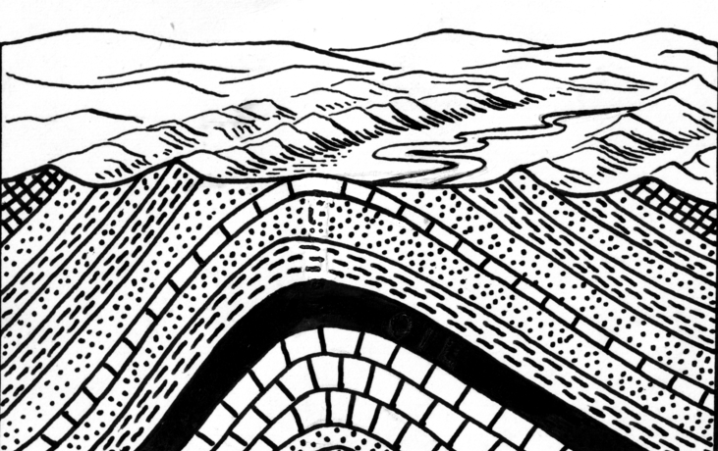
Anticlines

Slide 43
Folding rock

Slide 44
Fault Block Mountains
Fault-Block mountains –
formed by crustal movements
crust fractures into huge block
blocks shift - moving up or down along the faults
Blocks pushed or tilted up = mountains,
Blocks that sink down =valleys (Example: Sierra Nevada in California)

Slide 45
Fault Block Mountains
Sierra Nevadas

Slide 46
Plateaus
Plateau – a broad, flat-topped region, underlain by horizontal layers of rock, that rises somewhat abruptly above the surrounding landscape
(Example: Colorado Plateau)

Slide 47
Colorado Plateau

Slide 48
Plains
Plain – a broad, flat region composed of horizontal layers of rock or sediment. HOWEVER, a plain lies lower than the land around it.
Different types of plains:
Marine – formed on sea floor – raised above
Lake – dried-up beds of drained lakes
Glacial – deposits of sediments left after melting glaciers

Slide 49
Why The Crust Moves

Slide 50
Continental Drift

Slide 51
Plate Tectonics

Slide 52
Plate Motions

