Slide 1
Mountain Building

Slide 2
Mt. Everest
TALLEST mountain in the world – Mount Everest (in the Himalayas) about 9 km above sea level

Slide 3
Mountains
Mountain – a part of Earth’s crust that has been raised high above the surrounding landscape
MOST mountain ranges formed by processes of folding and faulting
Orogeny – the process of mountain building

Slide 4
Folds and Faults: Geologic Structures
How rocks respond to tectonic stress
Stress is a force directed against an object
When a rock is stressed it may:
- deform elastically
- deform plastically
- break by brittle fracture

Slide 5
Types of Stress
Tensional – pulling apart
Compressional – squeezing together
Shear – sliding past

Slide 6
how rock responds to stress
Several factors control how a rock responds to stress:
- the nature of the rock
- temperature
- pressure
- time

Slide 7
Nature of the rock
Varying chemical composition results in different deformation………………..
- Quartz : when hit with a hammer will shatter because it is brittle
- A gold nugget : when hit with the same hammer will deform in a plastic manner…flatten and stay flat
- If you strike a rubber ball with a hammer it will deform elastically and rebound immediately sending the hammer flying back at you

Slide 8
Temperature
The higher the temperature, the greater the tendency of a rock to deform in a plastic manner
(It is difficult to bend an iron bar at room temperature, but if the bar is heated to a red-hot temperature, it becomes plastic and bends easily)

Slide 9
Pressure
High non-directed (hydrostatic) pressure favors plastic behavior
Because both temperature and pressure increase during burial, and because both promote plastic deformation, deeply buried rocks have a greater tendency to bend and flow under stress than do shallow rocks

Slide 10
Time
Stress applied slowly, rather than suddenly, also favors plastic behavior
(Marble park benches in New York City have sagged plastically under their own weight within 100 years)
In contrast, rapidly applied stress, such as the blow of a hammer, causes brittle fracture in a marble bench

Slide 11
Geologic Structures
Tectonic movement creates tremendous stress near plate boundaries; this stress deforms rocks
A geologic structure is any feature produced by rock deformation.
Tectonic stress creates three types of structures:
- folds
-faults
- joints

Slide 12
Folds
A fold is a bend in rock
Some folded rocks display little or no fracturing, indicating the rocks deformed in a plastic manner
In other cases, folding occurs by a combination of plastic deformation and brittle fracture

Slide 13
Folded rock

Slide 14
Characteristics of folds
Folding usually results from compression stress
Folding always shortens the horizontal distances in rock
A fold usually occurs as part of a group of many similar folds

Slide 15
Fold Mountains
Fold Mountains – mountains formed by crustal movements that press layers of sedimentary rock together, squeezing them into wavelike folds.
Up-folded sections of rock = anticlines
Down-folded sections of rock = synclines
The sides of a fold are called the limbs

Slide 16
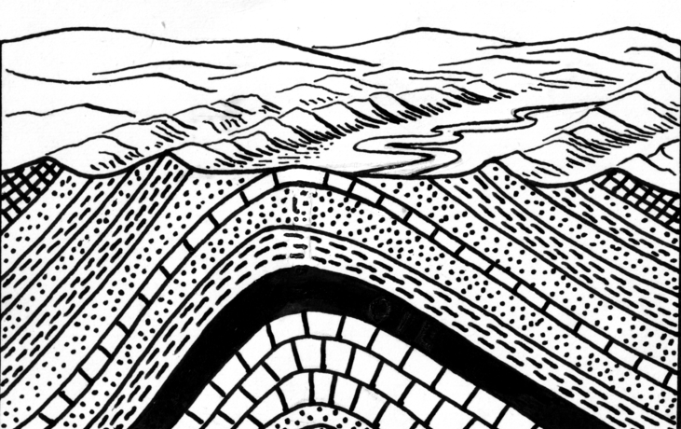
Anticlines

Slide 17
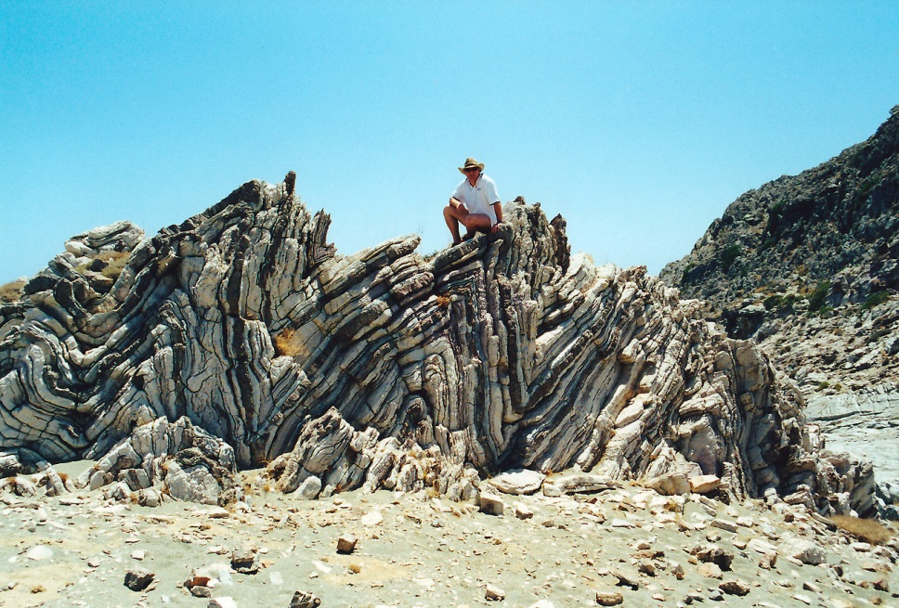
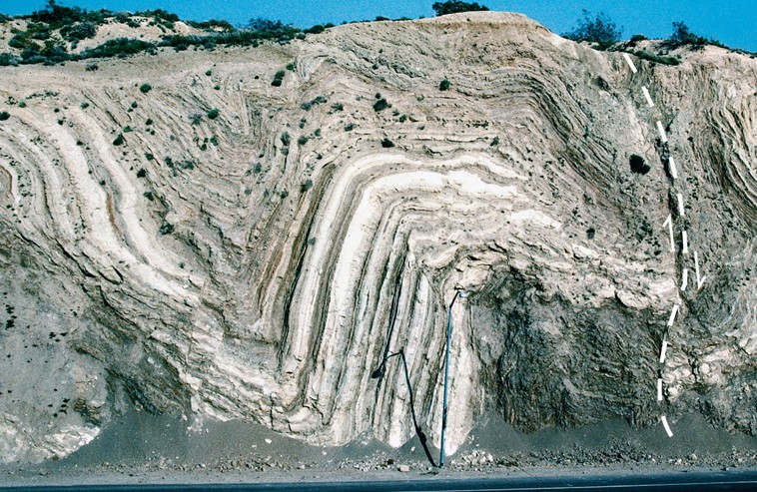

Slide 18
Appalachians
The Appalachian Mountains are a series of anticlines and synclines formed by folded rock layers

Slide 19
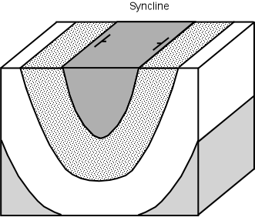
Synclines

Slide 20
Basins and domes
A circular or elliptical anticlinal structure is called a dome
(resembles an inverted cereal bowl)
A similarly shaped syncline is called a basin

Slide 21
BlaCk Hills of South Dakota
Black Hills of South Dakota are a large structural dome

Slide 22
Michigan BasiN

Slide 23
Faults
A fault is a fracture along which rock on one side has moved relative to the rock on the other side
Slip is the distance that rocks on opposite sides of a fault have moved
A fault zone is an area of numerous closely spaced faults

Slide 24
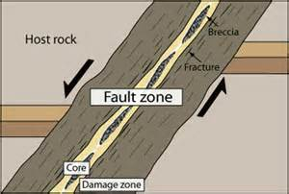

Slide 25
Slip

Slide 26
Faults
Hanging wall – a term to describe the top side of an inclined fault (the rock hanging above ones head)
Footwall – a term to describe the lower side of an inclined fault (the rock one would walk on)
Normal Fault – a fault in which the hanging wall has moved downward relative to the footwall; caused by tension stress

Slide 27
Hanging wall and footwall

Slide 28
Normal Faulting

Slide 29
Horst and Graben
Graben – a wedge-shaped block of rock that has dropped downward between two normal faults
Horst – the block of rock between two down-dropped grabens that appears to have moved upward relative to the grabens

Slide 30
Horst and Graben

Slide 31
Reverse fault
Reverse fault – a fault in which the hanging wall has moved up relative to the footwall
- Caused by compressional stress
Thrust fault – a type of reverse fault that is nearly horizontal

Slide 33
Fault Block Mountains
Fault-Block mountains –
formed by crustal movements
crust fractures into huge block
blocks shift - moving up or down along the faults
Blocks pushed or tilted up = mountains,
Blocks that sink down =valleys (Example: Sierra Nevada in California)

Slide 34
Fault Block Mountains
Sierra Nevadas

Slide 35
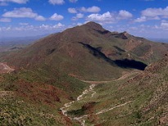
Franklin Mountains - Geologists refer to them as tilted-block fault mountains and in them can be found 1.25 billion-year-old Precambrian rocks, the oldest in Texas.

Slide 36
Franklin Mountains - Faulting

Slide 37
Joints
Joint - A fracture along which the rock on either side of the break have not moved
Most rocks near Earth’s surface are jointed
Joints become less abundant with depth (rocks become more plastic and less prone to fracturing at deeper levels in the crust)

Slide 38
Columnar Jointing - Turkey

Slide 39
Plate Boundaries
Each of the three types of plate boundaries – divergent, transform or convergent – produce difference tectonic stresses and therefore different kinds of folds and faults

Slide 40
Divergent
Tectonic plates drift apart
Tensional stress stretches adjacent rocks
Produce normal faults and grabens
Little folding action
Example: Mid-Ocean Ridge mountain ranges

Slide 41
Mid-Ocean Ridge - Mountain Range

Slide 42
Transform
Friction holds rock together
Plates slip past each other
Shear stress
May cause folding, faulting, and uplift in nearby rocks
Example: San Gabriel Mountains along San Andreas fault zone and mountain ranges north of the Himalayas

Slide 43
San Gabriel Mountains

Slide 44
convergent
Three types: Ocean - Ocean; Ocean -Continental; Continental - Continental
Compression stress
Produces large areas of folding, reverse faults, and thrust faults
Examples: Appalachian Mountains, The Alps, and the Himalayas

Slide 45
The Alps

Slide 46
The Himalayas

Slide 47
Ocean – Ocean
Island arc - volcanic mountain chain that forms where two plates carrying ocean crust converge
Example: Aleutian Islands

Slide 48
Aleutian Islands

Slide 49
Ocean - Continental
Subduction at a continental margin; termed an Andean margin
Example: The Andes

Slide 50
The Andes

Slide 51
Continent - Continent
A collision between continents
Example: The Himalayas

Slide 52
The Himalayas

