Slide 1
Interpreting Ancient Environments
Lab # 3

Slide 2
Introduction
Stratigraphy – the branch of geology that deals with the study of layered rocks or strata
The fundamental unit of rocks used in stratigraphy is the formation
Formation – is a body of rock that has enough distinctive characteristics so that it may be mapped as a unit
Lithology – the rock type
Contacts – boundaries between formations
Stratigraphic section – a vertical sequence of rock units
Correlation – the determination of the equivalency of widely separated rock units

Slide 3
Strata

Slide 4
Formations

Slide 5
Correlation
Geologists may correlate formations based on:
Age – chronostratigraphic units
Rock Type – lithostratigraphic units or
Fossils – biostratigraphic units
From correlation of stratigraphic units we can obtain information on …
relative ages of the units
depositional environment
tectonic setting and
climate

Slide 6
Chronostratigraphic

Slide 7
Chrono and litho

Slide 8
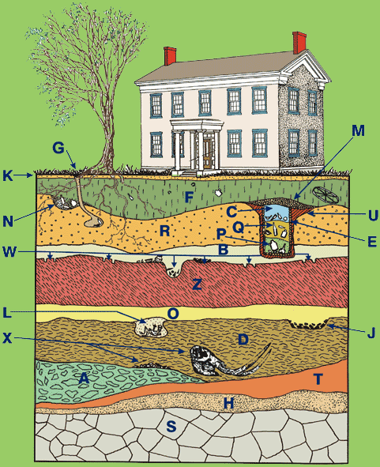
Lithostratigraphic

Slide 9
biostratigraphic

Slide 10
Use of Fossils in Stratigraphy
Guide Fossils……. aka index fossils
Widely distributed
Existed for a short geologic time span
Especially useful as stratigraphic indicators

Slide 11
Guide fossils

Slide 12
Biostratigraphic Correlation
Determining the equivalency of widely separated rock units by using fossils
Geologists use fossil assemblages, first occurrence and/or last occurrence of particular fossils to make this type of correlation
Usually the boundaries of these first and last occurrences and the overlapping ranges of fossil assemblages are shown to be of the same age worldwide
When this happens, the biostratigraphic correlation is also indicating a time correlation

Slide 13
Biozone
When a biostratigraphic correlation also shows a time (chronostratigraphic) correlation geologists refer to this as a biozone when they use fossils to indicate a restricted time interval.

Slide 14
Biozone

Slide 15
Geologic ranges
Important points when doing biostratigraphic correlations:
Many organisms are only able to live in particular habitats
For this reason – these organisms may not appear in some rock units because they could not have survived the environment
Trace fossils (like burrows) or weathering may make it appear as if fossils are in rocks outside their geologic range

Slide 16
Geologic Range

Slide 17
Correlating Stratigraphic sections
To correlate stratigraphic sections…
First determine which units are equivalent
Look at sequences of beds
Draw lines from contact to contact
When correlating unconformities - connecting lines should be wavy

Slide 18
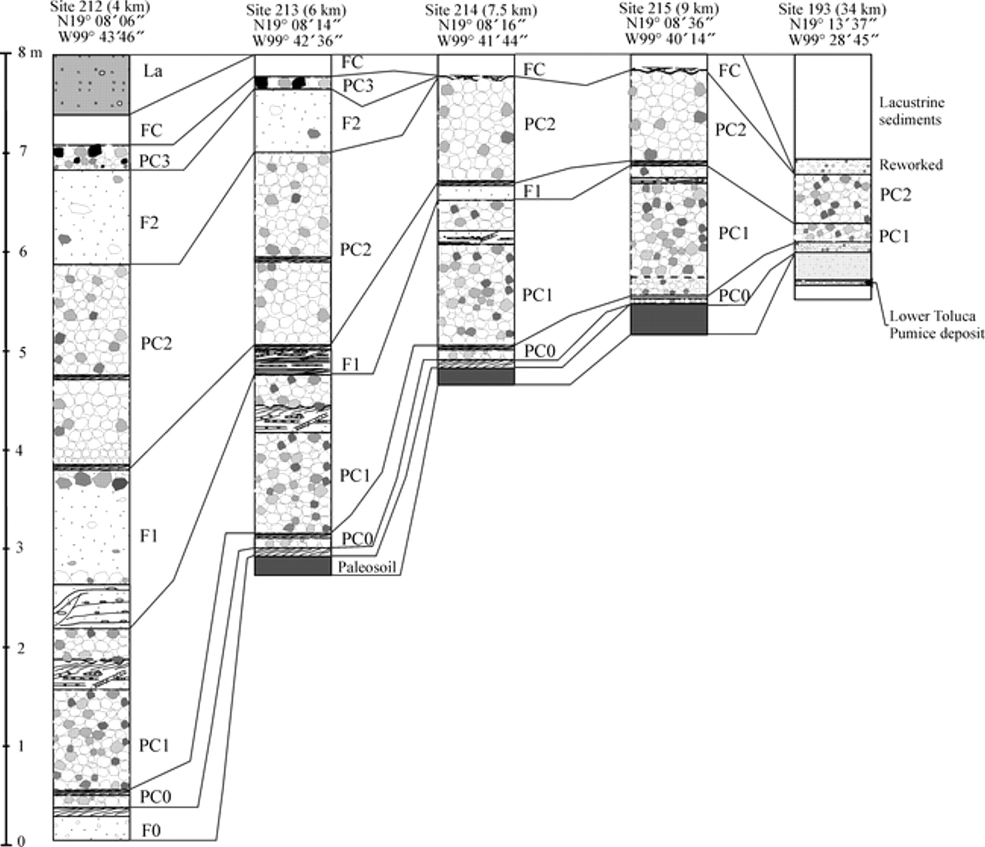
Correlated Strata

Slide 19
Sedimentary facies
Stratigraphic sections are used to gain information of paleoenvironments
“Sedimentary facies” describes the characteristic sedimentary bodies or sedimentary rocks deposited in an environment
Example: near shore beach environment = sand facies
playa lake = evaporite facies
deep ocean = carbonate facies

Slide 20
Sedimentary Facies

Slide 21
Depositional Environments

Slide 22
Transgressive/regressive
Vertical sequences of rock that indicate a lowering of sea level are called regressive sequences
Vertical sequences of rock that indicate a rising sea level are called transgressive sequences
Both represent a change in sea level through time
Changes in sedimentary facies will also result in changing rock type BUT these change will occur laterally, representing a simultaneous deposition of rock in different environments.

Slide 23
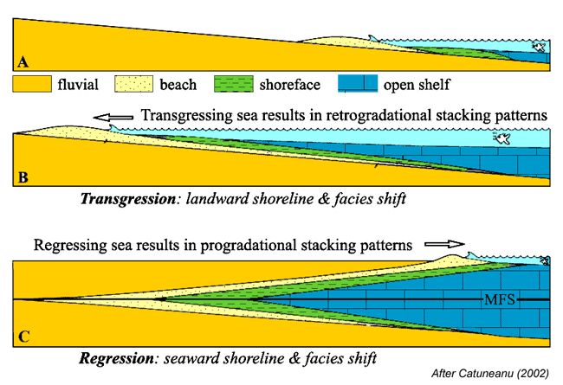
Transgression/regression

Slide 24
Epeiric Sea
Throughout geologic time, sea level has risen and fallen many times.
When sea level rises and covers continental crust that sea is called an epeiric sea…. In order to distinguish it from ocean water that is above oceanic crust

Slide 25
Epeiric sea

Slide 26
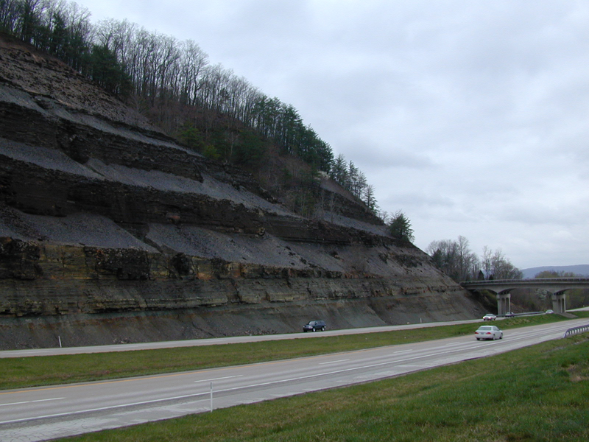
Evidence of epeiric sea

Slide 27
Cratons
tSedimentary rocks deposited by epeiric seas record he history of transgressions and regressions onto the stable part of a continent called a craton
There are six major epeiric seas that have transgressed onto the North American craton during the Phanerozoic.
Sedimentary rocks deposited by these epeiric seas are called cratonic sequences.

Slide 28
Cratonic sequences

