Slide 1
The History of Earth
Fossils and Fossil Formation

Slide 2
Beginnings of Life
Living things evolved in early oceans – about 3 billion yrs ago
First life – single celled organisms- microscopic
After 100’s of millions of yrs larger, complex organisms evolved (worms, jellyfish) – soft body parts
Animals with hard parts (shells, bones) appeared much later
Next major group of animals were fish

Slide 3
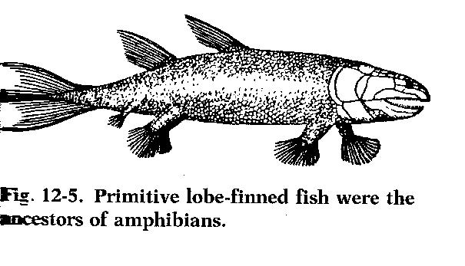

Slide 4
Primitive fish
First fish had gills – breathing underwater
Some gills evolved into lungs
Lungs allow ….
breathe air from atmosphere
Primitive fish evolved into amphibians (frogs, newts)

Slide 5
Fossils
Evidence of extinct plants and animals – found in sedimentary rocks = fossils
A fossil is the remains or trace of an ancient organism that has been preserved naturally in Earth’s crust.

Slide 7
Fossils in Rocks
Virtually NONE in igneous rocks
Few found in metamorphic rocks
Usually found in sedimentary rocks.
Oldest known fossils – traces of 3.5 billion year old bacteria
Fossils indicate :
Form and behavior, as well as how it became a fossil

Slide 8
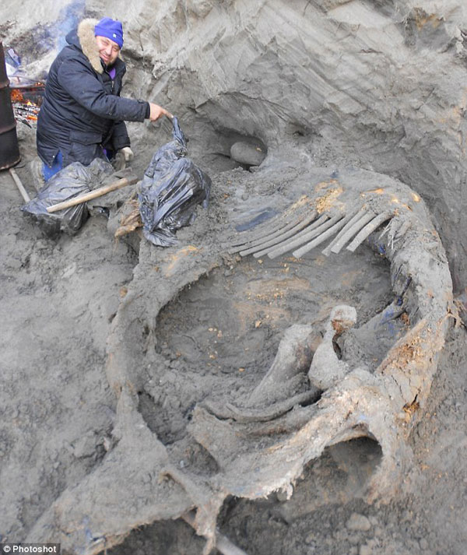
Fossils in Ice
Soft animal parts are often preserved in ice. Wooly mammoths lived during the last Ice Age, about 15,000 years ago.

Slide 9
Fossils in Tar
Some of best preserved animal remains discovered in tar pits (La Brea tar pits in Los Angeles California)
When animals fell in – they could not get out
Bones of the extinct saber-toothed cat were found in the tar pits

Slide 10
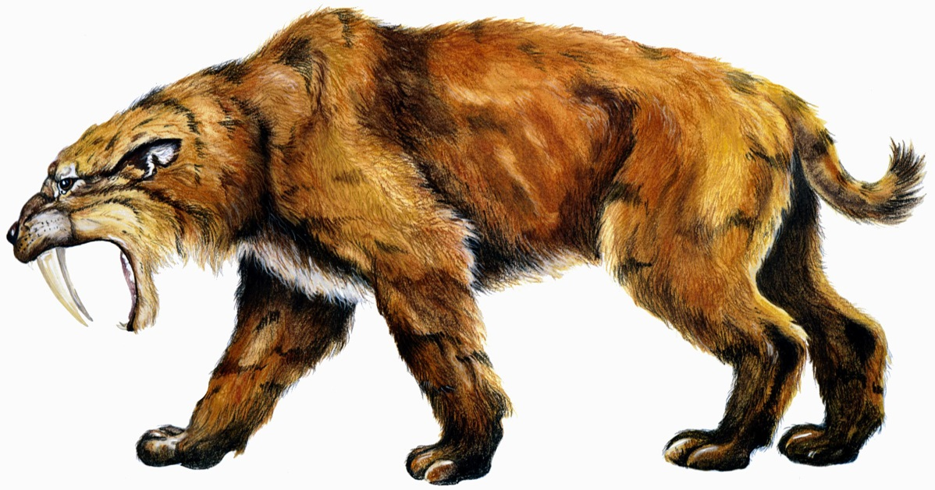

Slide 11
Fossils in Amber
Pine trees produce sticky substance - resin
Resin hardened and turned into amber (or fossil resin)
Millions of years ago, insects sometimes became trapped in this hardening resin

Slide 12
Praying Mantis in Amber

Slide 13
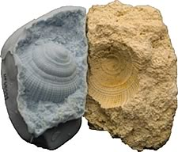
Fossil Molds and Casts
Mold
When bones and shells dissolve completely -may leave a mold of the shape of the organism
Molds often filled with sediments (or minerals) that harden - a cast of the original organism
Cast

Slide 14
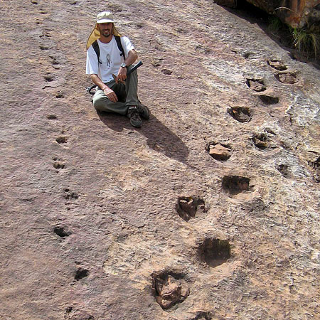
Fossil Tracks
When birds or other animals walk over mud they leave tracks or footprints
Mud hardens into stone – imprints remain and become fossilized

Slide 15
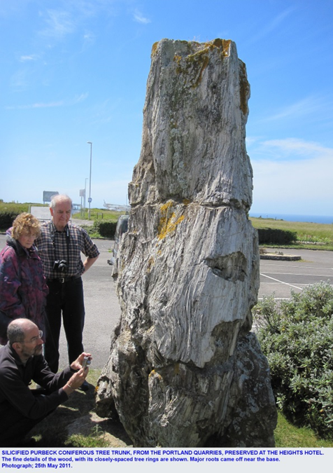
Replaced Fossil Remains
Fossils that have different composition from the living specimen are called replaced remains
Petrified trees original wood has been changed to stone (or petrified)

Slide 16
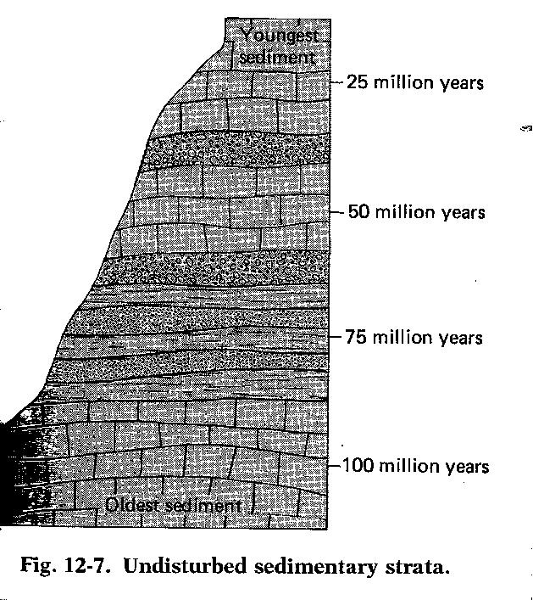
Fossil Record
Principle of Superposition – When sedimentary rock strata are not disturbed by natural forces, the oldest strata are on the bottom and more recent strata are on top.
Using this principle, geologists determine relative ages of undisturbed sedimentary rock strata and fossils in them

Slide 17
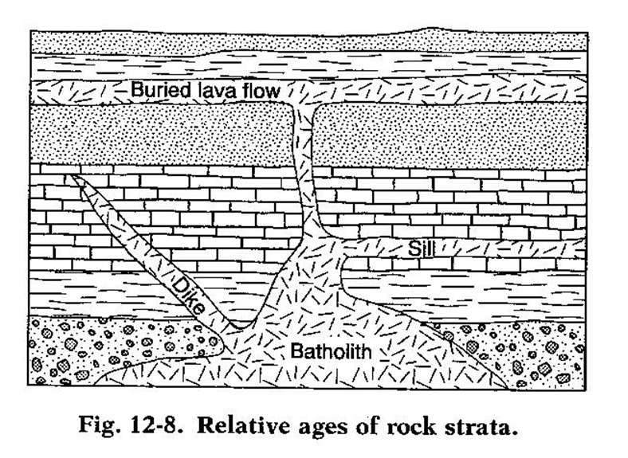
Geologic Time
Igneous rock masses called batholiths, dikes, sills, and lava flows indicate the relative age of sedimentary rock and fossils.
Any intrusive igneous body is younger than the sedimentary strata that it intrudes

Slide 18
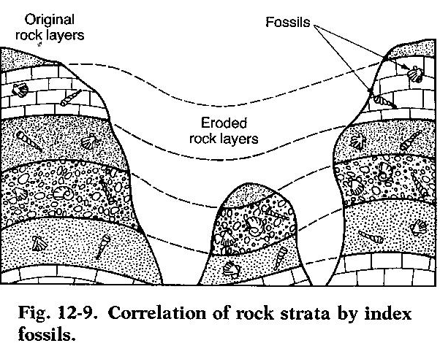
Index Fossils
Fossils most useful in dating strata of rock are called index fossils

Slide 19
Precambrian Time
Most of earth’s history
Little known about this time
Comprised of:
Proterozoic Eon
Archean Eon
Hadean Eon

Slide 20
Paleozoic Era – 570 mya
Divided into three ages:
Age of invertebrates
Animals with No backbones
Dominate life - trilobites
Age of Fishes
First animal WITH backbone
Plants also appeared here
Age of Amphibians
Earliest frogs, toads, salamanders
END OF PALEOZOIC – Trilobites became extinct

Slide 21
Mesozoic Era – 245 mya
Age of Reptiles
Dinosaur dominant life form
“Cousins” of dinos = snakes, turtles, lizards
Birds likely evolved from dinosaurs
END OF MESOZOIC – Dinosaurs became extinct

Slide 23
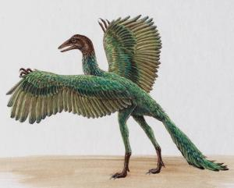

Slide 24
Cenozoic Era – 65 mya
Most recent era of Geologic time
Age of Mammals
Small mammals in Mesozoic
Larger – dominant species in Cenozoic
Mammals:
Have hair or fur
Mothers provide milk for their young
END OF LAST ICE AGE IN EARLY CENOZOIC – Larger mammals extinct

Slide 25
Human Beginnings
Apelike humans - australopithecines
about 1-4 million yrs ago
Homo habilis – 1.5 million yrs ago
Homo erectus – 1 million to 500,000 yrs ago
First “true” humans – Homo sapiens – 200,000 yrs ago (Neanderthals)
More modern Homo sapiens – 35,000 yrs ago (Cro-Magnons – good hunters/fishers)

Slide 26
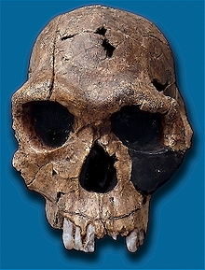
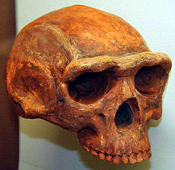
australopithicenes
Homo habilis
Homo erectus

Slide 27
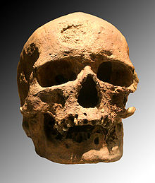
Homo sapiens - Neanderthal
Homo sapiens – Cro-Magnon

