Slide 1
Energy Review MC and FRQ

Slide 2
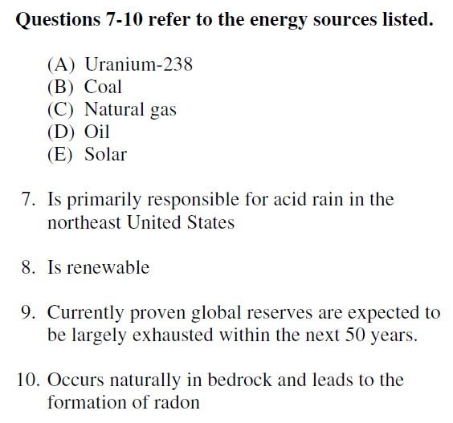

Slide 3
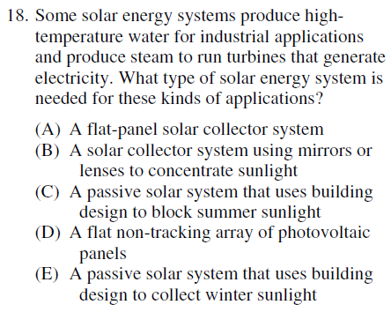

Slide 4
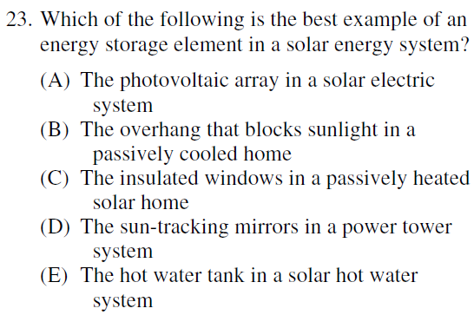

Slide 5
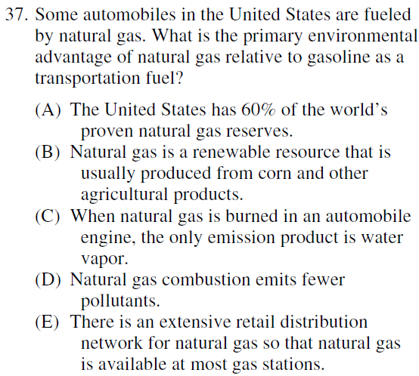

Slide 6
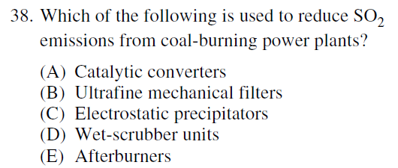

Slide 7
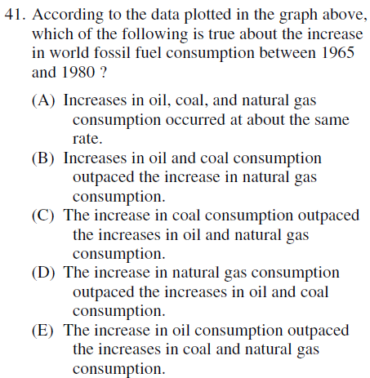
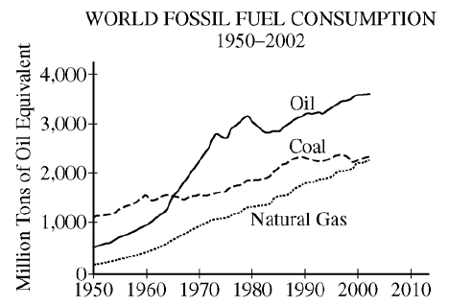

Slide 8
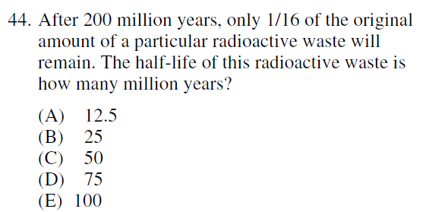

Slide 9
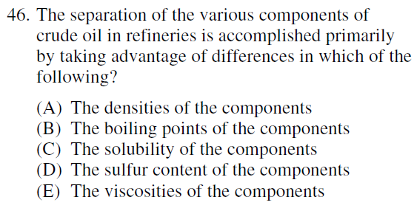

Slide 10
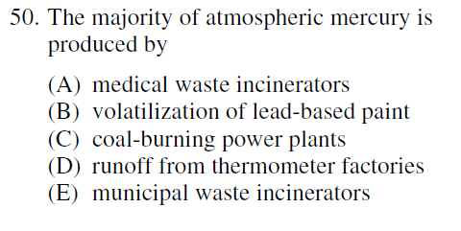

Slide 11
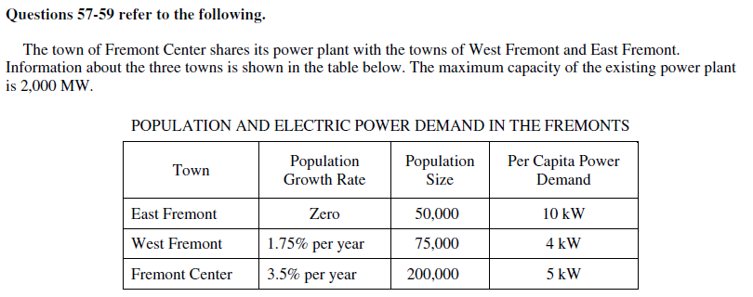
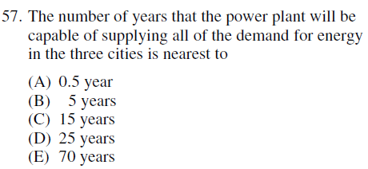
Start by calculating how much energy is being used currently:
50,000 x 10 kW = 500,000 kW (500 MW); 75,000 x 4 kW = 300 MW;
200,000 x 5 kW = 1,000 MW for a total of 1,800 MW. WF is adding
1,312 people x 4 kW or 5.25 MW/year (multiply growth rate x population) and FC is adding 7,000 x 5.25 kW or 35 MW/year. The max capacity is 2,000 MW so you only have 200 MW to be used. 5.25 MW + 35 MW = 40.25 MW and 40.25 goes into 200 roughly 5 times. Voila!

Slide 12
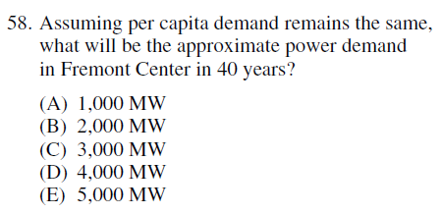
When you see a question like this and years plus population is mentioned, think “doubling time”. Recall that doubling time is found by dividing the growth rate into 70. In this case 70/3.5 = 20 years. Fremont Center has 200,000 people now, will have 400,000 in 20 years and 800,000 in 40 years. Multiply 800,000 times 5 to get 4,000,000kW then divide by 1,000 to get 4,000MW

Slide 13
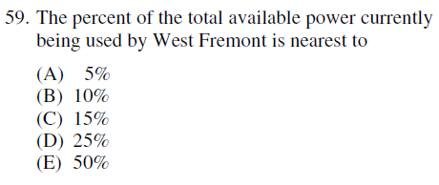
Easy! Take the PART/WHOLE. We’ve already determined that WF is using 300 MW (the “PART”). Max capacity is 2,000 MW (the “WHOLE”). 300/2,000 = .15 or 15%

Slide 14
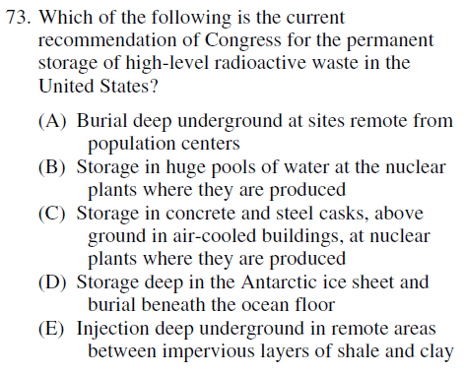

Slide 15
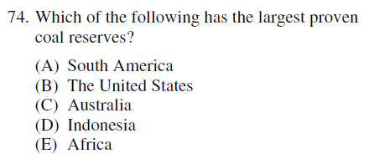

Slide 16
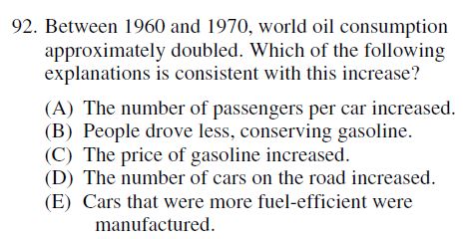

Slide 17
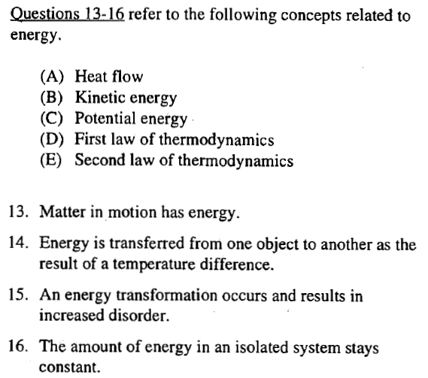

Slide 18
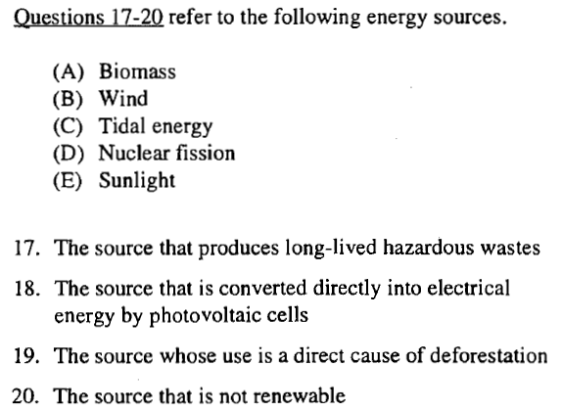

Slide 19
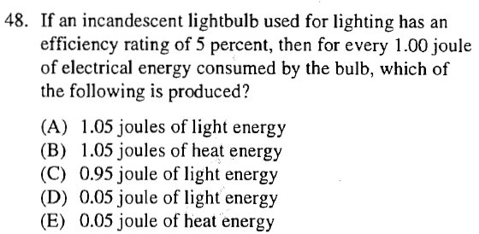

Slide 20
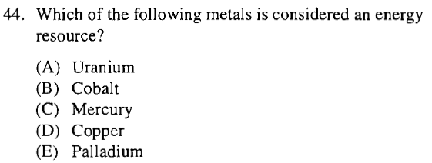

Slide 21
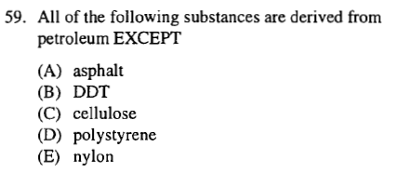

Slide 22
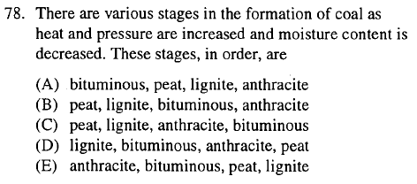

Slide 23
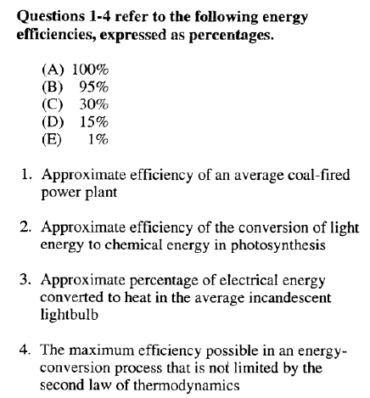
v

Slide 24
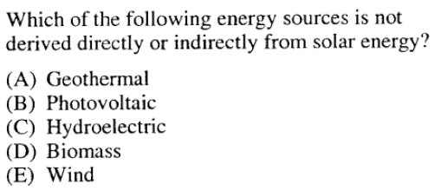

Slide 25
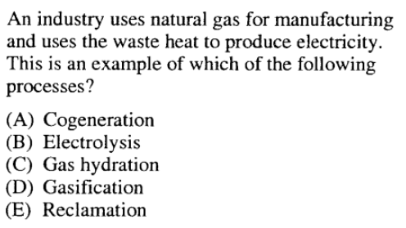

Slide 26
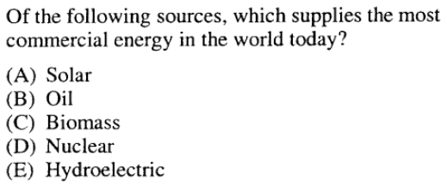

Slide 27
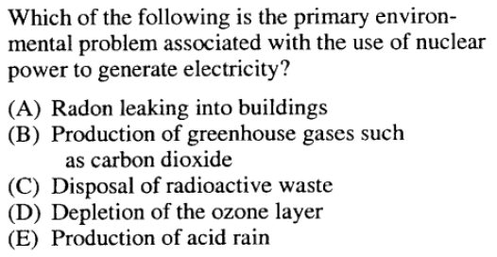

Slide 28
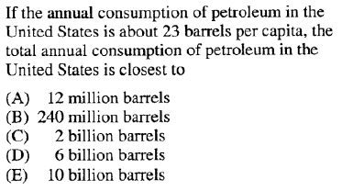

Slide 30
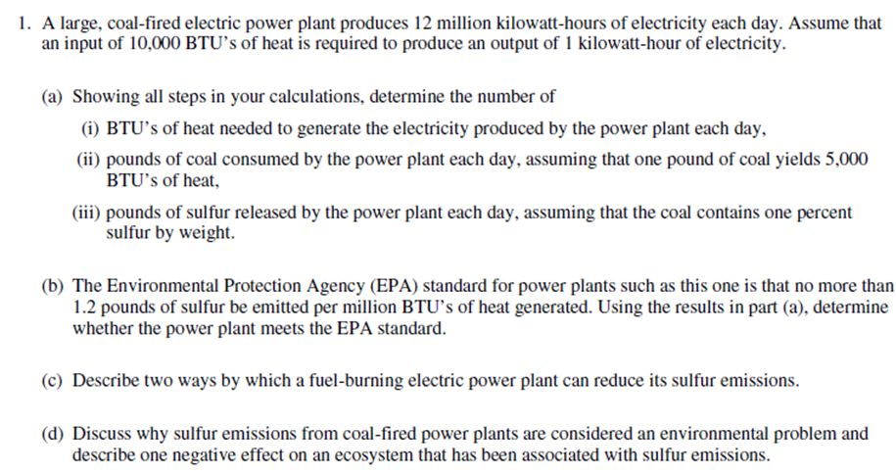

Slide 31
