Slide 1
Earth’s External Processes
Weathering, Soil Formation, and Mass Wasting
Tarbuck/Lutgens/Tasa 13th Edition

Slide 2
External processes
Weathering, mass wasting, and erosion are called external processes because they occur at or near Earth’s Surface and are powered by energy from the sun
Weathering – the physical breakdown (disintegration) and chemical alteration (Decomposition) of rocks at or near Earth’s surface
Mass wasting – the transfer of rock and soil downslope under the influence of gravity
Erosion – the physical removal of material by mobile agents such as water, wind, or ice

Slide 3
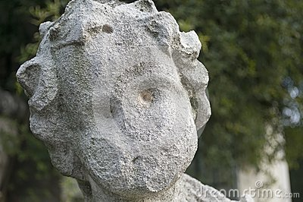
Weathering
Utah – Arches National Park
Statue of a child

Slide 4
Internal Processes
Some parts of Earth’s surface are gradually elevated by mountain building and volcanic activity
These are called internal processes
Internal processes get their energy from Earth’s interior

Slide 5
weathering
All materials are susceptible to weathering
Two basic types of weathering:
Mechanical – accomplished by physical forces that break rock into smaller and smaller pieces without changing the rock’s mineral composition
Chemical – involves a chemical transformation of rock into one or more new compounds

Slide 6
Weathering

Slide 7
Mechanical weathering
Breaking rocks into smaller pieces increases surface area available for chemical attack
In nature, four physical processes are especially important in breaking rocks into smaller fragments:
Frost wedging
Salt crystal growth
Sheeting
Biological activity

Slide 8
Increased Surface Area

Slide 9
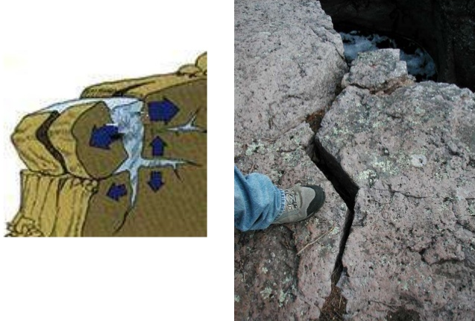
Frost wedging
- after water works its way into cracks in rocks, then freezes, the freezing water enlarge the cracks and angular fragments are produced
Can also affect soils – when moist soils
freeze, they expand (or frost heave)
due to the growth of ice lenses; as
most water accumulates and freezes
the soil is heaved upward

Slide 10
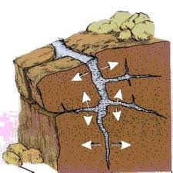
Frost Wedging

Slide 11
Salt crystal growth
Growth of salt crystals can also split rocks…
Rocky shorelines and arid regions are common settings for this process
Sea spray from breaking waves or salty groundwater penetrates crevices and pore spaces in rock
As this water evaporates, salt crystals form
Crystals gradually grow larger, weakening the rock and pushing the grains of the rock apart or enlarging tiny cracks

Slide 12
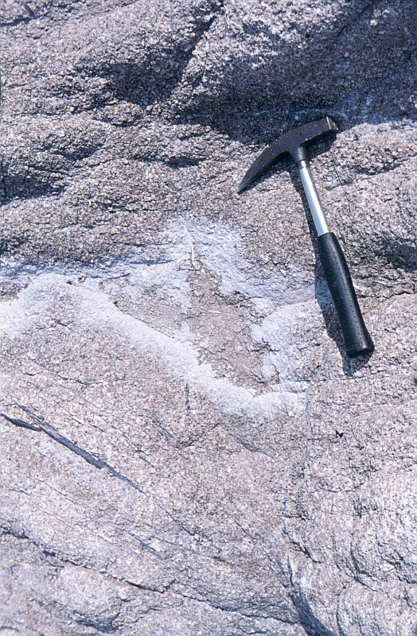
Salt Weathering
France

Slide 13
Sheeting
When large masses of igneous rock, particularly those composed of granite, are exposed by erosion, concentric slabs begin to break loose.
The process generating the onion-like layers is called sheeting
Accompanying this unloading , the outer layers expand more than the rock below and separate
Continued weathering eventually causes the slabs to separate and spall off creating exfoliation domes
Examples of exfoliation domes: Stone Mountain in Georgia, and Half Dome in Yosemite national Park

Slide 14
Sheeting

Slide 15
Sheeting

Slide 16
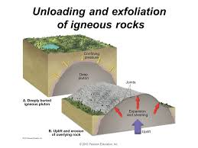
Exfoliation Domes

Slide 17
Half Dome - Yosemite

Slide 18
Sheeting - continued
Many fractures are created by expansions, but others are produced by contraction as igneous materials cool, and still others by tectonic forces during mountain building
Fractures produced by these activities for a definite pattern and are called joints
Joints are important rock structures that allow water to penetrate deep into the interior of rock and start the process of weathering long before the rock is exposed

Slide 19
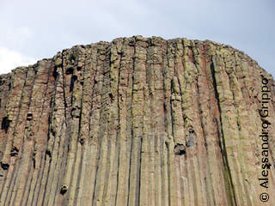
Joints

Slide 20
Biological activity
Weathering is also accomplished by activities of organisms, including plants, burrowing animals, and humans
Plat roots in search of minerals and water grow into fractures
As roots grow, they wedge the rock apart
Urrowing animals break down rockby moving fresh material to the surface where physical and chejial processes can more effectively attack it
Decaying organisms also produce acids (which contribute to chemical wethering)
Where rock has been blased insearch of minerals or for road construction, the impact of humans is noticeable

Slide 21
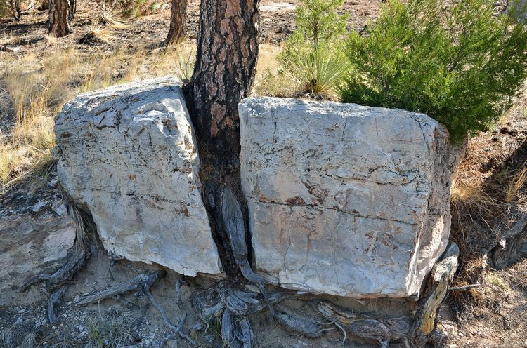
Biological

Slide 22
Chemical weathering
Involves the complex processes that alters the internal structures of minerals by removing and/or adding elements
During this transformation the original rock decomposes into substances that are stable in the surface environment
Consequently, products of chemical weathering will remain essentially unchanged as long as they remain in an environment similar to the one in which they formed

Slide 23
Water and carbonic acid
Water is the most important agent of chemical weathering
Oxygen dissolved in water will oxidize some materials
Carbon dioxide (CO₂) dissolved in water (H₂O) forms carbonic acid (H₂CO₃) (the same weak acid in soft drinks)
Rain dissolves carbon dioxide as it falls through the atmosphere
Additional amounts of carbonic acid are released by water percolating through decaying organic matter and into the soil

Slide 24
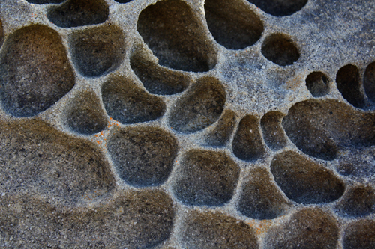
Water as a weathering agent

Slide 25
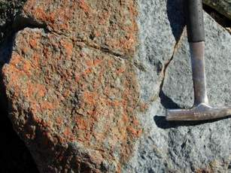
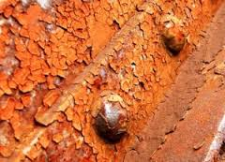
Chemical weathering
Iron reacts with oxygen to
form iron oxide……

Slide 26
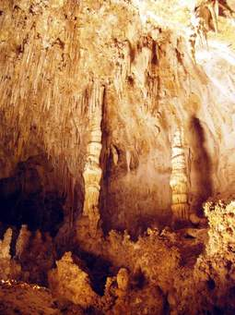
Chemical weathering

Slide 27
How granite weathers
To illustrate how rock chemically weathers when attacked by carbonic acid, consider the weathering of granite……
Granite consists mainly of potassium feldspar and quartz
In the chemical reaction, hydrogen ions replace potassium ions in the feldspar
The potassium is then available as nutrients for plants, or it may become a soluble salt: potassium bicarbonate
Some silica is also removed from the feldspar and carried away by groundwater
However, the most abundant product of the chemical breakdown is in the form of clay minerals
Quartz – the other component of granite is very resistant to chemical weathering
Quartz (SiO₂) is basically unaltered, but is carried away as silica

Slide 28
Old Man in the Mountain (Granite outcrop) New Jersey
Before and after photos – “After” a collapse due to chemical weathering

Slide 29
Weathering of silicate minerals
Silicate minerals make up most of Earth’s crust
Silicate minerals are composed essentially of only eight elements
When weathered, silicate minerals yield sodium, calcium, potassium, and magnesium ions which form soluble products that may be removed by groundwater
Iron combines with oxygen producing relatively insoluble iron oxides which give soil a reddish-brown or yellowish color
Under most conditions, the 3 remaining elements – aluminum, silicon, and oxygen – join with water to produce residual clay minerals

Slide 30
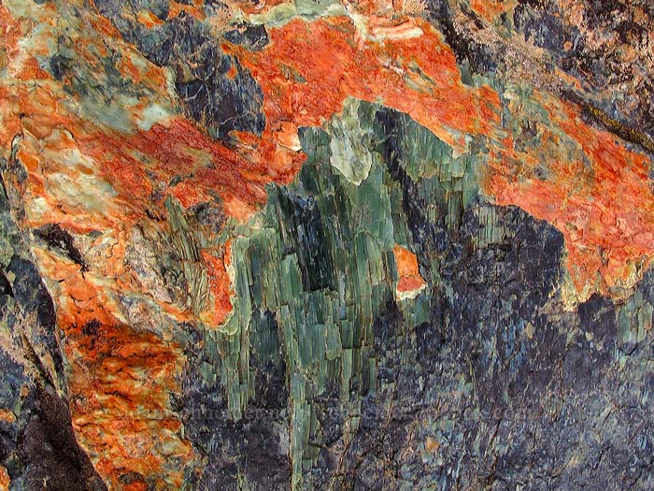
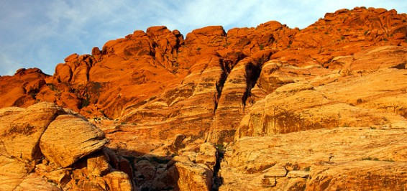
Oxidized Rocks
Mohave Desert
Rock sample from Oregon
Red Rock Canyon, Nevada

Slide 31
Spheroidal weathering
Chemical weathering causes physical changes as well
Angular rock masses that are chemically altered tend to take on a spherical shape
Gradually the corners and edges of the angular blocks become more rounded
The corners are attacked most readily because of the greater surface area
This process called spheroidal weathering gives the weathered rock a more rounded or spherical shape

Slide 32
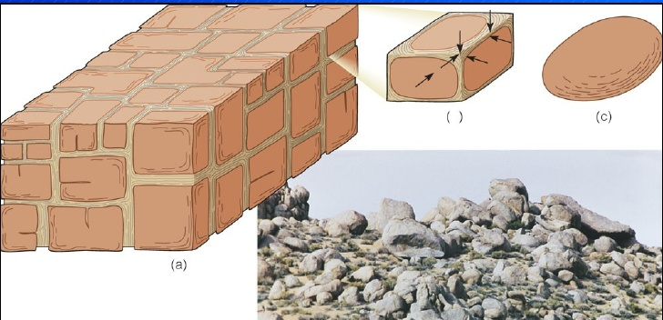
Spheroid formation

Slide 33
Concept check –
Answer questions relating to these power point notes…….

