Slide 1
Earth Science
Introduction

Slide 2
Obectives
Describe Earth’s four spheres
List the sciences traditionally included in Earth science
Discuss some resource and environmental issues
Describe the nature of scientific inquiry

Slide 3
Earths Four “Spheres”
Hydrosphere
Atmosphere
Biosphere
LIthosphere

Slide 4
Hydrosphere
Hydrosphere – the dynamic mass of water that is continually on the move
1. Ocean – most prominent feature of the hydrosphere
About 71% of Earth’s surface
About 97% of Earth’s water
2. Also includes freshwater

Slide 6
Atmosphere
Atmosphere – the gaseous envelope surrounding Earth
a layer of gases surrounding the Earth
retained by Earth's gravity
protects life on Earth by absorbing ultraviolet solar radiation
warms the surface through heat retention (greenhouse effect), and
reduces temperature extremes between day and night (the diurnal temperature variation).

Slide 7
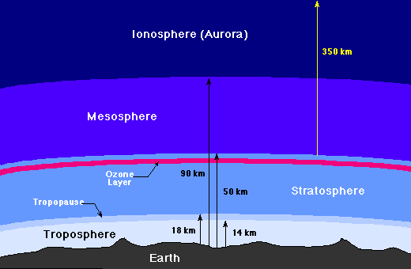
r

Slide 8
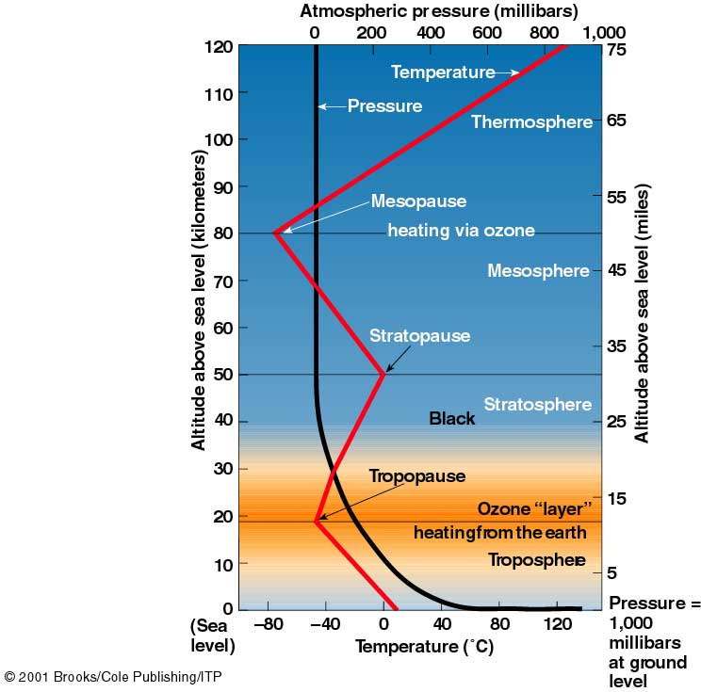
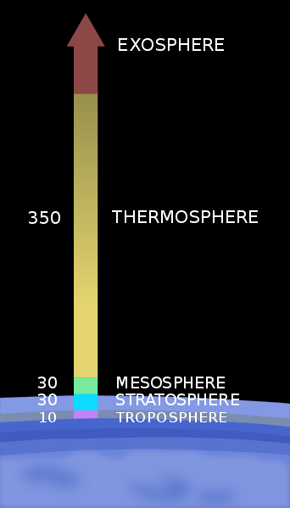

Slide 10
Biosphere
Biosphere – includes all life
Influences other three spheres

Slide 11
lithosphere
Lithosphere – outer layers of the Earth
1. Earth’s rigid outer layer
2. Solid Earth consists of
A. core
B. mantle
C. crust
3. Lithosphere includes
A. crust
B. part of the upper mantle
4. Divisions of Earth’s surface
A .continents
B. ocean basins

Slide 12
Earth Science
Encompasses all sciences that seek to understand Earth and earths neighbors in space
Includes:
Geology
Oceanography
Meteorology
Astronomy

Slide 13
Geology
Physical geology
Study of materials composing the Earth
Rocks and minerals
Historical geology
Study of the origin and development of Earth
Plate tectonics
Mountain building
Earthquakes
Volcanoes
Paleontology

Slide 14
Oceanography
Not a separate and distinct science
Oceanography integrates several sciences:
Chemistry
Physics
Geology
Biology

Slide 15
Meteorology
Study of weather and climate

Slide 16
Astronomy
Study of space and our solar system

Slide 17
Environment and resources
Environment refers to everything that surrounds and influences an organism.
Resources are an important environmental concern
Two broad categories:
Renewable
Nonrenewable

Slide 18
Environmental
Surrounds and influences organisms
Influences can be:
Biological
Social
Physical –non-living environment
Water
Air
Soil
Rock

Slide 19
Resources
Important environmental concern
Includes:
Water
Soil
Minerals
Energy
Broad Categories
Renewable
Can be replenished (examples: plants, wind energy)
Nonrenewable
Fixed quantities (examples: metals, fuels)

Slide 20
Environmental problems
Local, regional, and global
Human-induced and accentuated
Urban air pollution
Acid rain
Ozone depletion
Global warming
Natural hazards
earthquakes
Landslides
Floods
Hurricanes
World population pressures

Slide 21
Scientific inquiry
Science assumes the natural world is
Consistent
predictable
Goal of science
Discover patterns in nature
Use the knowledge to predict
An idea can become
Hypothesis (untested)
Theory (tested and confirmed)
Law (no known deviation)

Slide 22
Scientific method
Gather facts through observation
Formulate
Hypothesis
Theories
Laws

Slide 23
Scientific knowledge
Gained through
Following systematic steps
Collecting facts
Developing a hypothesis
Conducting experiments
Reexamining hypothesis and
Accept
Modify
Reject
Theories that withstand examination
Totally unexpected occurences

Slide 24
Key terms
Astronomy
Atmosphere
Biosphere
Core
Crust
Earth science
Environment
Geology
Hydrosphere
Hypothesis
Law
Lithosphere
Mantle
Meteorology
Nonrenewable
Resource
Oceanography
Renewable resource
Resource
Theory

