Slide 1
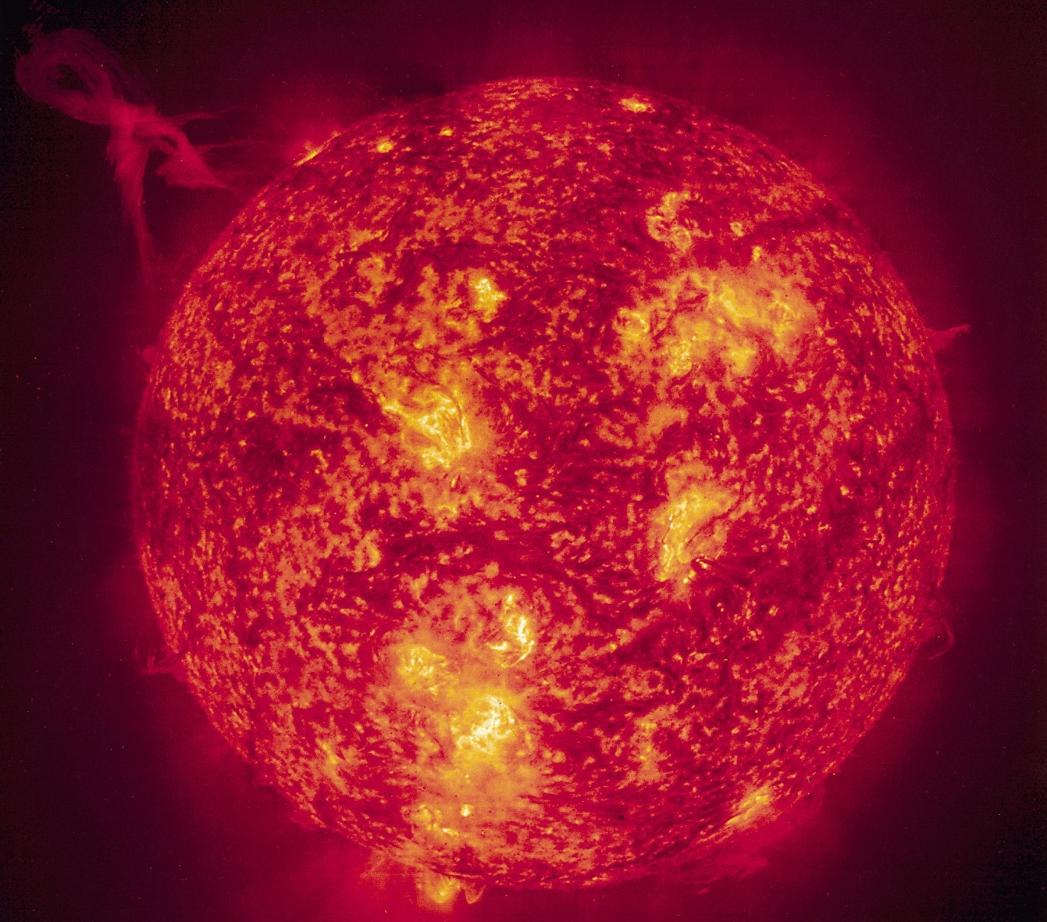
Formation of the Earth and the atmosphere

Slide 2
Solar System Formation and Structure
Gravity
  Mutual attracting force exerted by mass on all other objects
Planetesimal hypothesis
  Suns condense from nebular clouds

Slide 3
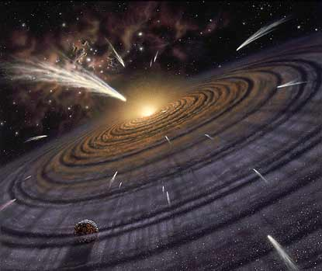

Slide 4
PLANETARY
EVOLUTION

Slide 5
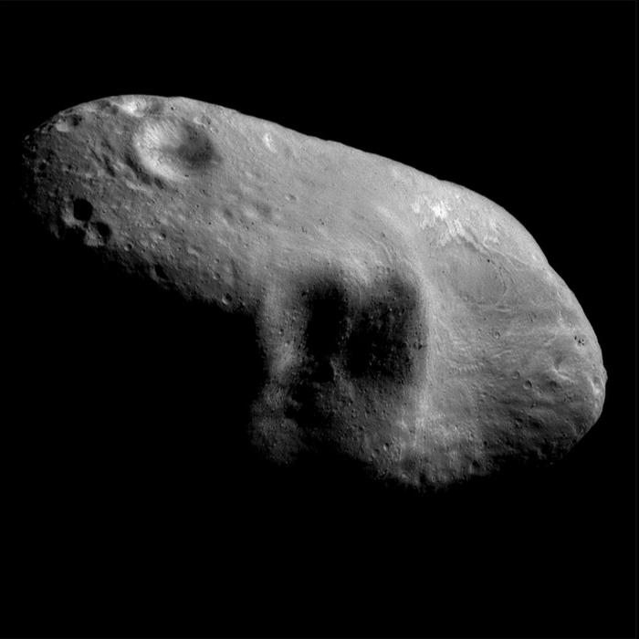
Eros. Taken by NEAR
http://nssdc.gsfc.nasa.gov/imgcat/hires/nea_0127504836_mos.jpg

Slide 6
PLANETARY
EVOLUTION

Slide 8
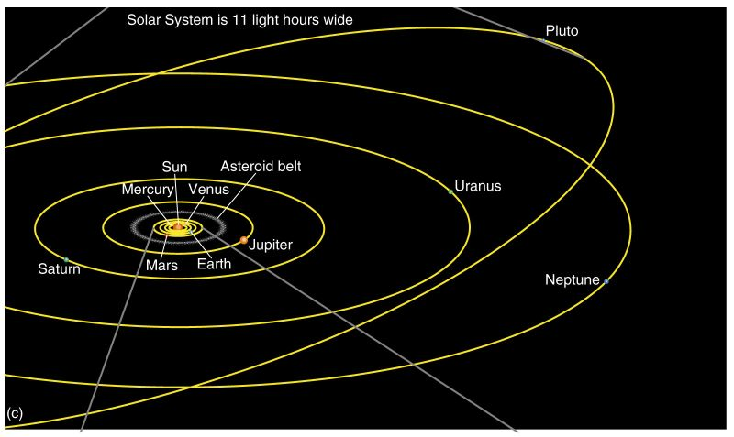
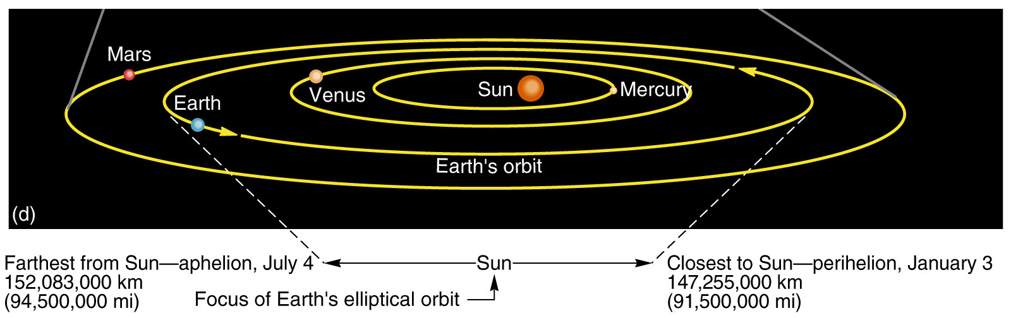
Our Solar System
Figure 2.1

Slide 9
Dimensions and distances
Earth’s orbit
  Average distance from Earth to the Sun is 150,000,000 km (93,000,000 mi)
  Perihelion – closest at January 3
    147,255,000 km (91,500,000 mi)
  Aphelion – farthest at July 4
    152,083,000 km (94,500,000 mi)
  Plane of Earth’s orbit is the plane of the ecliptic

Slide 10
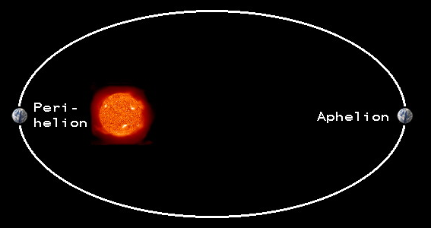
  Perihelion – closest at January 3
    147,255,000 km (91,500,000 mi)
  Aphelion – farthest at July 4
    152,083,000 km (94,500,000 mi)

Slide 11
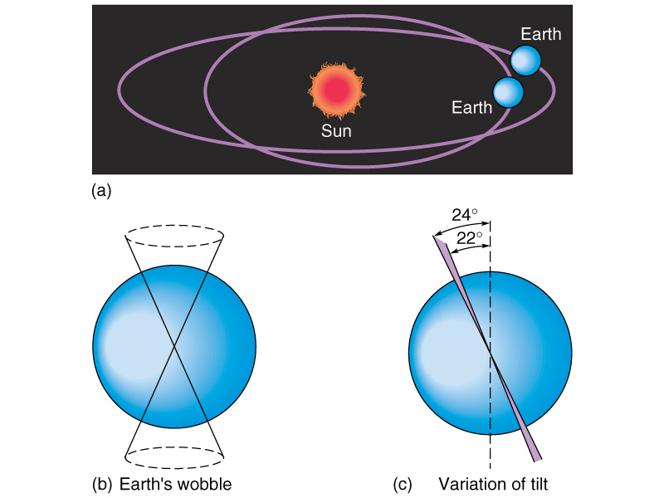
Milankovitch Cycles
Ellipticity of the orbit
  100,000 year cycle

Slide 12
Precession
  The earth’s wobble
  26,000 year cycle

Slide 13
Axial tilt
  40,000 year cycle

Slide 14
Solar Energy: From Sun to Earth
Solar Activity and Solar Wind
Electromagnetic Spectrum of Radiant Energy
Intercepted Energy at the Top of the Atmosphere

Slide 15
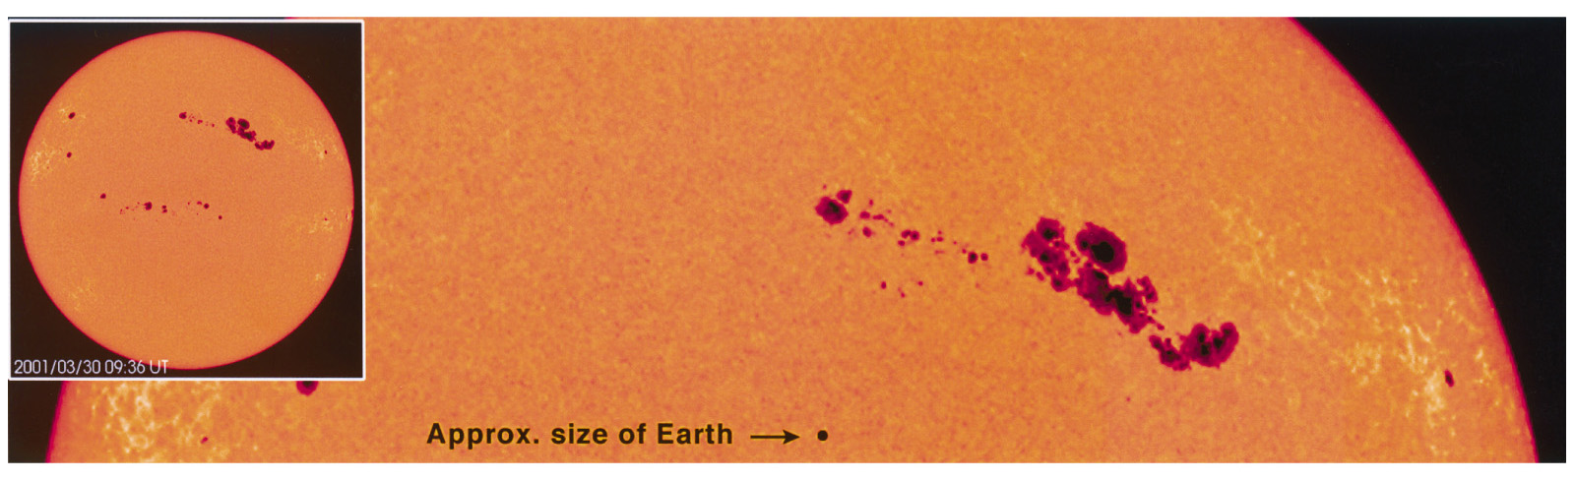
Solar Activity and Solar Wind
Solar wind is clouds of electrically charged particles
Sunspots are caused by magnetic storms
Sunspots have activity cycle of 11 years
Figure 2.2

Slide 16
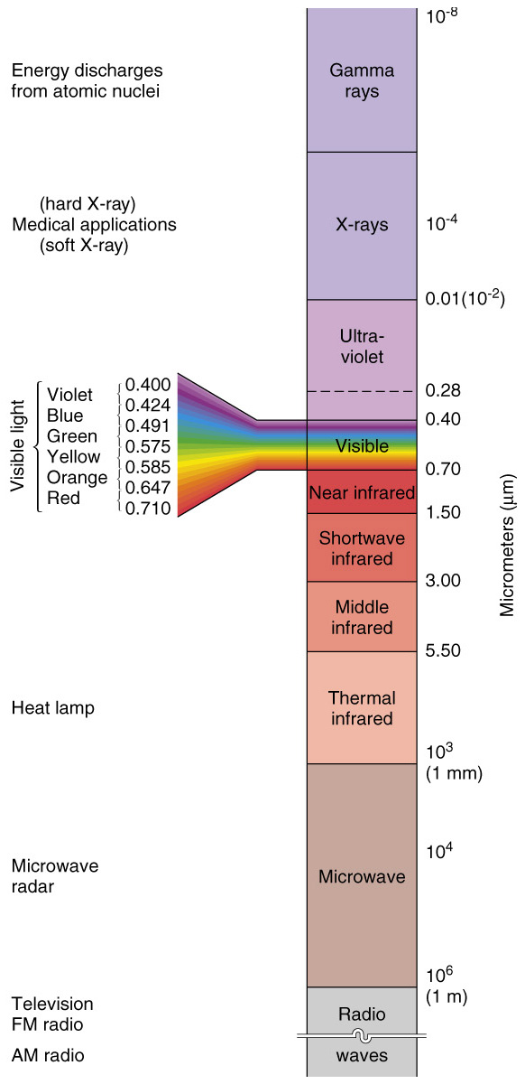
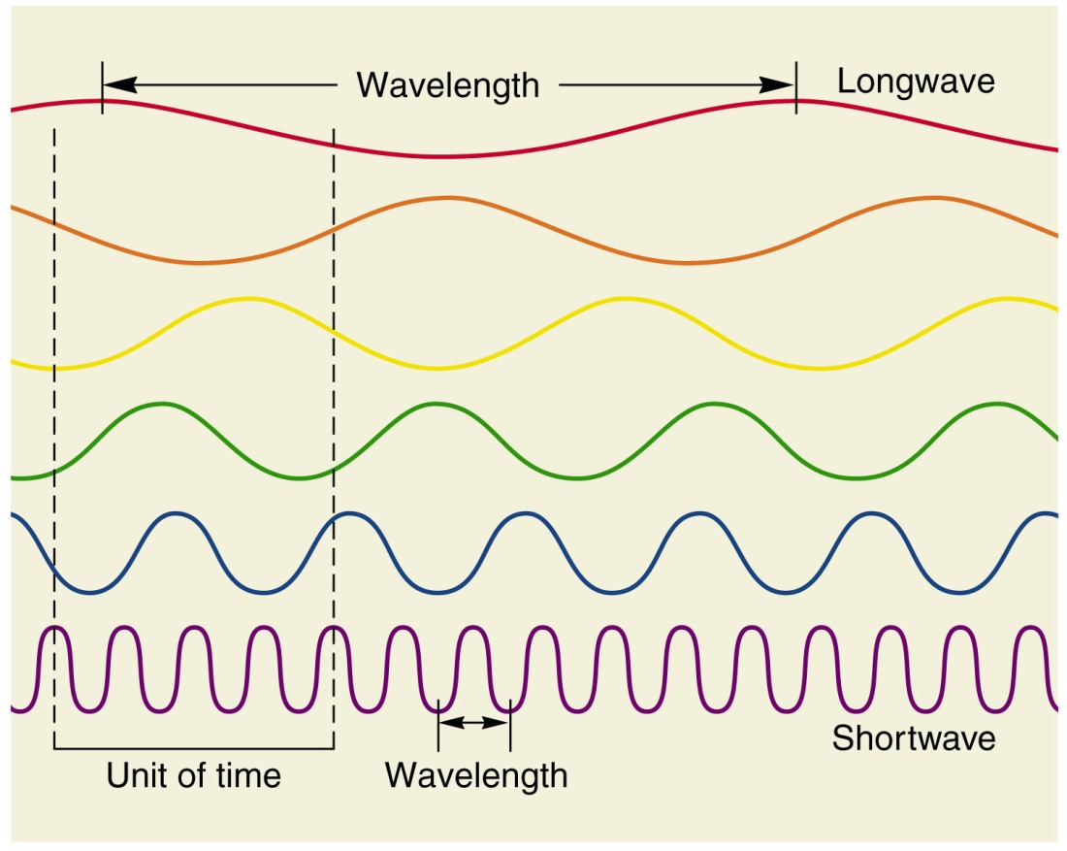
The Electromagnetic Spectrum
Sun radiates shortwave energy
Shorter wavelengths have higher energy
Earth radiates longwave energy
Figure 2.5
Figure 2.6

Slide 17
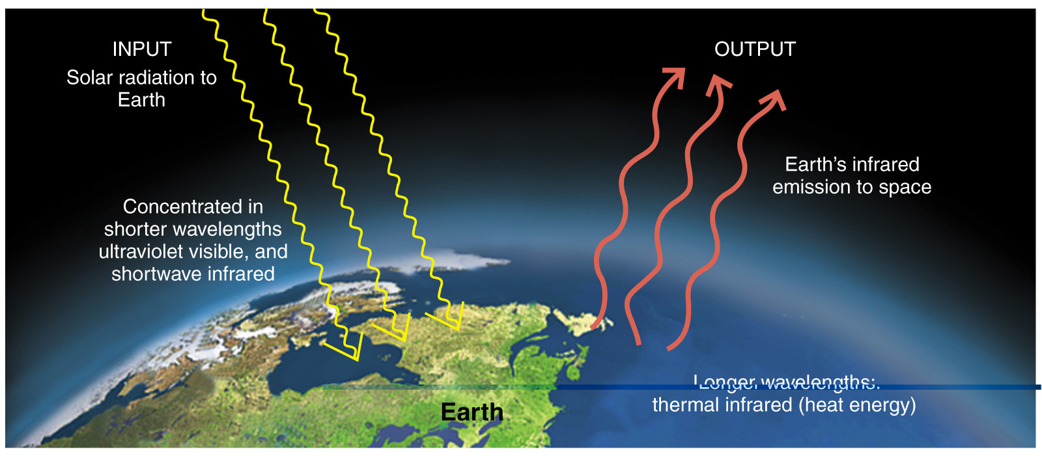
Earth’s Energy Budget
Figure 2.8

Slide 18
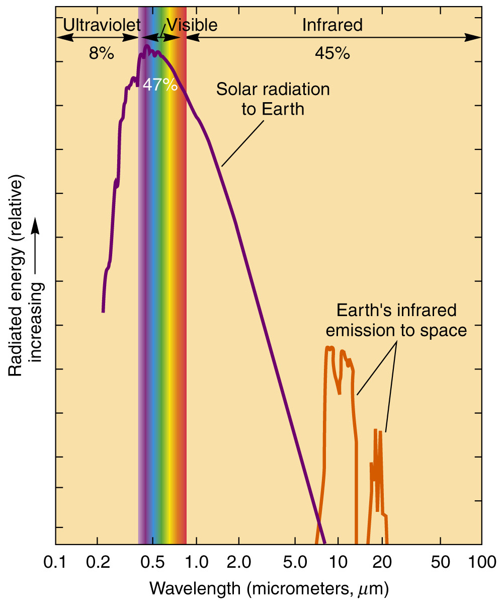
Solar and Terrestrial Energy
Figure 2.7

Slide 19
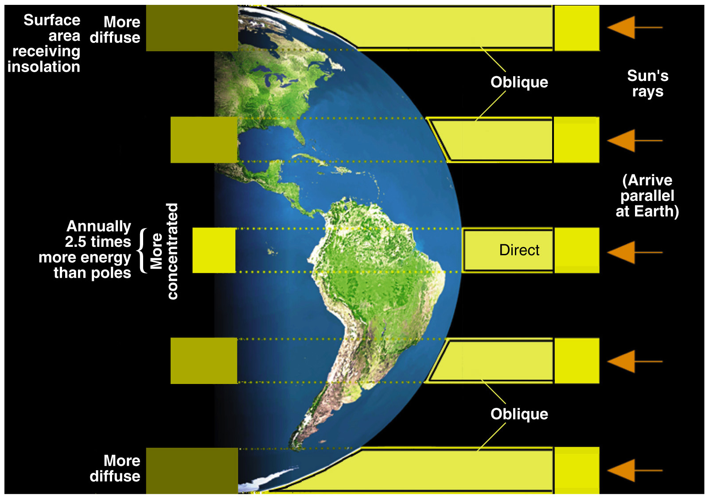
Tropics receive more concentrated insolation (2.5x more) than the poles due to the Earth’s curvature
Figure 2.9

Slide 20
The Seasons
Seasonality
Reasons for Seasons
Annual March of the Seasons
What seasonal changes in the sun do we observe?

Slide 21
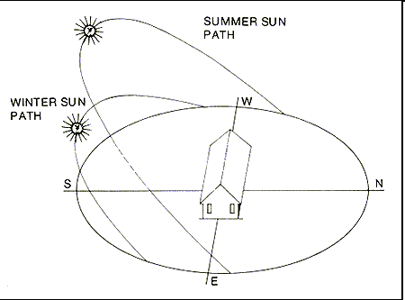
Sun’s Altitude

Slide 22
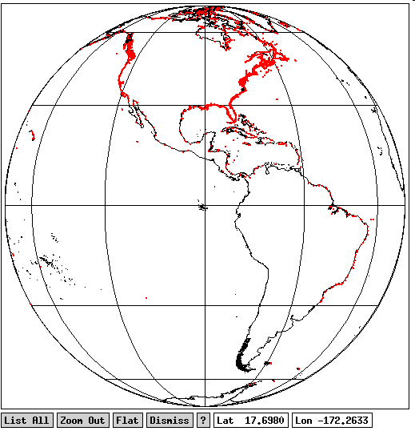
Tilt of the earth’s axis
Memphis’ Latitude
N
N
SUN
Equator
Memphis
Equator
S
S

Slide 23
Sun’s altitude

Slide 24
Sun’s Altitude
Winter
Summer

Slide 25
Sun’s Altitude
Winter
Summer

Slide 26
Declination – latitude where the sun is directly overhead.
Winter
Summer
Tropic of Cancer
Tropic of Capricorn

Slide 27
Seasonality
Seasonal changes
  Sun’s altitude – angle above horizon
  Declination – location of the subsolar point
  Daylength

Slide 28
Reasons for Seasons
Revolution
  Earth revolves around the Sun
  Voyage takes one year
  Earth’s speed is 107,280 kmph (66,660 mph)
Rotation
  Earth rotates on its axis once every 24 hours
  Rotational velocity at equator is 1674 kmph (1041 mph)

Slide 29
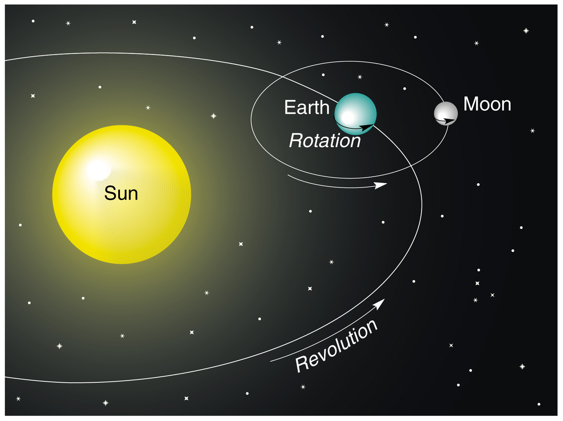
Revolution and Rotation
Figure 2.13

Slide 30
Reasons for Seasons
Tilt of Earth’s axis
  Axis is tilted 23.5° from plane of ecliptic
Axial parallelism
  Axis maintains alignment during orbit around the Sun
  North pole points toward the North Star (Polaris)

Slide 31
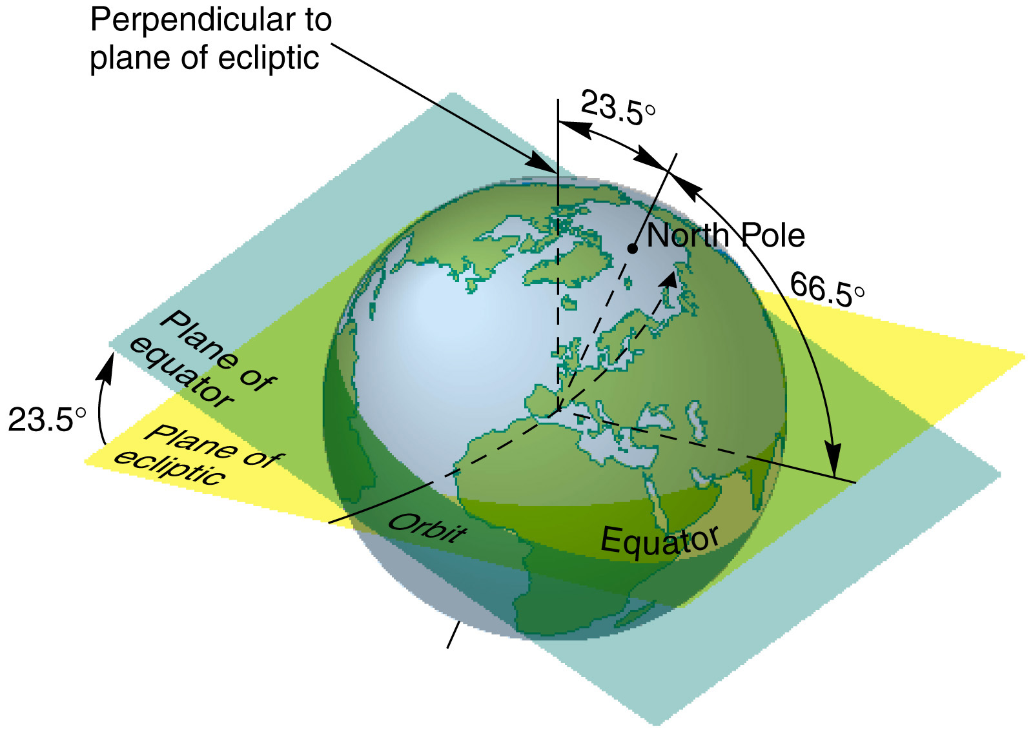
Axial Tilt and Parallelism
Figure 2.14

Slide 32
Solstice – when the sun is at its maximum north or south.
Winter
Summer
Tropic of Capricorn
Tropic of Cancer
Winter solstice – December 21 or 22
  Subsolar point Tropic of Capricorn
Summer solstice – June 20 or 21
  Subsolar point Tropic of Cancer

Slide 33
Equinox – when the sun passes over the equator
Summer
Fall equinox – September 22 or 23
  Subsolar point Equator
Spring equinox – March 20 or 21
  Subsolar point Equator
Winter

Slide 34
Annual March of the Seasons
Winter solstice – December 21 or 22
  Subsolar point Tropic of Capricorn
Spring equinox – March 20 or 21
  Subsolar point Equator
Summer solstice – June 20 or 21
  Subsolar point Tropic of Cancer
Fall equinox – September 22 or 23
  Subsolar point Equator

Slide 35
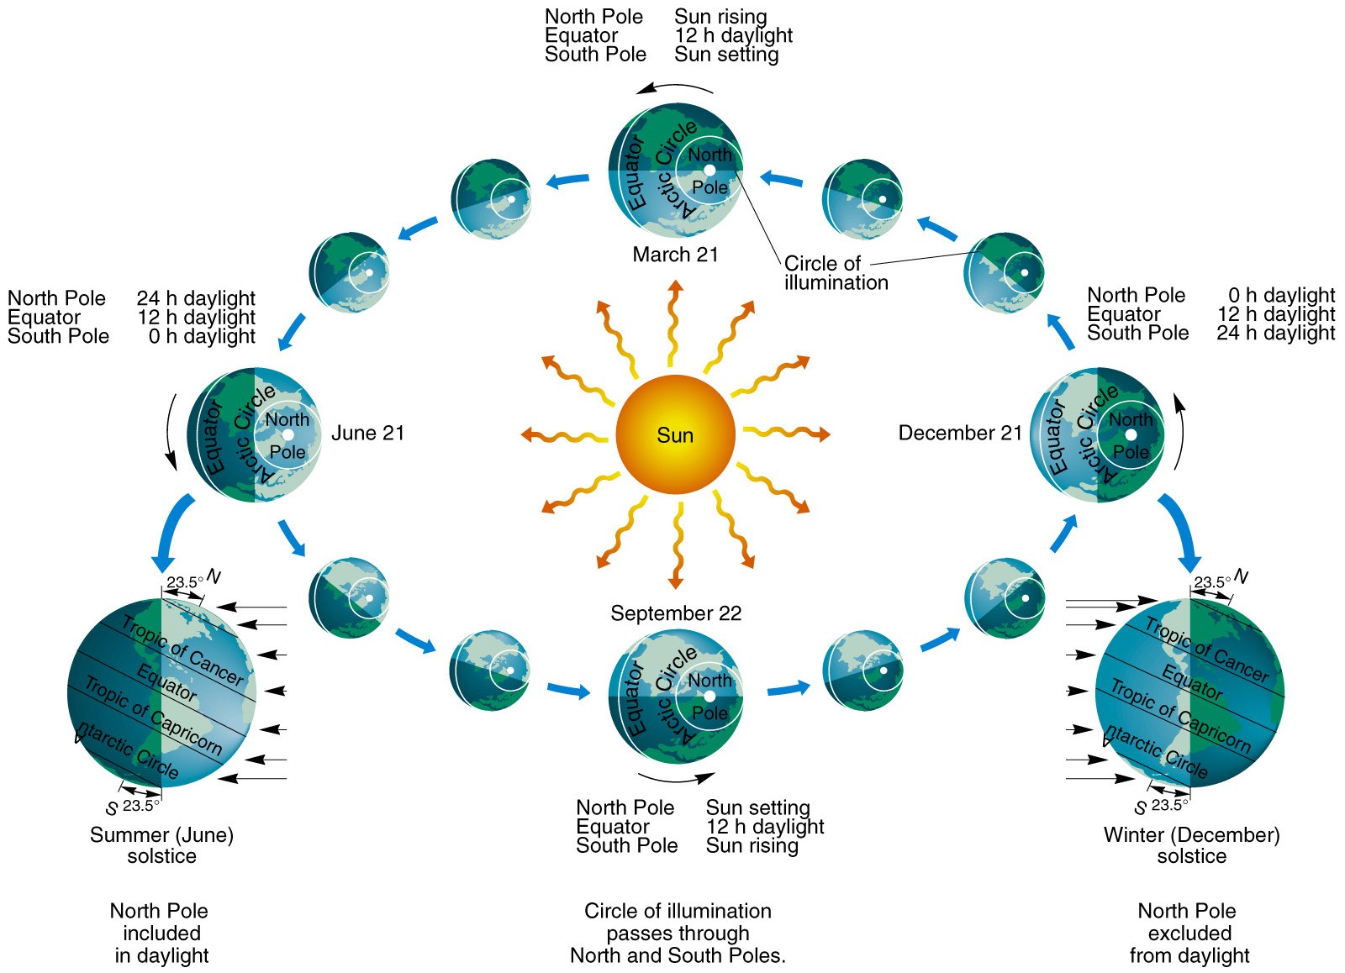
Annual March of the Seasons
Figure 2.15

Slide 36
The sun
Termperature of the surface = 6000 ºC

