Slide 1
Atmosphere
Unit 6

Slide 2
Science Terms to know…
Argon Mesosphere
Atmosphere Neon
Carbon dioxide Nitrogen
Dust particles Oxygen
Helium Stratosphere
Humidity Thermosphere
Hydrogen Tropopause
Water vapor

Slide 3
Atmosphere
Atmosphere - a mixture of gases and solids that completely covers the lithosphere and hydrosphere
Meteorologist – scientist who studies the weather

Slide 4
Earth’s Early Atmosphere
Abundant elements - Hydrogen and Helium
Low mass gas elements – escape into space
Early volcanic activity = gases into atmosphere (largely compounds)
Ammonia (NH₃)
Methane (CH₄)
Water vapor (H₂O)
Carbon dioxide (CO₂)
In time – sunlight began to break down these compounds into elements (N₂, O₂, and H₂)

Slide 5
Nitrogen in Atmosphere
While H and He were escaping into space; nitrogen was also accumulating
Nitrogen – a heavier gas
Accumulation near surface
Heavier – cannot escape earth’s gravity
Began to accumulate in atmosphere

Slide 6
Oxygen in the Atmosphere
Early – LOTS of CO₂ and little O₂
Evolution of algae and aquatic plants = increased amounts of O₂ in atmosphere
About 400 mya amount of O₂ in atmosphere similar to today
Photosynthesis – in presence of sunlight; plants take in carbon dioxide from the air and release oxygen as a waste product
6CO₂ + 6H₂O -> 6O₂ + C₆H₁₂O₆

Slide 7
Photosynthesis

Slide 8
Oxygen in Early Atmosphere
Greater abundance of plants led to changes in the atmosphere….
Greater abundance of Oxygen
Less Carbon dioxide

Slide 9
Loss of Carbon Dioxide from Atmosphere
Some dissolved into the ocean
Combined with calcium compounds in ocean water to form carbonate compounds
Many marine animals use CaCO₃ compounds to form shells and other hard parts
Thus… amounts of CO₂ in atmosphere decreased due to (1) photosynthesis and (2) use by marine organisms

Slide 10
Present Composition of Atmosphere
Proportion of gases in atmosphere has remained relatively constant for the past 400,000 years
Photosynthesis (plants) = carbon dioxide is removed and oxygen is given off
Respiration (animals) = oxygen is removed and carbon dioxide is given off
Exchange of carbon dioxide and oxygen is called the carbon dioxide-oxygen cycle

Slide 12
Carbon Dioxide-Oxygen Cycle
Photosynthesis equation:
6CO₂ + 6H₂O --> 6O₂ + C₆H₁₂O₆
Cellular Respiration equation:
6O₂ + C₆H₁₂O₆ --> 6CO₂ + 6H₂O
LEARN THESE!!

Slide 13
Present Composition
Nitrogen - about 4/5 of gases in atmosphere
Relatively constant for next several hundred years
Altered somewhat by human activity
Adding pollutants
Burning fossil fuels
15% increase in CO₂ since 1900
1960 = 0.0313%
1970 = 0.0321%
1980 = 0.0330%
1990 = 0.0340%

Slide 14
Composition of Pure, Dry Air
Gas | Approximate % by Volume
Nitrogen (N₂) | 78.084%
Oxygen (O₂) | 20.946%
Argon (Ar) | 0.9340%
Carbon dioxide (CO₂) | 0.035% – 0.04%
Neon (Ne)
Helium (He)
Krypton (Kr)
Xenon (Xe) | 0.0038% (Total)
Hydrogen (H)
Nitrous Oxide (N₂O)
Methane (CH₄)
Other Gases

Slide 15
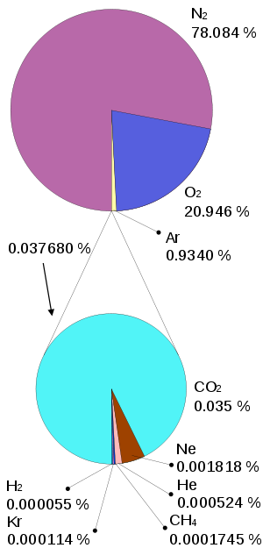
Composition of Earth's atmosphere. The lower pie represents the trace gases which together compose 0.0038% of the atmosphere. Values normalized for illustration. The numbers are from a variety of years (mainly 1987, with CO2 and methane from 2009) and do not represent any single source.

Slide 16
Global Warming
Caused by emission of CO₂ from burning fossil fuels
CO₂ prevents heat from leaving the atmosphere (similar to greenhouse)
Sunlight enters – changed to heat energy – heat energy then trapped by glass (CO₂ “Acts” like the glass of a greenhouse)
Greenhouse effect – the trapping of heat energy by water vapor, carbon dioxide, and other gases in Earth’s atmosphere

Slide 18
Water Vapor in Atmosphere
Water as a gas is called water vapor
Water vapor always present in atmosphere
Amount of water vapor varies worldwide
Amount may vary from as little as 0.5% to as much as 4% of the total volume of air

Slide 19
Water Vapor in the Atmosphere
The amount of water vapor in the atmosphere is called the humidity.
Water vapor displaces other gases when it enters the atmosphere
Any increase in water vapor decreases percentages of other gases
Example: On a very humid day, oxygen content may be about 18% instead of about 21% by volume.

Slide 20
Dust in the Atmosphere
In addition to gases, atmosphere also contains dust particles
Dust particles include sands, clays, soils, sea salts, and ashes from erupting volcanoes and forest fires.
Dust particles are related to weather phenomena (such as rain and snow)
Water vapor collects on dust particles – vapor condenses to form water droplets – droplets form clouds – clouds may bring rain or snow)

Slide 21
Dust and Sky Color
Sky looks blue during the day because of light scattering
Light scattering occurs when air molecules separate the blue wavelengths of light from the other wave lengths (colors) of visible sunlight
An increase in the amount of dust causes a decrease in the blue color

Slide 22
Light Scattering

Slide 23
Dust and Sky Color
Why do Sunrise and sunset appear more red or orange?
Sunlight is traveling at a lower angle
Passing through much more dust
Longer wavelengths* of light come through more readily
*Electromagnetic spectrum (Visible light - ROY G BIV – Longest waves on left [Red] – shortest waves on right [Violet])
ROY G BIV = red, orange, yellow, green, blue, indigo, violet

Slide 24
Properties of Gases in the Atmosphere
Many properties important to humans and all other living organisms
Some examples of properties of Oxygen:
Gaseous oxygen - supports respiration
Combustion (or burning) requires oxygen – so if there were no oxygen in the atmosphere it would be impossible for people to burn fuels
Organisms need oxygen to breathe
Liquid oxygen – LOX used in rocket engines

Slide 25
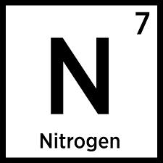
Nitrogen
The most abundant element in atmosphere
Does not burn – does not support combustion
Main ingredient of fertilizers
Main ingredient in manufacture of explosives such as nitroglycerin and TNT
Used to produce dyes, chemicals, and plastics

Slide 26
Oxygen
Extremely active element
Does not burn – DOES support combustion
Animals use to release energy in foods
A waste product of photosynthesis
Almost 50% of the weight of rocks and minerals in earth’s crust
When combined with iron – forms rust
Important ingredient in tap water and many household products

Slide 27
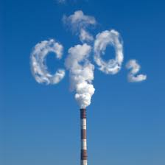
Carbon Dioxide
Plants use for photosynthesis
Produced by combustion of fuels
Water and carbon dioxide combine to form carbonic acid
Use - bubbles of gas (fizz) in soft drinks
Use – Fire extinguishers for oil/electrical fires
Dry ice – solid form of carbon dioxide
Use – a refrigerant (Temp. -79⁰ Celsius)

Slide 28
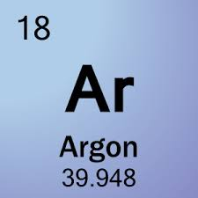
Argon
Chemically inert (inactive) element
Major use – light bulbs

Slide 29
Water Vapor
Weight of air decreases as quantity of water vapor in air increases
Also contributes to greenhouse effect by preventing the escape of heat from the atmosphere into outer space
Condensation of water vapor leads to formation of water droplets, then clouds, and eventually precipitation

Slide 30
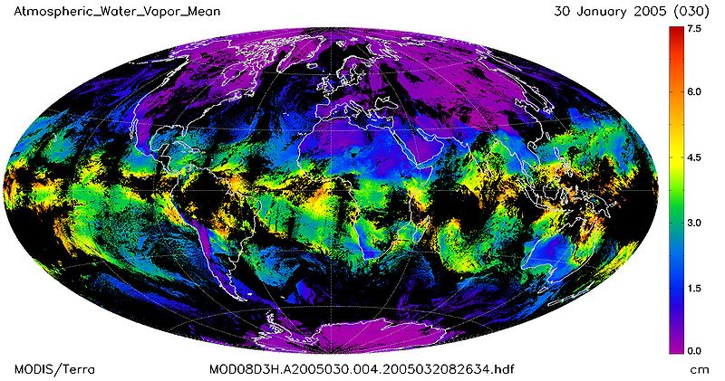
Mean atmospheric water vapor

Slide 31
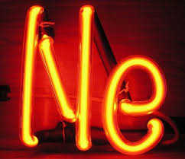
Neon
Chemically inert element in atmosphere
Used in electric signs and billboards
When an electric current is passed through neon it glows red

Slide 32
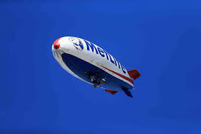
Helium
Second lightest chemical element
Inert gas (like argon and neon)
Does not burn
Does not support combustion
Used to give buoyancy, or lift
Used in balloons and blimps
Some divers use helium instead of nitrogen in scuba gear because it does not cause the “bends”
Some old, valuable documents are preserved by being stored in containers filled with helium

Slide 33
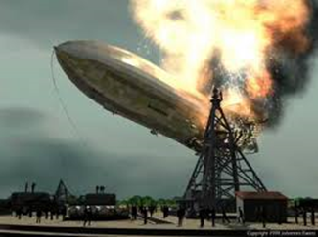
Hydrogen
Lightest chemical element
Very active
Can burn in air
Major component of water
Component of many fuels, oils, and acids
Formerly used in blimps, but no longer due to explosive nature

Slide 34
Structure of the Atmosphere
Extends thousands of km above Earth surface
Gases continually mixing by local winds and global air currents near surface; this leads to composition relatively similar over entire Earth
About 90% of atmospheric gases found within 30 km of surface; rest of them extend upward
At altitude of 150 km - gas molecules are widely separated = “thin” air
Atmosphere classified into several layers or regions

Slide 35
Regions of the Atmosphere
Regions divided based on temperature differences and other physical characteristics
Four main regions, or layers:
Troposphere
Stratosphere
Mesosphere
Thermosphere

Slide 36
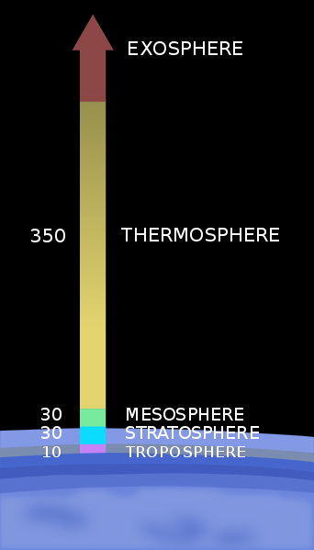
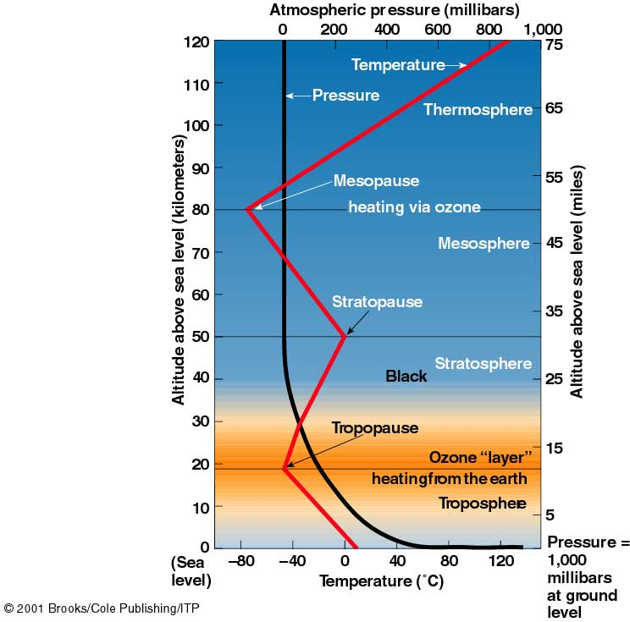

Slide 37
Troposphere
Layer closest to earth’s surface
From surface to about 10 km at the North and South poles and 16 km at the equator
Most water vapor and dust particles here
Mostly heated by transfer of energy from surface
Lowest part is warmest - temperature decreases with increasing altitude
(about 6.5⁰C every 1000 meters)
Contains roughly 80% of mass of atmosphere
Contains most of the planet’s air
“Weather” occurs here

Slide 38
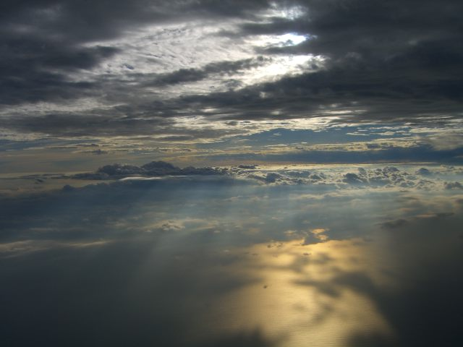
A view of Earth's troposphere from an airplane

Slide 39
Tropopause
Highest area of troposphere
Very low air temperatures
Air is so cold – clouds at this altitude consist of only ice crystals
Lowest air temperature (about -80⁰C) at tropopause recorded over the equator
Typical air temperature at the tropopause averages -60⁰C above continental U.S.

Slide 40
Stratosphere
Extends from the tropopause to about 48 km
Very little water vapor and dust particles; means very few clouds seen here
Lower region of nearly steady temperature, and upper region where temperature increases with altitude
(lower region may be about −55°C; and upper region may increase to about −2°C)
Earth’s global “sunscreen” – Ozone layer

Slide 41
Space Shuttle Endeavour appears to straddle the stratosphere and mesosphere in this photo. The orange layer is the troposphere, where all of the weather and clouds which we typically watch and experience are generated and contained. This orange layer gives way to the whitish stratosphere and then into the mesosphere.

Slide 42
Stratopause
Boundary between stratosphere and mesosphere
Characterized by increasing air temperature because of the ozone layer
Ozone heats the air in this part of the atmosphere by absorbing ultraviolet rays

Slide 43
Mesosphere
Extends from stratopause to 80–85 km
Where most meteors burn up upon entering atmosphere
Air temperature decreases with increasing altitude
Extremely strong winds blow here
Blow from east to west during summer; west to east in winter
Due to the cold temperature of mesosphere, water vapor is frozen, forming ice clouds

Slide 44
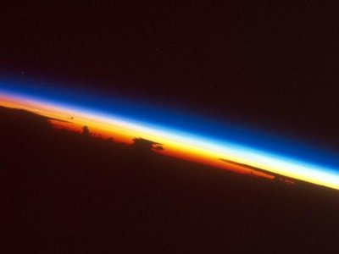
Mesosphere (blue layer) from space

Slide 45
Mesopause
Boundary between mesosphere and thermosphere
Mesopause – lowest temperatures in atmosphere with average temperature around −85 °C
At mesopause, temperatures may drop to −110 °C over the North and South Poles

Slide 46
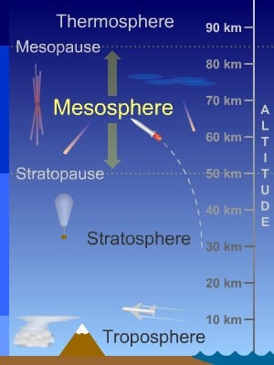
A type of lightning called sprites sometimes appears in the mesosphere above thunderstorms. Strange, high-altitude clouds called noctilucent clouds sometimes form in this layer near the North and South Poles.

Slide 47
Noctilucent clouds

Slide 48
Thermosphere
Uppermost layer of atmosphere
Begins at mesopause gradually fades into outer space
Chemical composition differs from other layers
Lower regions contain individual atoms of oxygen instead of O₂ molecules
Upper regions consist of individual helium and hydrogen atoms
Air temperature increases rapidly with height from the mesopause, then levels off
Temperature can rise to 1,500 °C
The International Space Station orbits in this layer, between 320 and 380 km

Slide 49
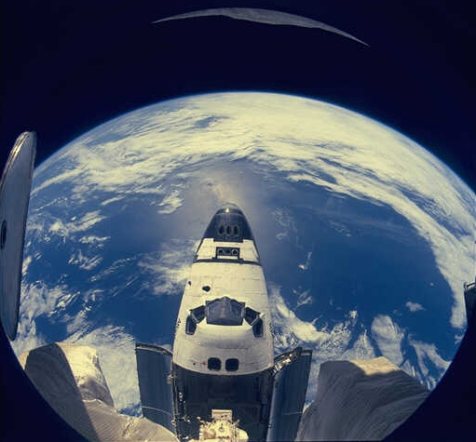
This is an image of the space shuttle as it is orbiting around the Earth. The space shuttle orbits in the thermosphere of the Earth. Image from: Courtesy of NASA

Slide 50
Ionosphere
Collisions with high energy solar rays and gas molecules in thermosphere cause gas particles to lose electrons and become positively charged ions
Most ions are produced in the lower part of the thermosphere
Ionosphere – the region of the atmosphere containing electrically charged (ionized) gases
Important to long-distance radio communication
Electrically charged ions reflect radio signals back to Earth; otherwise they would continue to travel into outer space

Slide 52
Auroras
Phenomena produced in the ionosphere during periods of increased sunspot activity
Produced when charged particles emitted by the sun are captured by Earth’s magnetic field
Solar particles smash into the thermosphere in a ring around each of Earth’s magnetic poles, releasing light energy
Appear as shimmering bands, folds, and streamers, of red, green, blue, and violet light
Aurora borealis (Northern Lights)
In Southern hemisphere – Aurora australis (Southern Lights)

Slide 53
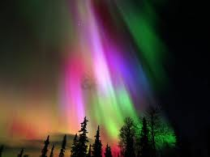
Aurora borealis
(Northern Lights)
Aurora australis
(Southern Lights)

Slide 54
Exosphere
Upper part of the thermosphere
Outermost layer of Earth's atmosphere
Begins at an altitude of about 480 km above Earth’s surface and fades into outer space
Small amount of atmospheric gases, mainly composed of H and He
At upper part of exosphere (about 1,000 km) rapidly moving atoms of lightweight hydrogen escape earth’s gravity into outer space

Slide 55
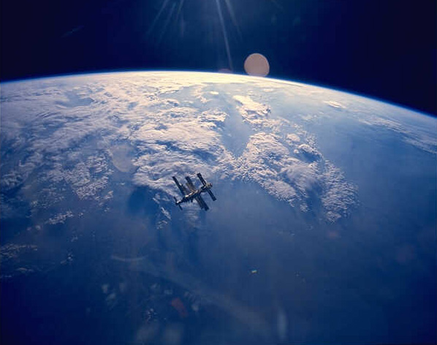
This is a picture which shows the Earth, its atmosphere (the clouds are likely in the troposphere and stratosphere), the limb of the Earth (the dark blue curved edge which is the mesosphere and thermosphere), and the dark blue to black region of space (where our exosphere extends). Image courtesy of NASA

